Slide 1
Chapter 10 CES:
Building an Organization Capable of Good Strategy Execution
Group 7
Bo Adeyeye, Zane Cox, Daniel Galvan, Mason Harkins, Gabrielle Ruffeno

Slide 2
Chapter 10 Learning Objectives
LO 1 What managers must do to execute strategy successfully.
LO 2 Why hiring, training, and retaining the right people constitute a key component of the strategy execution process.
LO 3 That good strategy execution requires continuously building and upgrading the organization’s resources and capabilities.
LO 4 What issues to consider in establishing a strategy-supportive organizational structures and organizing the work effort.
LO 5 The pros and cons of centralized and decentralized decision making in implementing the chosen strategy.

Slide 3
A Framework for Executing Strategy
Staffing the organization with managers and employees capable of executing the strategy well.
Developing the resources and organizational capabilities required for successful strategy execution.
Creating a strategy-supportive organizational structure.
Allocating sufficient resources (budgetary and otherwise) to the strategy execution effort.
Instituting policies and procedures that facilitate strategy execution.
Adopting best practices and business processes to drive continuous improvement in strategy execution activities.
Installing information and operating systems that enable company personnel to carry out their strategic roles proficiently.
Trying rewards and incentives directly to the achievement of strategic and financial targets.
Instilling a corporate culture that promotes good strategy execution.
Exercising the internal leadership needed to propel strategy implementation forward.

Slide 4
A Framework for Executing Strategy
Core Concept - Good strategy execution requires a team effort. All managers have strategy executing responsibility in their areas of authority, and all employees are active participants in the strategy execution process.
When strategies fail, it is often because of poor execution. Strategy execution is therefore a critical managerial endeavor.
The two best signs of good strategy execution are whether a company is meeting or beating its performance targets and whether it is performing value chain activities in a manner that is conducive to company wide operating excellence.

Slide 5
Building an organization capable of good strategy execution: Three Key Actions
Staffing the Organization.
Putting together a strong management team.
Acquiring, developing, and strengthening the resources and capabilities required for good strategy execution.
Accumulating required resources.
Developing proficiencies.
Update to changing markets.
Structuring the organization and work effort.
Organizing business processes.
Establishing lines of authority and reporting relationships.
Decision making authority to lower level managers.

Slide 6
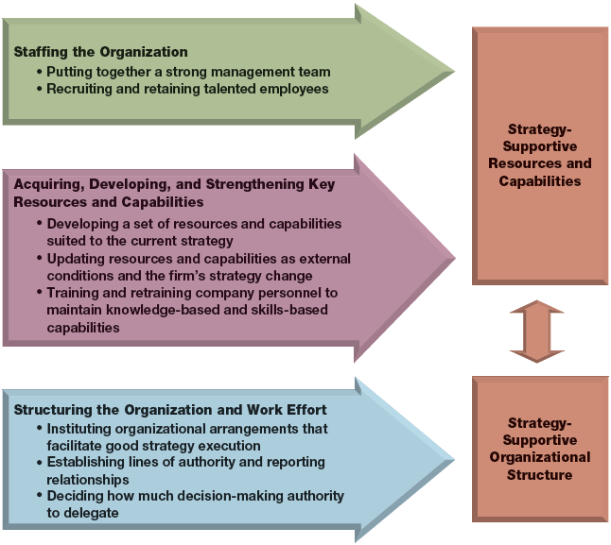

Slide 7
Staffing the Organization
Putting together a strong management team
Full Spectrum Leadership
Deliver Results
Shape the Future
Build Effective Relationships
Energize the Team
Model Personal Excellence, Integrity and Accountability

Slide 8
Staffing the Organization
Recruiting, training and retaining capable employees
The Center for Leadership Excellence (CLE)
Institute for Leadership Excellence (ILE)
Mentoring
Performance Management System

Slide 9
Developing and building critical resources and capabilities
Three Approaches to Building and Strengthening Capabilities
Developing Capabilities internally
Acquiring Capabilities through Mergers and Acquisitions
Accessing Capabilities through Collaborative Partnerships

Slide 10
Acquiring Capabilities through Mergers and Acquisitions
Video Clip
https://www.youtube.com/watch?v=5XcnlKUoc6Ec6E

Slide 11
Developing and Building Critical Resources and Capabilities
The Strategic Role of Employee Training
Strategy Execution capabilities and competitive advantage

Slide 12
Matching the Organizational Structure to the strategy
Decide which value chain activities to perform internally and which ones to outsource
An Organizational structure matched to the requirements of successful strategy execution
Align the organizational structure with the strategy
Decide how much authority to centralize at the top and how much to delegate to down-the-line managers and employees
Facilitate collaboration with external partners and strategic allies

Slide 13
Decide Which value chain activities to perform internally and which to outsource
Focusing on performing strategy critical activities can yield important benefits:
1. Outclassing rivals in the performance of strategy critical activities
2. The streamlining of internal operations that flows from outsourcing
3. Partnerships can add to a company’s arsenal of capabilities and contribute

Slide 14
Aligning The firm’s Organizational Structure with its strategy
Making Strategy critical activities the main building blocks of the orgizational structure.
Matching type of organizational structure to strategy execution requirements
Simple Structure
Functional Structure
Multidivisional Structure
Matrix Structure

Slide 15
Determining how much Authority to Delegate
Centralized decision making
Decentralized decision making

Slide 16
Facilitating Collaboration with External Partners and Strategic Allies
Joint Ventures, Strategic alliances, Coop partnerships
A Network Structure is the arrangement linking a number of independent organizations involved in some common undertaking

