Slide 1
Chapter 3: Evaluating a Company’s External Environment
Team 3: Alex Buslawski, Jessica Bussell, Matthew Jimenez, Corey Smith, Fabio Pinzon, and Cody Bruce

Slide 2
Key Takeaways
Strategically relevant factors in the macro-environment
Competitive forces industry members are facing
Factors driving change in the industry
Market positions of industry rivals
Strategic moves rivals will make next
Key factors for competitive success
Industry outlook for profitability

Slide 3
Strategically Relevant Factors in the Company’s Macro-Environment
Political factors
Trade policies and tax laws/tariffs
Economic conditions
Inflation rates and GDP
Sociocultural forces
Population and demographics/consumer preferences
Technological factors
Research and development
Environmental factors
Green initiatives and natural disasters

Slide 4
Competitive Forces in the Industry
The Five Competitive Forces:
Competition from rival sellers
Competition from potential new entrants
Competition from producers of substitute products
Supplier bargaining power
Customer bargaining power

Slide 5
Competitive Forces Cont.
Competition from rivals
The number of competitors in the field today.
Industry products are becoming more alike.
Potential new entrants
Strengths barriers to entry
Capabilities and resources of potential entrants
Substitute products
Ready availability of substitutes
Pricing, quality, performance, and other relevant attributes of substitutes

Slide 6
Competitive Forces Cont.
Supplier bargaining power
Ready availability of supplier products
Customer bargaining power
Degree to which industry products are commoditized
Strength of buyer demand for seller's’ products

Slide 7
Factors Driving Change in the Industry
Driving Forces Analysis
3 steps
Identify
Common categories
Assess
Determining
“The real payoff”
Notes:
Talk about what driving force is. Then talk about driving force analysis. Identifying what the driving forces are. Assessing whether the drivers of change are, on the whole, acting to make the industry more or less attractive. Determining what strategy changes are needed to prepare for the impact of the driving forces. Relate to IBM.

Slide 8
The Value Net Framework
The Value Net Framework
Illustrates relationships between the firm and other external parties
Includes
The Firm
Suppliers
Competitors
Firms producing similar goods/services
Complementors
Firms that produce goods that enhance the firm’s product
Customers

Slide 9
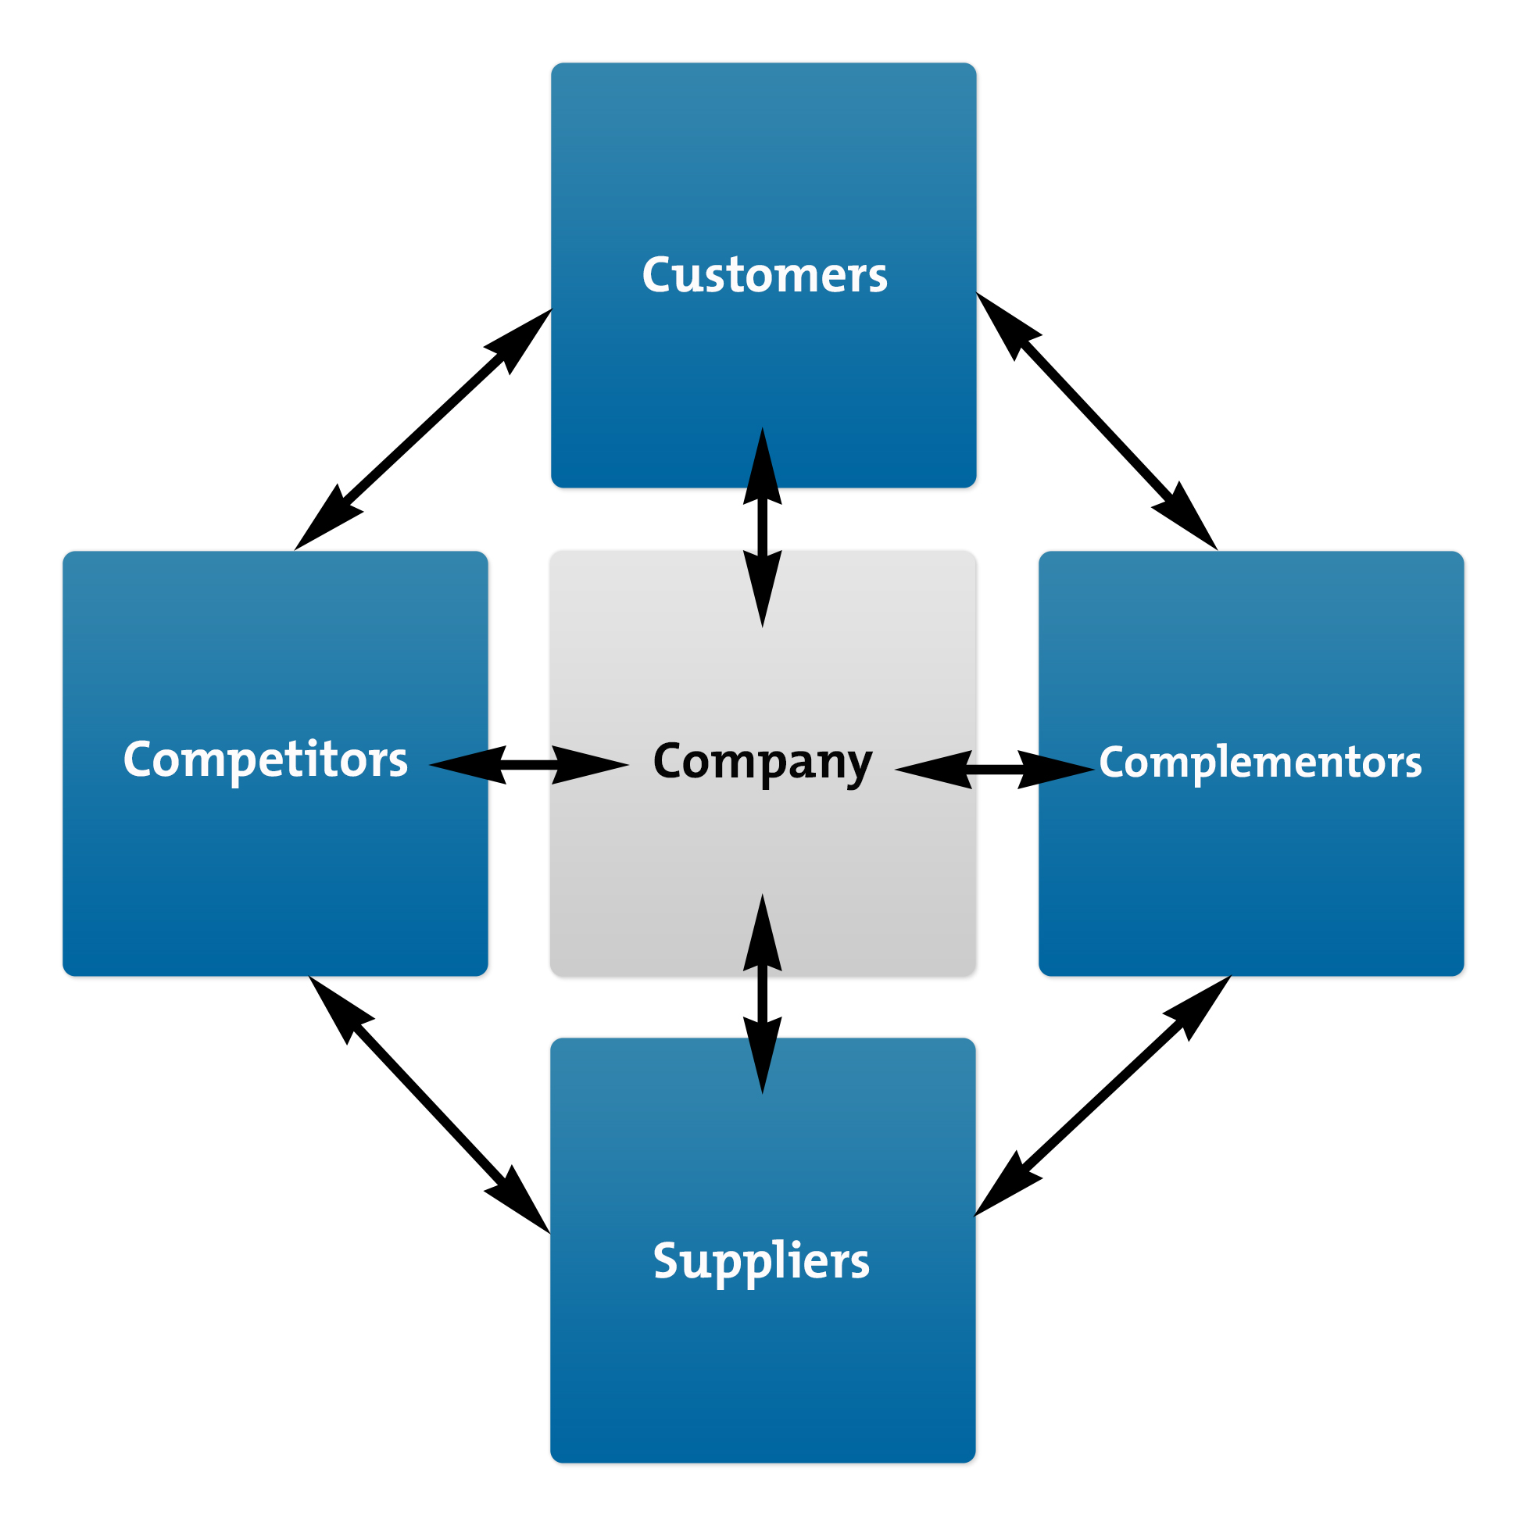
IBM’s Value Net (Server Products)
Customers
Firms such as Google and Rackspace
Banking systems
Suppliers
Firms such as Intel and Western Digital
Competitors
HP Enterprise, Dell Computer, Lenovo
Complementors
Firms such as Canonical and Oracle

Slide 10
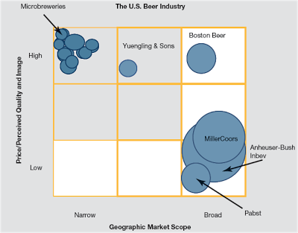
Market Positions of Industry Rivals
Strategic Groups
Groups of firms that are similarly aligned in a given industry
Strategic Group Mapping
Technique to visualize alignment of firms in an industry
Plots firms on graph based on two distinctions in industry

Slide 11
Developing Strategic Group Maps
Identify characteristics that determine strategic approaches
Typical variable include
Price/quality range
Geographic coverage
Product-line breadth
Degree of service offered
Degree of vertical integration
Degree of diversification into other industries
Plot firms on a two-dimensional graph based on two characteristics

Slide 12
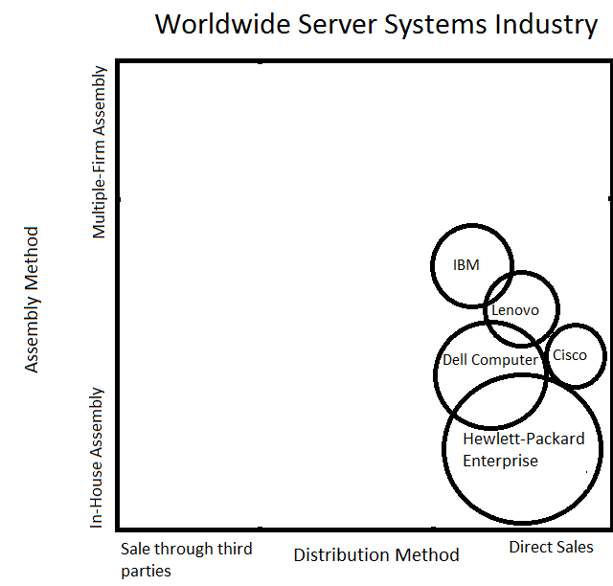
Strategic Group Map--Worldwide Server Systems Vendors
Viewing the top five firms in the global industry
Group viewed on
Assembly Method
Distribution Method
Notes:
IBM is the 3rd largest player in Server Systems industry worldwide

Slide 13
Strategic Moves Rivals Will Make Next

Slide 14
Strategic Moves Rivals Will Make Next Cont.
Current Strategy
Having a good understanding to have an indicator of the rival’s pattern of behavior and best strategic options
Objectives
Financial Performance Objectives
Strategic Objectives
Resources and Capabilities
Strategic moves and countermoves are both enabled and constrained by it
Serve as a strong signal of future strategic actions
Assumptions
How top managers view their strategic situation and the impact it has on its rivals

Slide 15
Key Success Factors
Competitive factors that most affect an industry member’s ability to survive
ALL members of an industry must pay attention to KSFs to prevent stagnation or even failure
ID’ing KSFs always come before actual strategy making
What product attributes/characteristics are the most important?
What resources and capabilities are needed to be competitive?
What shortcomings will put us at a disadvantage?

Slide 16
Industry Outlook for Profitability
Combining the frameworks from this chapter provides an accurate perspective on future success
Shows if the industry has strong prospects and potential to return a high profit
But, everything is relative… there are plenty of reasons to decline/greenlight investing in an industry
Ex. despite dismal industry conditions, a company may invest because their rivals are vulnerable

Slide 17
Works Cited
https://www.ukessays.com/essays/business/business-environment-of-international-business-machines-corporation-business-essay.php
http://highered.mheducation.com/sites/0078112729/student_view0/chapter3/key_points.html
http://filzahaninah.blogspot.com/2013_10_01_archive.html
https://www.sec.gov/Archives/edgar/data/51143/000104746914001302/0001047469-14-001302-index.htm
https://www.coursehero.com/file/p7svlv0/PC-Industry-Strategic-Group-Map-Gateway-Direct-selling-Dell-Hewlett-Packard-IBM/
https://www.idc.com/getdoc.jsp?containerId=prUS41424716

