Slide 1
Chapter 7: Strategies for Competing in International Markets
JESSICA MEDINA, LACEY WARREN, CARSON HOFFMAN, MITCH WILSON, BLAKE WEBSTER

Slide 2
REASONS COMPANIES COMPETE IN INTERNATIONAL MARKETS
To gain access to new customers
To achieve lower costs through economies of scale, experience, and increased purchasing power.
To further exploit core competencies
To gain access to resources and capabilities located in foreign markets.
To spread business risk across a wider market base

Slide 3
COMPETING INTERNATIONALLY V. COMPETING GLOBALLY
Typically a company will start to compete internationally by entering just one or a few foreign markets.
When the company has established operations in several continents and foreign markets and begins competing with rivals for global market leadership is when the company globally.

Slide 4
WHY COMPETING INTERNATIONALLY MAKES STRATEGY-MAKING MORE COMPLEX
Creating a strategy in different countries is more complex for 5 reasons
Different countries have different competitive strengths
Location-based value chain advantages for certain countries
Variances in government policies, economic conditions, and tax rates
Exchange rate shift risks
Differences in demographics, cultures, and market conditions

Slide 5
PORTER’S DIAMOND OF NATIONAL COMPETITIVE ADVANTAGE FRAMEWORK
Different countries are known for certain strengths
Example strength of Japan: Electronics
Apple outsources various phone parts from Japan
Developing competitive advantages depends on 4 main factors:
Demand Conditions
Factor Conditions
Related and Supporting Industries
Firm Strategy, Structure, and Rivalry

Slide 6
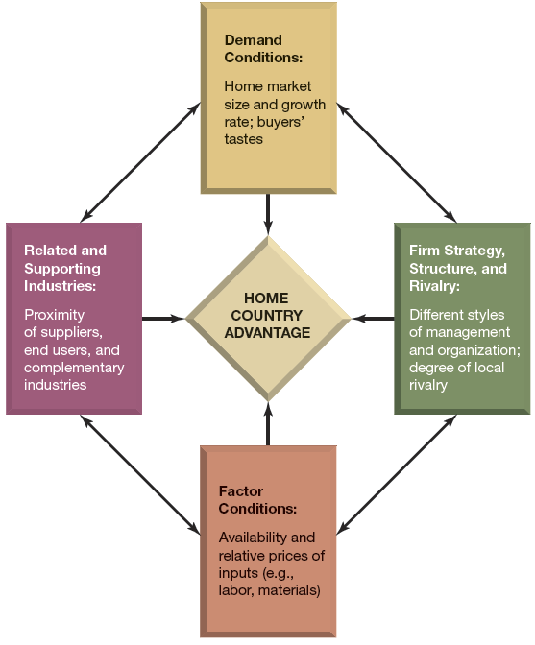
Figure 7.1
The Diamond of National Advantage Diagram
Notes:
Explain the diagram., then give examples involving apple.

Slide 7
LOCATION-BASED VALUE CHAIN ADVANTAGES FOR CERTAIN COUNTRIES
Value chain activities in different countries provide varying advantages
The following differences can greatly impact manufacturing costs:
Wage rates
Energy Costs
Government regulations
Hourly wage average difference by country:
China: $1.36
Mexico: $5.48
Portugal: $11.95
U.S.: $33.53

Slide 8
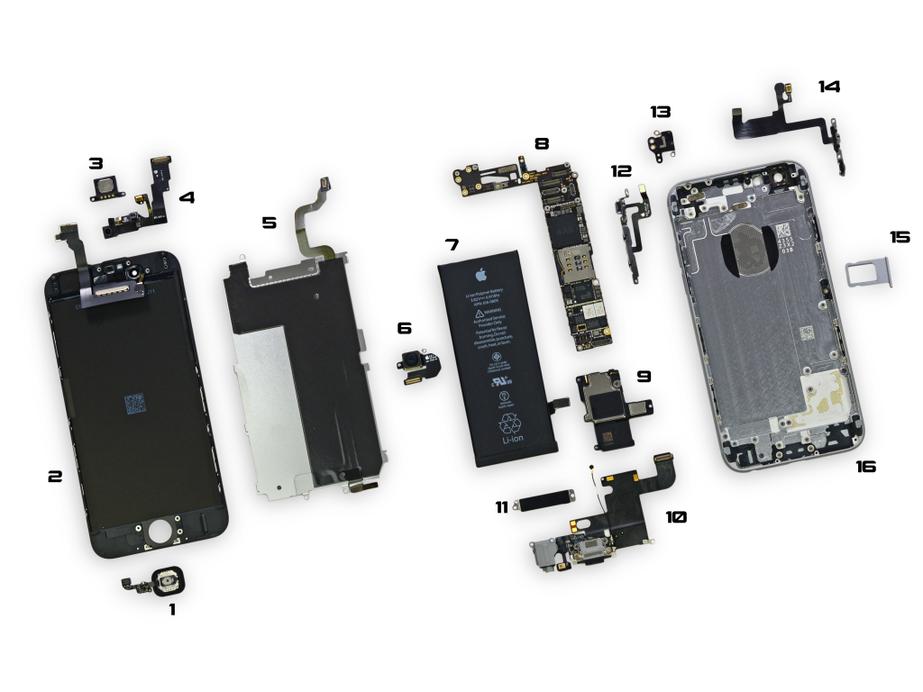
APPLE’S VALUE CHAIN INCLUDES DIFFERENT COUNTRIES
Apple utilizes value chain advantages from many countries
The following iPhone 6 parts are made in these different countries:
Batteries: made in South Korea
Fingerprint sensors: made in Taiwan
Flash memory: made in Japan
Main chassis assembly: made in China
Notes:
These are just a few examples. They have many other parts being manufactured in different parts of the world.

Slide 9
VARIANCES IN GOVERNMENT POLICIES, ECONOMIC CONDITIONS, AND TAX RATES
Government policies and economic conditions can affect foreign businesses negatively or positively
Political risks: instability or weakness in governments
Economics risks: instability of a country’s:
Monetary system
Regulatory policies
Property rights protections
Economic Policies
Notes:
Try to do business with North Korea might be a political risk, due to the negative aspects of it’s goverment.

Slide 10
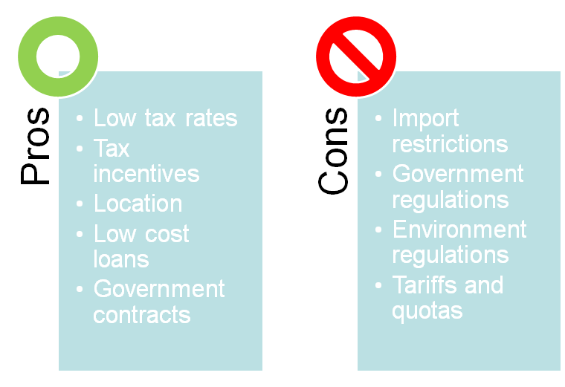
VARIANCES IN GOVERNMENT POLICIES, ECONOMIC CONDITIONS, AND TAX RATES

Slide 11
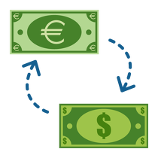
EXCHANGE RATE SHIFT RISKS
Effects of Exchange Rate Shifts:
Fluctuating exchange rates can create economic risks to companies in foreign markets
For exporters:
Demand rises when their currency grows weaker relative to the importing country’s currency
Demand falls when their currency grows stronger relative to the importing country’s currency
Notes:
Declines in the value of the U.S. dollar against foreign currencies have the effect of raising the U.S. dollar–costs of goods manufactured by foreign rivals at plants located in the countries whose currencies have grown stronger relative to the U.S. dollar. A weaker dollar acts to reduce or eliminate whatever cost advantage foreign manufacturers may have had over U.S. manufacturers (and helps protect the manufacturing jobs of U.S. workers)

Slide 12
DIFFERENCES IN DEMOGRAPHICS, CULTURES, AND MARKET CONDITIONS
Buyer demand for particular products and services can differ substantially from country to country
Differences in population size, income levels, and other demographic factors create differences in market size and growth rates from country to country
Companies should customize their products/services to match the preferences and tastes of local buyers

Slide 13
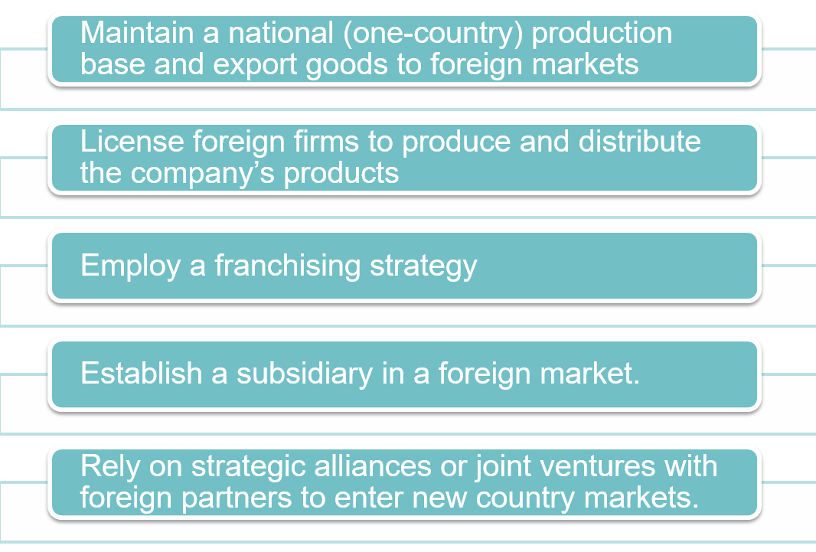
THE 5 STRATEGIC OPTIONS FOR ENTERING FOREIGN MARKETS

Slide 14
Export Strategies
Strengths
Limited involvement in foreign markets
Efficiency in utilizing existing productions
Low capital needed
No investment risks
Weaknesses
High shipping costs
Tariffs or other trade barriers
Fluctuating exchange rates
Notes:
Using domestic plants as a production base for exporting goods to foreign markets is an excellent initial strategy for pursuing international sales.

Slide 15
Licensing/Franchising Strategies
Strengths
Avoid risk of foreign markets that are economically unstable
Low resource requirements
Quick expansion into many foreign markets
Income from royalties and franchising fees
Weaknesses
Loss of operational and quality control
Risk of losing valuable knowledge to foreign companies
Adjust to different market expectations & tastes
Notes:
Franchising and licensing share many of the same advantages as licensing.
While licensing works well for manufacturers and owners of proprietary technology, franchising is often better suited to the global expansion efforts of service and retailing enterprises.

Slide 16
Foreign Subsidiary Strategies
Strengths
High level of control
Avoids entry barriers
Local distribution channels
Government relationships
Supplier connections
Fast large-scale market entry
Weaknesses
High acquisition costs
Complexity of acquisition process
Integration of the firm's’ structures, cultures, operations and personnel
Notes:
Companies pursuing international expansion may elect to take responsibility for the performance of all essential value chain activities in foreign markets.
-> Companies that prefer direct control over all aspects of operating in a foreign market can establish a wholly owned subsidiary
->Acquisition – quicker option and might be the least risky and cost effective means of entry
The big issue an acquisition-minded firm must consider is whether to pay a premium price for a successful local company or to buy a struggling competitor at a bargain price.

Slide 17
Alliance & Joint Venture Strategies
Strengths
Firms can benefit greatly from a foreign partner’s familiarity with:
Local market conditions
Local government regulations
Buying habits & preferences of local consumers
Achieving economies of scale through joint operations
Weaknesses
Costs of establishing the working arrangement
Differences in corporate values and ethical standards.
Cultural and language barriers
Notes:
Alliances and Joint Venture Strategies
Export minded rms in industrialized nations have traditionally sought alliances with firms in less developed countries to import and market their products locally—such approvals were often necessary to win approval for entry from the host country’s government

Slide 18
Apple’s alliance with SAP
Apple just partnered with SAP, a German enterprise software company
“This partnership will see SAP building corporate apps tailored for Apple’s mobile devices like the iPhone and iPad.”
SAP CEO: “This is the key to staying ahead in business”

Slide 19
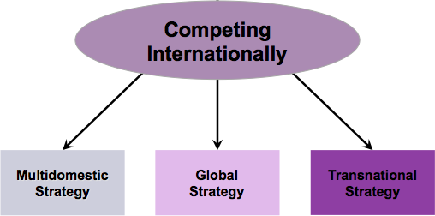
THE 3 MAIN STRATEGIC APPROACHES FOR COMPETING INTERNATIONALLY

Slide 20
Multidomestic Strategy
“Think Local, Act Local”
Companies tailor their products and services to the specific need of each country the Company competes in
Cultural traditions
Buyer tastes
Market conditions

Slide 21
Multidomestic Strategy
Disadvantages
Hinders the Company’s ability to transfer knowledge and other resources across the border
Raises production costs
Doesn’t create a worldwide competitive advantage

Slide 22
Global Strategy
“Think Global, Act Global”
Companies sells the same products under the same brand name everywhere
Allows the use of the same distribution channels
Allows for mass production
Similar marketing approaches

Slide 23
Global Strategy
Disadvantages
Doesn’t address local needs
Is less responsive to changes in market conditions
Raises transportation costs
Raises coordination costs

Slide 24
Transnational Strategy
“Think Global, Act Local”
Middle ground approach
Incorporate country-specific products
Allows for the adjustment of marketing, distribution, and production of products in response to local markets

Slide 25
Transnational Strategy
Disadvantages
Most difficult to implement
Places demands on an organization to pursue different objectives
Costly and time consuming to implement

Slide 26
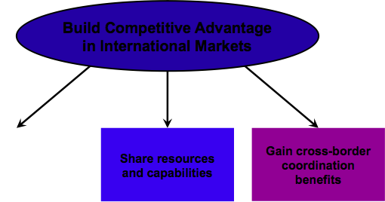
The Quest for Competitive Advantage in the International Arena

Slide 27
Location to Build Competitive Advantage
To build an advantage there are two issues to consider:
Customize product offerings to match each individual local market
Vs.
Offer a mostly standardized product worldwide

Slide 28
Few Locations vs. Many Locations
Few Locations:
The cost is lower in one place compared to a different location
More beneficial to have a few efficient plants compared to small plants across the country
Certain locations have more valuable advantages

Slide 29
Few Locations vs. Many Locations
Many Locations:
Buyer-related activities can be conducted from a distance
Transportation costs are high
Central location is too costly due to trade barriers
Dispersion helps: prevent supply interruptions, avoid political developments, and reduces exchange rates

Slide 30
Sharing and Transferring Resources and Capabilities to Build Competitive Advantage
Build a Resource-Based Competitive Advantage:
Using powerful brand names to extend a differentiation-based competitive advantage beyond the home market
Coordinating activities for snaring and transferring resources and production capabilities across different countries’ domains to develop market dominating depth in key competencies

Slide 31
UNIQUE CHARACTERISTICS OF COMPETING IN FOREIGN MARKETS
Whether to customize the company's offerings in each different country market to match the tastes and preference
Whether to employ the same basic competitive strategy in all countries or modify the strategy
Where to locate the company's production facilities, distribution centers, and customer service operations
How to efficiently transfer the company's resource strengths and capabilities from one country to another.

Slide 32
References
http://www.macworld.co.uk/feature/apple/are-apple-products-truly-designed-in-california-made-in-china-iphonese-3633832/
http://d1298eg8eju4xv.cloudfront.net/image/50aa653d572b947a1b000001/210/Exchange%20rate.png?v=2991077720
http://ujg433eawlo3i4uqknhm8e1b.wpengine.netdna-cdn.com/wp-content/uploads/2014/03/icons-people.png
https://pixabay.com/p-24502/?no_redirect
http://fortune.com/2016/05/05/apple-sap-partnership/
http://highered.mheducation.com/sites/0073530425/student_view0/chapter7/index.html
http://appleinsider.com/articles/16/01/09/apples-competition-is-going-to-have-a-tough-year-in-2016

