Slide 1
Chapter 8: Corporate Strategy
Diversification and the Multibusiness Company
By: Kerwin, Brent, Justin, Jake

Slide 2
Diversification Strategy
Picking new industry/Means of entry
Leveraging cross-business value chain relationships
Establish investment priorities/allocate corporate resources
Initiate actions to boost performance business collection

Slide 3
Tests of Corporate Advantage
The Industry attractiveness test
The cost of entry test
The better-off test

Slide 4
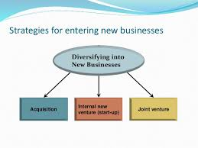
Entering New Businesses
Acquisition
Internal Startup
Joint Ventures

Slide 5
Diversifying Related vs Unrelated Businesses
Related: Strategic Fit across corresponding value chains
Unrelated: Dissimilar value chain and resource requirements

Slide 6
Related Business: Strategic Fit along Value Chain
How Strategic Fit exists with Value Chain activities:
Supply Chain Activities
R&D and Technology Activities
Manufacturing-Related Activities
Sales and Marketing Activities
Distribution-Related Activities
Customer Service Activities

Slide 7
Strategic Fit, Economies of Scope, Competitive Advantage
Related diversification is an attractive strategy because of the ability to convert the Cross Business Strategic Fit into a Competitive Advantage.
Economies of Scope (cost reductions from multiple business operations)
Stems from strategic fit along the value chain.
Resource sharing results in a greater potential for a diversified strategy to give a cost advantage over rivals.
Competitive Advantage
Sharing assets can help value chain activities
Business can contribute to efficiency and lower costs to competition.
Can provide a differentiation basis.

Slide 8
Diversifying Unrelated Business
Perform industry attractiveness, cost of entry, and better off tests.
Building shareholder value
Drawbacks
Demanding managerial requirements.
Limited competitive advantage potential.
Misguided reasons to pursue unrelated business
Risk reduction
Growth
Stability
Managerial motives

Slide 9
Combination of Related-Unrelated Diversification Strategies
The following are categories of diversified strategies
Dominant Business Enterprises: One core business accounts for 50%-80% of total revenue. A collection of small related-unrelated business accounts for the rest
Narrowly Diversified: comprised of 2-5 related/unrelated businesses
Broadly Diversified: a wide range collection of related, unrelated, or mixture of both businesses
Several unrelated groups of related businesses: when a number of multibusiness enterprises have diversified into unrelated areas, but have a collection of related business within each area.

Slide 10
Evaluating the Strategy of a Diversified Company
The procedure for evaluating a diversified company’s strengths and weaknesses and what actions to take to improve company performance involves six steps
Assessing the attractiveness of the industries the company has diversified into
Assessing the competitive strength of the company’s business units
Determining the competitive value of strategic fit in diversified companies
Checking for resource fit
Ranking business units and assigning a priority for resource allocation
Crafting new strategic moves to improve overall corporate performance

Slide 11
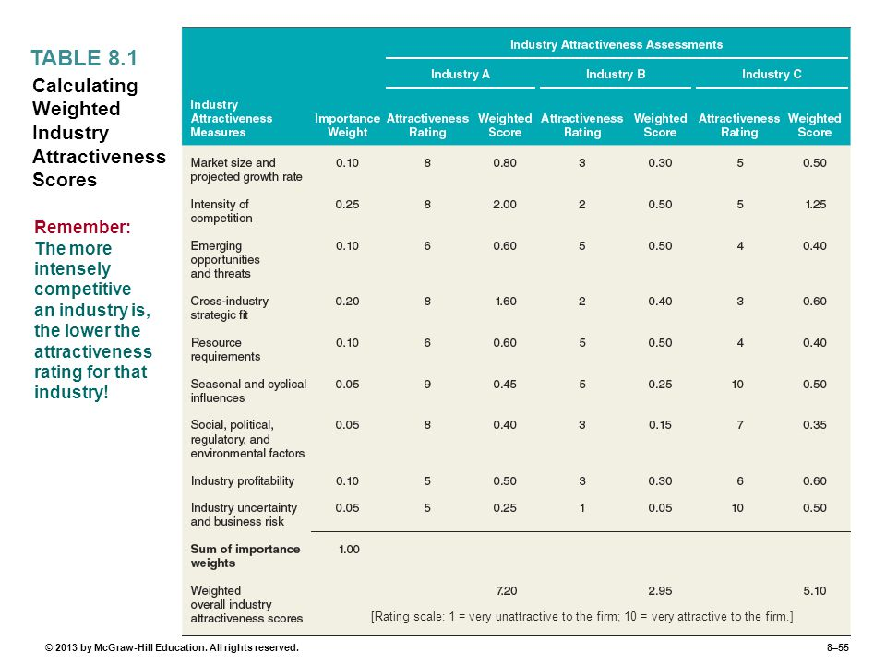
Step #1: Evaluating Industry Attractiveness

Slide 12
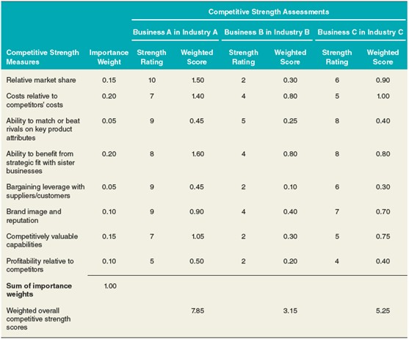
Step #2: Evaluating Business-Unit Competitive Strength
Interpreting the Competitive Strength Scores
0-3.2: weak competitive strength/market position
3.3-6.7: moderate competitive strength/market position
6.8-10: Strong competitive strength/market position

Slide 13
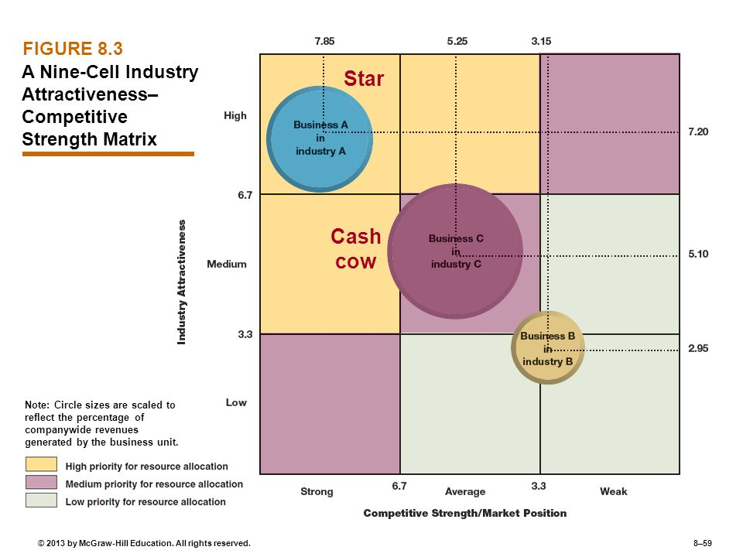
Nine-Cell Matrix Portraying Industry Attractiveness and Competitive Strength
Businesses in the top left corner have favorable strength and attractiveness
Businesses in the diagonal section have moderate strength and attractiveness
Businesses in the bottom right corner have low strength and attractiveness

Slide 14
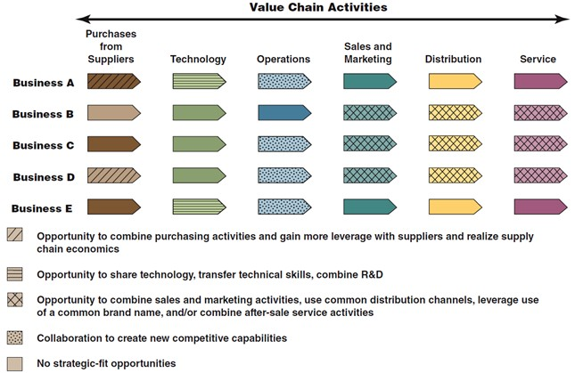
Step #3: Determining the Competitive Value of Strategic Fit in Diversified Companies
Assessing the degree of strategic fit across its business is central to evaluating a company’s related diversification strategy
The real test of a diversification strategy is what degree of competitive value can be generated from strategic fit

Slide 15
Step #4: Checking for Resource Fit
Financial Resource Fit
Exists when:
Businesses add to a company’s resource strengths, either financially or strategically.
A company has the resources to support the resource requirements of its businesses as a group without spreading itself too thin.
There are close matches between a company’s resources and industry key sucess factors. An important test of financial resource fit involves determining whether a company has cash cows and not too many cash hogs.
Nonfinancial Resource Fit
Does the firm have (or can it develop) the specific resources and capabilities needed to be successful in each of its businesses?
Are the firm’s resources being stretched too thinly by the resource requirements of one of more of its businesses?

Slide 16
Step #5: Ranking Business units and Assigning a Priority for Resource Allocation.
Ranking Factors:
Sales Growth
Profit Growth
Contribution to company earning
Return on capital invested in the business
Cash flow
Guide resources to business units with the brightest profit and growth prospects and solid strategic and resource fit.

Slide 17
Step #6: Crafting New Strategic Moves to Improve Overall Corporate Performance

