Slide 1
Chapter Four:
Focus on the Big Picture,
Not the Numbers
By: Kerwin, Brent, Justin, Jake

Slide 2
Red Ocean Strategic Planning
Conflicting Agendas
Irrelevant Numbers
Muddled Strategies
Costly
No Clear Direction

Slide 3
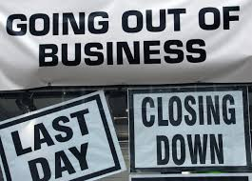
EQUALS = Undifferentiated Strategy

Slide 4
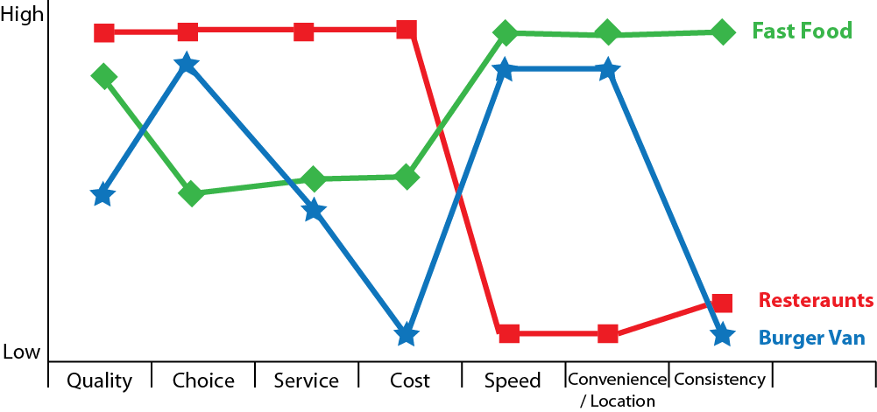
Strategy Canvas
Profile of Industry
Profile of Competitors
Profile of Company

Slide 5
Visualizing Strategy
1. Visual Awaking: Compare your business with your competitors’ by drawing your “as is” strategy canvas. See where your strategy canvas needs to change.
2. Visual Exploration: Observe the distinctive advantages of alternative products and services. See which factors you should eliminate, reduce raise, create, or change.
3. Visual Strategy Fair: Draw your “to be” strategy canvas based on insights from field observations. Get feedback on alternative strategy canvases from customers, competitors’ customers.
4. Visual Communication:Distribute your before-and-after strategic profiles on one page for easy comparison. Support only those projects and operational moves that allow your company to close the gaps to actualize the new strategy.
2’

Slide 6
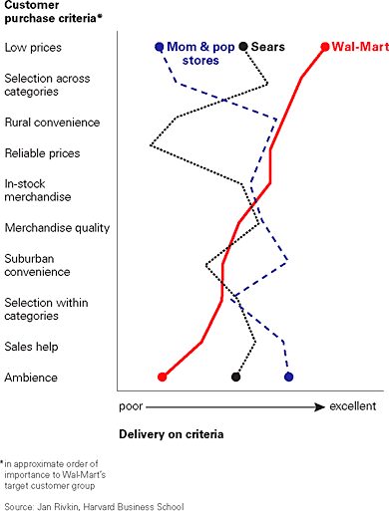
Step 1: Visual Awakening
Evaluate Current Strategy
Create Strategy Canvas
Differentiate With a Tagline
“Save Money. Live Better”
-Walmart

Slide 7
Step 2: Visual Exploration
Physically go into the field and explore the six paths to creating blue oceans
It is imperative that managers witness first-hand how people perceive their products
Determine the distinctive advantages of alternative products and services
This allows companies to see what else customers are buying that fulfill their needs
Identify which factors you should eliminate, create, or exchange
Managers should identify what customers feel strongly about

Slide 8
Step 3: Visual Strategy Fair
Create new strategies based on information gathered from field operations
Pitch new strategies to micro and macro constituents of the firm
Receive feedback on alternative strategies from customers, competitor’s customers, and noncustomers
Info is gathered from the research that is collected when managers go out and see what is important and what is not
Use this feedback to develop the best “to be” future strategy
Once feedback is recieved, firms can begin to create a new value curve that better meets customers and noncustomers expectations

Slide 9
Step 4: Visual Communication
The final step
Communicate in a way the employee can easily understand
EFS (European Financial Services) - distributed a one page picture showing its new and old strategic profile.
Easy for the employees to understand
Every employee could then see where the company stood
Employees were so motivated they posted the new priorities in their cubicles
Effective and Efficient

Slide 10
Pioneer-Migrator-Settler (PMS) Map
PMS Map: analyses a company or industry's product portfolio and reveals the growth potential of existing and planned products and services.
Walmart - portfolio every year to ensure they are on a path of growth

Slide 11
Pioneer-Migrator-Settler (PMS) Map Cont’d
Helps managers predict and plan the company’s future growth
Pioneers:
Strategists
Most powerful sources of profitable growth
These businesses have a great amount of customers
Settlers:
They settle
Dont usually contribute to the company’s future growth
Migrators:
Fall in between the Red Ocean and the Blue Ocean
Most their business offerings are better than most the marketplace

