Slide 1
Blue Ocean Strategy: Chapter 5 Reach Beyond Existing Demand
Jamie Bowlin, Kristen Righter,
Kristine Kauneckas & Chris Williams

Slide 2
Non-Customers
People who can be transformed into customers and they are a huge source of possible demand.
Three tiers:
First Tier Non-Customers
Soon to be
Second Tier Non-Customers
Refusing
Third Tier Non-Customers
Unexplored

Slide 3
First Tier Non-Customers
Customers that are actively looking for a new opportunity.
Non-customers who are eagerly waiting to jump ship.
What makes people change banks?
Fees
Location convenience
Customer service
Additional services

Slide 4
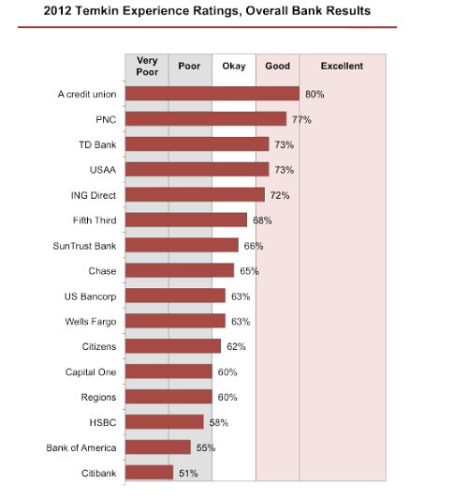

Slide 5
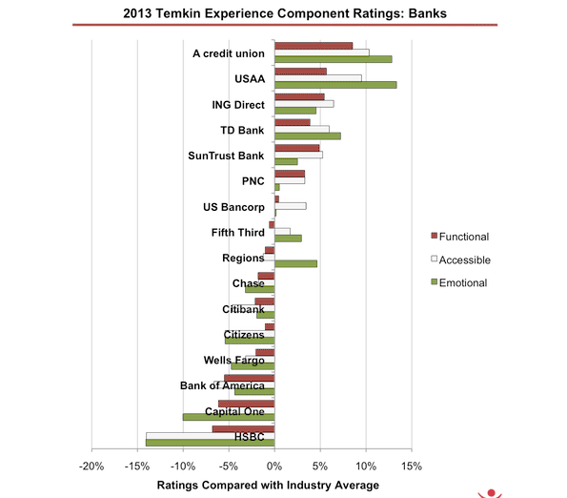

Slide 6
Second Tier NonCustomers
People who either do not use or can not afford to use the current market offerings
Ocean of untapped demand waiting to be released
Online banking

Slide 7
Third Tier Noncustomers
The furthest away from an industry’s existing customers.
They have not be targeted or thought of as potential customers.
It is assumed that the needs and business opportunities belong to other markets.

Slide 8
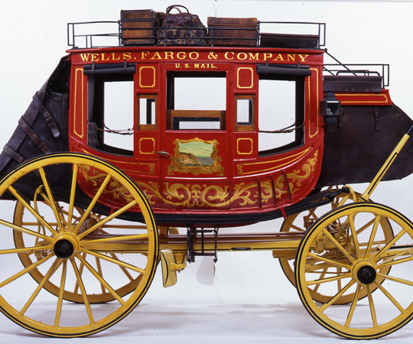

Slide 9
The Biggest and Most Dangerous Catch
Organization should focus on the tier that has the biggest catch that your organization has the capability to act on.

