Slide 1
Chapter 4: Evaluating a Company’s Resources, Capabilities, and Competitiveness
TEAM 5
Jamie Bowlin, Christopher Williams, Kristine Kauneckas, & Kristen Righter

Slide 2
How well is the company’s present strategy working?

Slide 3
Strategy Indicators
Whether the company is achieving its stated financial and strategic objectives.
Whether its financial performance is above the industry average
Whether it is gaining customers and increasing its market share.

Slide 4
Key Financial Indicators
Gross profit margin
Net profit margin
Free cash flows
27.7 Billion

Slide 5
What are the company’s most important resources and capabilities, and will they give the company a lasting competitive advantage over rival companies?

Slide 6
Identifying the Company’s Resources and Capabilities
Resource-a competitive asset that is owned or controlled by a company
Capability- capacity of a firm to perform some internal activity competently.

Slide 7
VRIN Test
Is the resource or capability Valuable
Is the resource or capability Rare
Is the resource or capability Inimitable
Is the resource or capability Non-substitutable

Slide 8
What are the company’s strengths and weakness in relation to the market opportunities and external threats?

Slide 9
SWOT Analysis
Internal Strength
Internal Weakness
Market Opportunities
External Threats

Slide 10
Internal Strengths
Competence- an activity that a company has learned to perform with proficiency, i.e. a capability
Core Competence- is an activity that a company performs proficiently and that is also central to its strategy and competitive success
Distinctive Competence- is a competitively important activity that a company performs better than its rivals

Slide 11
Bank of America: S
Market Recognition
Strong Banking Network
Broad Product and Service Portfolio

Slide 12
Internal Weakness
A shortcoming that constitutes competitive liability
Can relate to:
Inferior or unproven skills, expertise, or intellectual capital in competitively important areas of the business
Deficiencies in competitively important physical, organizational, or intangible assets
Missing or competitive inferior capabilities in key areas

Slide 13
Bank of America: W
Weak top-line Performance
Overdependence on the U.S.

Slide 14
Market Opportunities
A company is well advised to pass on a particular market opportunity unless it has or can acquire resources and capabilities needed to capture it.

Slide 15
Bank of America: O
Positive Outlook for Cards and Payments Industry in the U.S.
Growing U.S. Economy
Booming U.S. Market

Slide 16
Environmental Threats
Threats to a company's profitability and competitive well-being.
Can stem from technologies, cheaper options, foreign competitors, new regulations, ect.

Slide 17
Bank of America: T
Fluctuations in Interest Rates
Increase in Compliance Costs
Changing Rules and Regulations

Slide 18
SWOT Analysis
Simply making the four lists is not enough, draw conclusions and improve strategies either heighten your competencies or fix your shortcomings

Slide 19
Are the company’s cost structure and customer value proposition competitive?

Slide 20
Value Chain
Primary activities
Supply chain management
Operations
Distribution
Sales and marketing
Service
Support activities
Product R&D, technology, and systems development
HR management
General administration

Slide 21
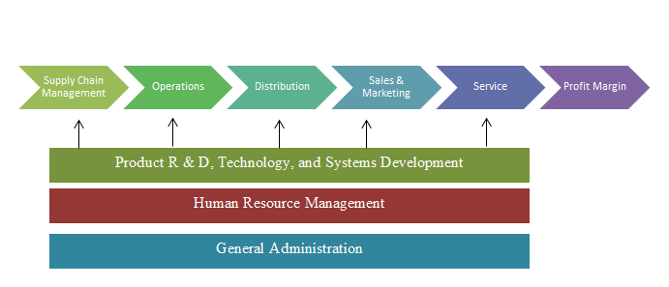
Representative Company Value Chain

Slide 22
Comparing Value Chains of Rival Companies
Purpose of value chain is comparison
How each segment is done changes costs
Supply chain of supplier and distributer can affect efficiency
Internal cost structure
Activity-based costing

Slide 23
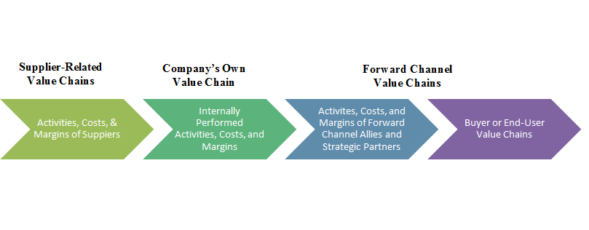
Representative Value Chain System

Slide 24
Value Chains of Suppliers and Distributors
Distribution partners value chain
Their costs and your price
Sales volume
Benchmarking

Slide 25
Remedies for Cost and Value Disadvantages
Main areas for improving efficiency
Internal activities
Supplier value chain
Forward channel
Encuring people to bank with Bank of America
http://about.bankofamerica.com/en-us/our-story/supplier-relations.html#fbid=HQsEDmMNSF9

Slide 26
Improving Internal Value Chain Activities
Best practices
Revamp
Outsource
http://www.computerworld.com/article/2574229/it-outsourcing/bank-of-america-creates-indian-outsourcing-subsidiary.html
Back office-office operations
Go around high costs
Redesign product

Slide 27
Improving Effectiveness of Value Proposition
Best practices through company
Good customer service
Reallocate resources
Marketing

Slide 28
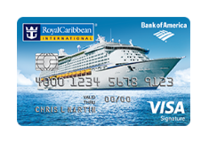
Improving and Enhancing Forward Channel
Improving value chain forward channel
Reduce markup
Win-win situation
Cheaper distribution
Enhancing differentiation through forward channel
Cooperative advertisement
Reward points
Exclusive agreements
standards

Slide 29
Competitive Advantage
Value creating
Increase efficiency and decrease costs
Basis for differentiation
How activities relate to resource and capabilities
Competitive advantage
Value creating activity = action
Rare and valuable resources and capabilities

Slide 30
Translating Company Performance of Value Chain Activities into Competitive Advantage
Beat rivals by getting more customer value
Improve quality → Competencies Emerge → Increase in core competence → Distinctive competence → Gain competitive advantage
Beat rivals with more efficient value chain activities
Cost effective activities → Cost is driven down → More efficient → Distinctive competence → Gain competitive advantage

Slide 31
Is the company competitively stronger or weaker than key rivals?

Slide 32
Competitive Strength Assessment
Step 1
Identify the industry’s key success factors and other important measures of competitive strengths and weaknesses.

Slide 33
Competitive Strength Assessment
Step 2
Assign weights to each of the measures based on their perceived importance.

Slide 34
Competitive Strength Assessment
Step 3
Calculate the weighted strength ratings
Using a 1-10 scale, score each competitor on each strength
Multiply the assigned rating by the assigned weight

Slide 35
Competitive Strength Assessment
Step 4
Sum the weighted strength ratings for each factor to get an overall measure of each company

Slide 36
Competitive Strength Assessment
Step 5
Use the individual strengths and overall measures to develop strategies

Slide 37
Bank of America Competitive Strength Assessment
Key Success Factors | Importance Weight | Strength Rating | Weighted Score
Customer Service Capabilities | 0.25 | 8 | 2.0
Reputation/Image | 0.15 | 7 | 1.05
Technological Skills | 0.10 | 6 | 0.6
Financial Resources | 0.4 | 8 | 3.2
Quality/Product Performance | 0.10 | 7 | 0.7
 | 1.0 |  | 7.55

