Slide 1
Overcome Key Organizational Hurdles
Gaston Arnold, Yussef Benelbar, Jorge Pallares and Edwin Hyslop

Slide 2
Tipping Point Leadership in Action

Slide 3
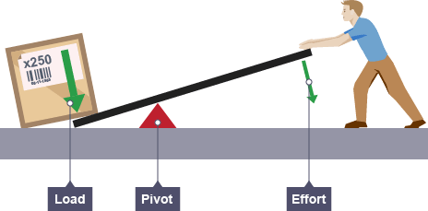
The Pivotal Lever: Disproportionate Influence Factors
People, acts, and activities exercise a disproportionate influence on performance

Slide 4
Jump the Resource Hurdle
Most Leaders are faced with the stark reality of limited resources.
Tipping point leaders focus concentrate on multiplying the value of the resources they have.
Factors that Executives can leverage to free up space and multiply value of those resources:
Hot Spots
Cold Spots
Horse Trading

Slide 5
Redistribute Resources to your Hot Spots
Hot Spots are activities that have low resource input but high potential performance
Redistribute your resources to your “Hot Spot”
Apple Ex: Iphone & Ipad

Slide 6
Redirect Resources from your Cold Spots
Cold Spots are activities that have high resource input but low potential performance impact.
Leaders need to free up resources by searching out cold spots.
Redirecting your resources from your cold spots to eventually what would be your hot spot.
Apple Ex: Ipod

Slide 7
Engage in Horse Trading
Horse trading involves trading your unit’s excess resources in one area for another unit’s excess resources to full remaining resource.
Tipping point leaders skillfully trade resources they don’t need fro those of others that they do need.
Apple Ex: Apple has been known to trade amongst its competitors for instance its partnership with samsung in which they trade different electronic components to one another.

Slide 8
Jump the Motivational Hurdle
How to reach your company's tipping point and execute blue ocean strategy:
Alert employees of needed strategic change.
Explain how the change can be achieved with limited resources.
Motivate employees to act on the change in an intrinsic manner.
Three factors of disproportionate influence in motivating employees.
Kingpins
Fishbowl management
atomization

Slide 9
Zoom in on Kingpins
Kingpins are the key influencers in an organization.
Natural leaders who are well respected and persuasive.
Concentrate on kingpins in order to avoid tackling everyone in the organization though everyone is touched and changed.

Slide 10
Place Kingpins in a fishbowl
Shines light on the actions and inactions of Kingspins.
Transparency is key.
Fishbowl strategy must be done fairly, engaging all members equally.

Slide 11
Atomize to get the Organization to Change Itself
Atomization relates to the framing of the strategic challenge.
People must believe the challenge is attainable in order for them to do it.
In order to make challenges attainable, they are broken down into smaller pieces.

Slide 12
Knock over the Political Hurdle
To overcome political forces, tipping point leaders focus on three disproportionate influence factors:
Angels
Devils
Consigliere

Slide 13
Secure a Consigliere on Your Top Management Team
Tipping Point leaders see a consigliere as an essential role when building an effective top management team.
Respected individuals within the organization
Knows the landmines that will be face while implementing a new strategy

Slide 14
Leverage Your Angles and Silence Your Devils
Who are my Devils?
Who will fight me?
Who will Lose the most by the future blue ocean strategy
Who are my Angels?
Who will naturally align with me?
Who will gain the most by the strategic shift?

Slide 15
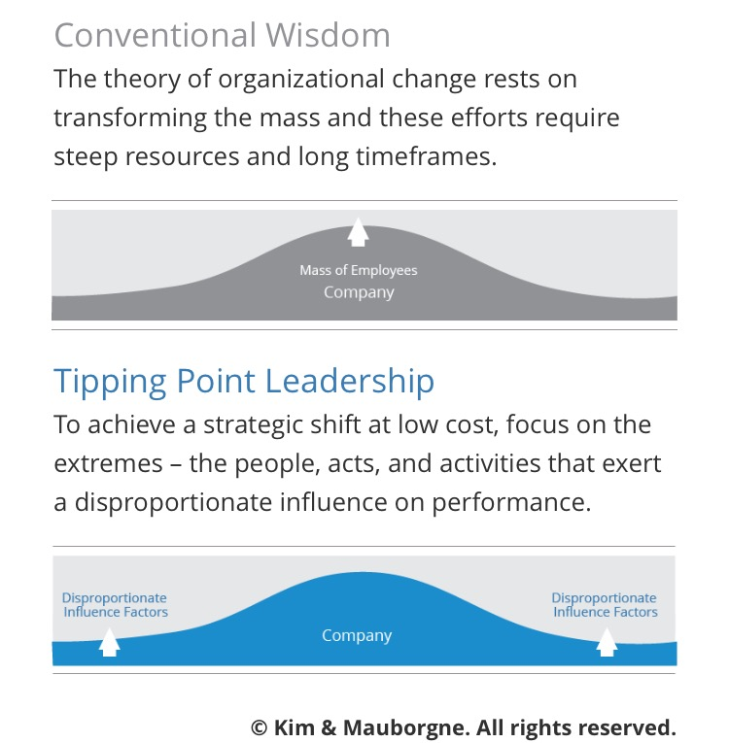
Challenging Conventional Wisdom
Tipping point leadership focus on transforming the extremes:
The People
Acts
Activities that exercise a disproportionate influence on performance
By transforming the extremes, tipping point leaders are able to change the core fast and at low cost to execute their new strategy

Slide 16
Leaping over the Cognitive Hurdle
Being attached or stuck to the Status Quo
Trying to wake up or enlighten your employees for a strategic shift
This is the hardest step to overcome
“Why rock the boat”?

Slide 17
Ride the Electric Sewer
To break from the Status Quo, your employees must witness/experiences the worst operational problems
Employees must witness weak/poor performance to want to change

Slide 18
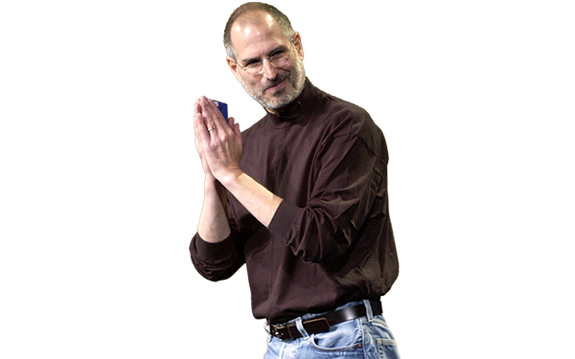
Meet with Disgruntled Customers
Witnessing the operational disaster isn’t enough
You need to speak with Disgruntled employees

