Slide 1
Summary of Lessons Learned
Team 2
By: Alicia Amodeo, Jared Coronado, Reed Harman, Jason Guevara and Jessica Stoddard

Slide 2
Chapter 7 BOS
Overcome Key Organizational Hurdles

Slide 3
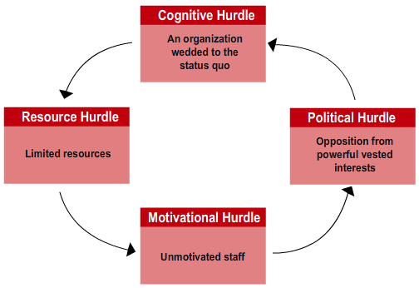
Managers Face 4 Hurdles
Cognitive Hurdle
Resource Hurdle
Motivation Hurdle
Political Hurdle

Slide 4
Tipping Point Leadership
Fundamental changes can happen quickly when beliefs and energies of critical mass of people create epidemic movement toward change
Realizing that People, Acts, and Activities exercise a disproportionate influence on performance.
All about conserving resources and cutting time by identifying and then leveraging these disproportionate influence factors to execute a blue ocean strategy.

Slide 5
Breaking Through Cognitive Hurdles
Ride the “Electric Sewer”
Numbers are disputable but coming face-to-face with poor performance is shocking and actionable.
Only 3% of major crimes occurred in the subway
Meet with Disgruntled Customers
Actively observe the market firsthand
Town hall meeting with officers and neighborhood residents filled gaps in perceptions. “Broken Windows” strategy was born.

Slide 6
Jump the Resource Hurdle
Tipping point leaders leverage 3 factors to free up resources and multiply resource value
Hot Spots - redistribute resources
Activities with low resource input but high potential performance gains
ex) NY subway policing
Cold Spots - redirect resources
Activities with high resource input but low performance impact
ex) “Bust buses”
Horse Trading - skillfully trade resources
Trading excess resources
ex) Office space for patrol cars

Slide 7
Jump the Motivational Hurdle
Tipping point leaders focus on 3 factors in motivating employees in a strategic shift
Kingpins - key influencers in the organization
Identify and motivate these natural leaders to trigger movement of the masses.
ex) 76 precinct heads, 36,000+ police force
Fishbowl Management
Spotlight actions and inactions with transparency, inclusion, and fair process.
ex) biweekly crime review meeting, mandatory attendance, level playing field
Atomization
Frame the challenge as attainable by breaking it into bite-size, relatable atoms.
ex) “block by block, precinct by precinct, borough by borough

Slide 8
Knock Over the Political Hurdle
Powerful vested interests will resist changes so tipping point leaders focus on 3 disproportionate influence factors
Leveraging Angels - who will gain and align?
Don’t fight alone, identify supporters, look for win-win solutions
Silencing Devils - who will lose and fight?
Know likely angles of attack, build counterarguments on irrefutable facts and reason
ex) NY city’s courts
Bring a Consigliere to Top Management Team
Politically adept, highly respected insider
ex) John Timoney, a cop’s cop

Slide 9
How AT&T is becoming a software company
https://youtu.be/BR6nxcKaMX0
Visualized the problem, paid attention to customer demands.
Horse trading with subsidiaries to meet strategic goal of becoming a software company.
Knows who the kingpins are, Celebrates them on National Innovation Day.
Made clear the expectations of the company for 2020.
Proven to employees that the goal is attainable with actual progress.

Slide 10
Chapter 8 BOS
Build Execution into Strategy

Slide 11
Build Execution
A company is everyone from top management to the front lines
You need trust and commitment to motivate your employees
Fair process is key

Slide 12
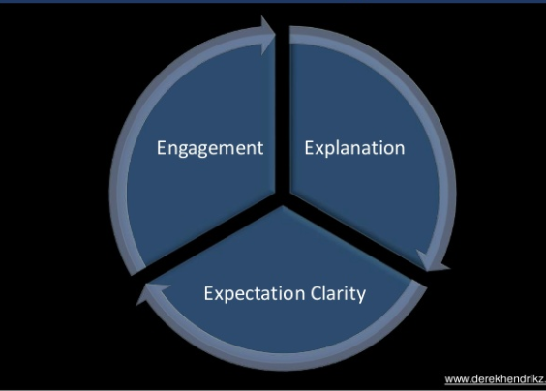
3 Principles of Fair Process

Slide 13
Emotional and Intellectual Recognition
Emotional:
Individuals want recognition for their value
Respect and Dignity
Intellectual:
Ideas are given thoughtful reflection
Actually being recognized for their worth

Slide 14
“We know diverse, talented and dedicated individuals are critical to our success, so we look for people from various background and give them opportunities to grow”
AT&T’s Inclusive Work Environment

Slide 15
Chapter 8 CES
Corporate Strategy

Slide 16
Chapter 8 CES: Corporate Strategy
When and how business diversification can enhance shareholder value
How related diversification strategies can produce cross-business strategic fit capable of delivering competitive advantage.
The merits and risks of unrelated diversification strategies
Analytic tools for evaluating a company’s diversification strategy.
Four main strategy options for solidifying strategy and improving performance.

Slide 17
Diversification Strategy
Picking New Industry/ Means of entry
Leveraging cross-business value chain relationships
Establish investment priorities/allocate corporate resources
Initiate actions to boost performance business collection

Slide 18
Tests of Corporate Strategy
The industry attractiveness test
Compare Industries
The Cost of entry test
Too difficult to enter?
The better-off test
synergy

Slide 19
Approaches to Diversifying Business Lineup
Diversifying by Acquisition
New Line of Business through Internal Development
Joint Ventures to Achieve Diversification
How to Choose?

Slide 20
Diversifying Related vs Unrelated Business
Related Businesses
Related fit across corresponding value chain
Unrelated Businesses
Dissimilar value chain and Resource Requirements

Slide 21
Related Business: Strategic Fit along Value Chain
How Strategic fit exists in value chains
Supply Chain Activities
R&D and Technology Activities
Manufacturing-Related Strategic Fit
Sales and Marketing Activities
Distribution-Related
Customer Service Activities

Slide 22
Strategic Fit, Economies of Scope, Competitive Advantage
Related diversification is an attractive strategy because the opportunity to convert cross-business strategic fit into a competitive advantage over business rivals.
Economies of Scope
Stem directly from strategic fit along the value chains of related businesses.
Competitive Advantage
Added Profitability
Gains in Shareholder value

Slide 23
Evaluating the Strategy of a Diversified Strategy
6 steps:
1.Evaluating Industry Attractiveness
2.Evaluating Business Unit Competitive Strength
3.Determining the competitive value of strategic fit in Diversified companies
4.Checking for Resource Fit
5.Ranking business units and assigning a priority for resource allocation
6.Crafting New Strategic moves to improve overall corporate performance

Slide 24
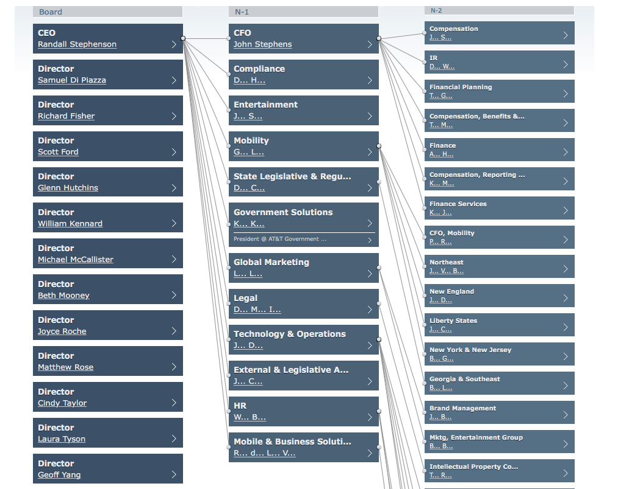
AT&T’s Organizational Structure
AT&T’s structure is based off of a Multidivisional structure.

Slide 25
AT&T’s Competitors’ Organizational Structure
Some of our competitors also follow the same Organizational Structure as AT&T.
They also have the same corporate structure with the Functional Structure set up.
These organizations also follow a more centralized flow of authority.

Slide 26
Chapter 9 CES
Ethics, Corporate Social Responsibility, Environmental Sustainability, and Strategy

Slide 27
WHAT IS THE MAIN CONCEPT OF BUSINESS ETHICS ?
Business ethics
Deals with the application of general ethical principles to the actions and decisions of the business and the conduct of their personnel.

Slide 28
BUSINESS ETHICAL STANDARDS Vs. SOCIETIES ETHICAL STANDARDS
Ethical principles in business should not materially be different from the general principles of the public.
Business actions have to be judged in the context of society’s standards.

Slide 29
ETHICAL STANDARDS FOR COMPANIES WITH INTERNATIONAL OPERATIONS
School of ethical universalism
The understandings of multiple cultures about what is deemed as right and wrong behaviors that give rise to universal ethical standards.
School of ethical relativism
Different societal cultures and customs have divergent values and standards of right and wrong. These are judged by the local customs, thus varying from culture to culture.
Integrated social contracts theory
This theory explains how there is a contract between collective views of multiple cultures and societies.

Slide 30
DRIVERS OF UNETHICAL BUSINESS STRATEGIES AND BEHAVIOR
The main drivers that contribute to unethical behavior
-Faulty oversight
-Heavy pressure on managers
-Company culture that puts profitability above all else

Slide 31
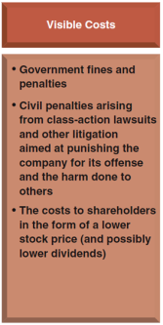
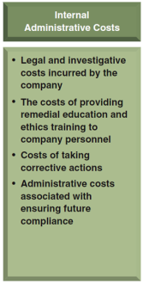
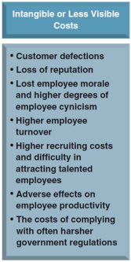
THREE TYPES OF COSTS THAT RESULT IN BUSINESS ETHIC FAILURES

Slide 32
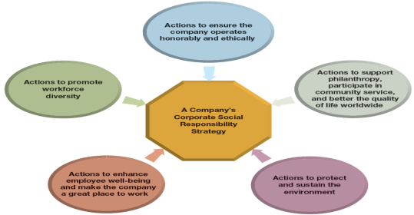
The Five Components of a Corporate Social Responsibility Strategy

Slide 33
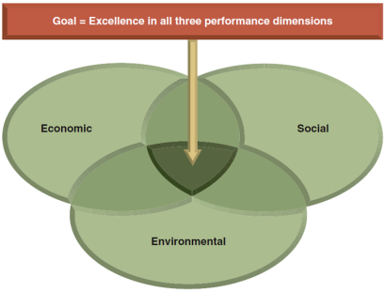
CORPORATE SOCIAL RESPONSIBILITY AND THE TRIPLE BOTTOM LINE

