Slide 1
Summary of Lessons Learned
Team 7
Gabrielle Ruffeno, Mason Harkins, Zane Cox, Daniel Galva, Bo Adeyeye

Slide 2
CES: Chapter 1
What is Strategy and Why is it Important?
Competing Differently
Outperforming competitors
Boeing, Raytheon, General Dynamics
Quest For Competitive Advantage →
Goal = Sustainability
Strategy Evolves Over Time
Willingness to modify strategy; proactive and reactive responses
Low-cost provider
Broad differentiation
Focused low-cost
Focused differentiation
Best-cost provider

Slide 3
CES: Chapter 1
What is Strategy and Why is it Important?
A Winning Strategy
Fit (external, internal and dynamic consistency)
Competitive Advantage ( durable competitive advantage)
Performance ( outstanding financial and market performance)
Competitive strength & market standing
Profitability & financial strength

Slide 4
CES: Chapter 2
Charting a Company’s Direction
Developing a Strategic Vision
Lockheed Martin Mission: We solve complex challenges, advance scientific discovery and deliver innovative solutions to help our customers keep people safe.
Lockheed Martin Vision: Be the global leader in supporting our customers' missions, strengthening security and advancing scientific discovery.
Lockheed Martin Values:
Do What's Right
Respect Others
Perform With Excellence

Slide 5
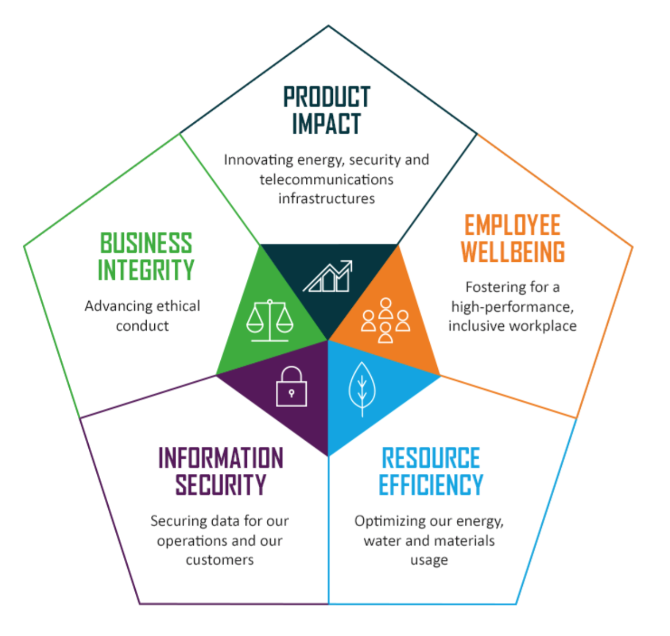
CES: Chapter 2
Charting a Company’s Direction
Setting Objectives
Financial objectives & Strategic objectives
Short term and long term objectives
“How much of what kind of performance by when”

Slide 6
CES: Chapter 2
Charting a Company’s Direction
Crafting a Strategy
Corporate Strategy
Business Strategy
Functional Areas Strategy
Operating Strategies
The combination of these 4 strategies create the hierarchy of the organization

Slide 7
CES: Chapter 2
Charting a Company’s Direction
Execute Strategy and Evaluate Performance
Execute → converting the strategic plan into action
Evaluate performance → assess the success of the strategic plan and potentially reconsider the company’s vision, mission, strategy and objectives

Slide 8
BOS Chapter 2: Analytical Tools and Frameworks
Strategy Canvas - Both a diagnostic and an action framework for a blue ocean strategy.
When it comes to Lockheed Martin’s Strategy Canvas we are a company who creates innovative technology to solve tomorrow's problems.
Lockheed Martin’s framework focuses on producing the most advanced technology that our clients face but we also look on how to improve our on technologies and our competitors technologies.
Due to Lockheed Martin’s market space we must find ideas that are innovative and outside the box to outdo our competitors in the current state of play.

Slide 9
BOS Chapter 2: Analytical Tools and Frameworks
Lockheed Martin’s Four Actions Framework - elements in crafting a new value curve.
Reduce
Lockheed Martin needs to reduce their NASA cargo shipment Program to the International Space Station
Eliminate
Lockheed Martin needs to eliminate the F-22 airplane for economical reasons.
New Value Curve
Create
Lockheed Martin has created the F -35 Airplane.
Raise
Lockheed Martin needs to improve on their unmanned aircraft (drones).

Slide 10
BOS Chapter 2: Analytical Tools and Frameworks
Three Characteristics of a good strategy
Lockheed Martin’s focuses on technologies that protect our client's interest, the most advanced technologies, and technologies that will last for years to come.
Lockheed Martin is able to diverse ourselves from the competition by being innovative, simplifying complex challenges, and producing products that last.
“We never forget who we’re working for”

Slide 11
BOS Chapter 2: Analytical Tools and Frameworks
Reading The Value Curves
A Blue Ocean Strategy - Focus, Divergence, and a compelling tagline
A Company Caught in the Red Ocean - Value Curve should not resemble their competition
Overdelivery without Payback - Strategy Canvas should not signal over supplying or add incremental value to buyers
Strategic Contradictions - A company should not offer one high level competing factor while ignoring other factors
An Internally Driven Company - A company needs to be use language that shows they are internally driven to create industry demand

Slide 12
Chapter 3: Evaluating a company’s external Environment
In order to evaluate a company’s strategic course Managers must:
Evaluate the company’s external environment.
Evaluate the company’s internal environment.

Slide 13
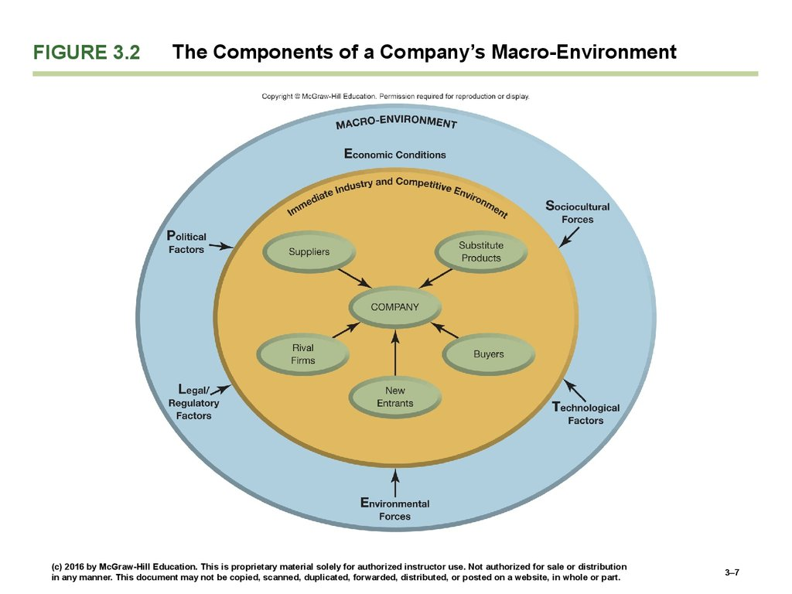
Macro Environment
Political factors
Legal/regulatory Factors
Environmental Forces
Technological Factors
Sociocultural Forces
Economic Conditions

Slide 14
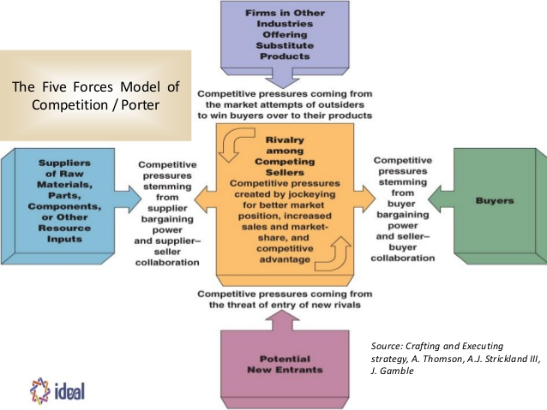
The Five Forces Model of Competition

Slide 15
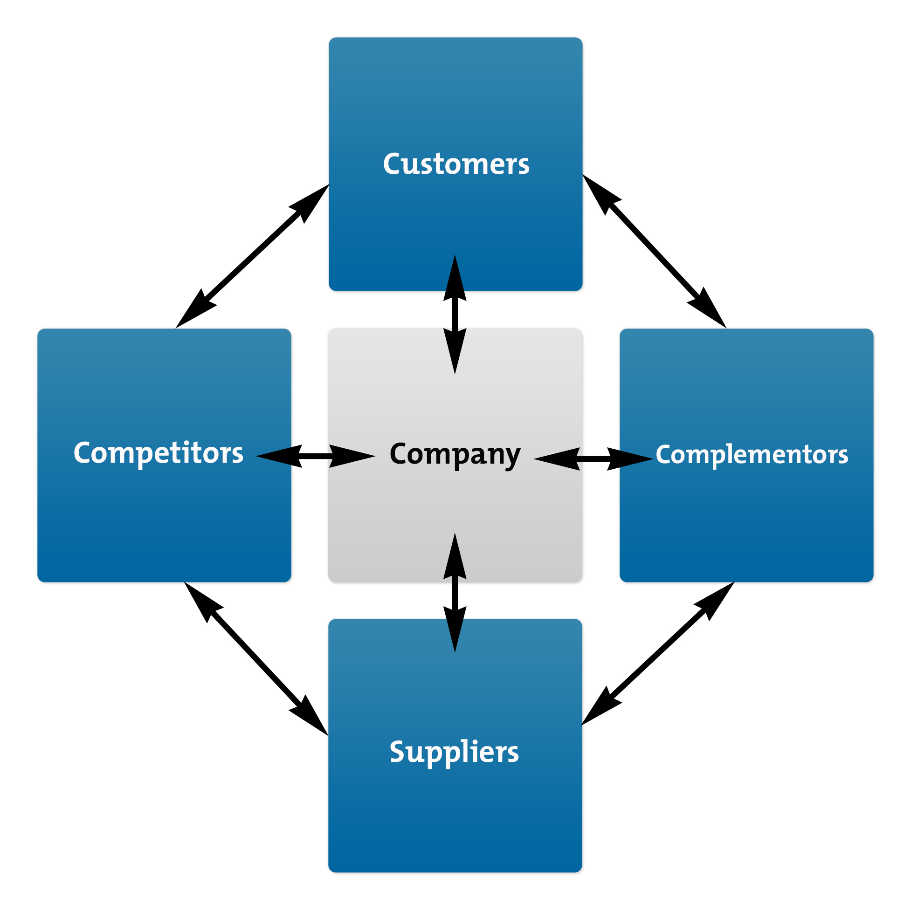
The Value Chain
Interactions with firm
Complementors

Slide 16
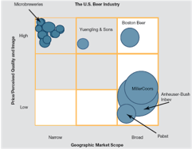
Strategic group map

Slide 17
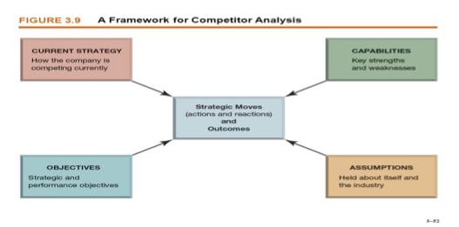
Competitor Analysis
Target a rivals likely moves and countermoves
Current Strategy
Objectives
Resources and capabilities
Assumptions

Slide 18
Key Success Factors
KSF’s determines whether the company will be a competitive success or failure.
Knowing the Industries KSF’s raises a company’s chance of crafting a sound strategy.

Slide 19
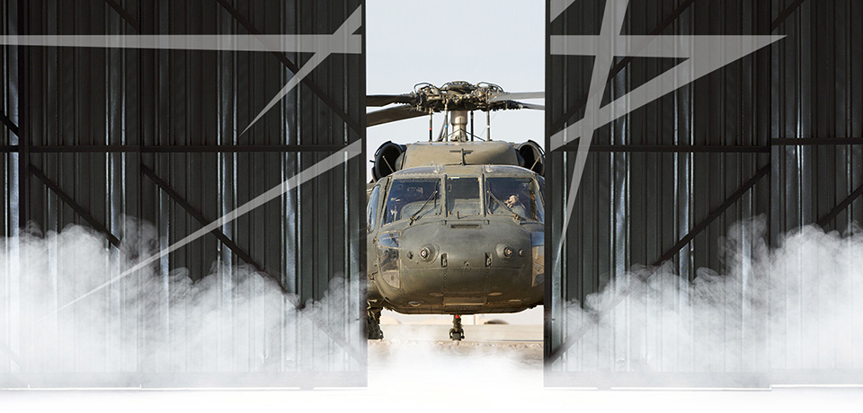
Lockheed Martin Acquires Sikorski

Slide 20
Chapter 4
Evaluating a Company’s Resources,Capabilities,and Competitiveness.
Focus in this Chapter is on the Internal Capabilities of a firm
Answering these 6 different questions will give you an idea of how well your company will compete.

Slide 21
Question 1:
How well is the Company’s present strategy working?
Is the company meeting the financial goals?
Is the company gaining market share?
If the answer is yes how well are they meeting these goals?

Slide 22
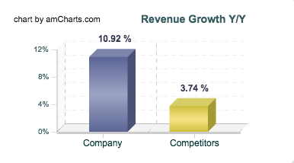
Lockheed Martin
“Comparing the results to its competitors, Lockheed Martin reported Total Revenue increase in the 2 quarter 2016 by 10.92 % year on year. The sales growth was above Lockheed Martin's competitors average revenue growth of 3.74 %, recorded in the same quarter.”
http://csimarket.com/stocks/compet_glance.php?code=LMT

Slide 23
Question 2:
What are the company’s most important resources and capabilities,and will they give the company a lasting competitive advantage over rival companies?
What resources and capabilities does your firm have that others don’t?
Tangible & intangible
VRIN Tests for competitive advantage.
Valuable (competitively valuable)
Rare (something rivals lack)
Inimitable (hard to duplicate)
Non-Sustainable (doesn’t have substitutes)

Slide 24
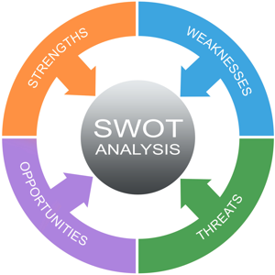
Question 3:
What are the company’s Strengths and Weaknesses in relation to the market opportunities and market threats?
SWOT Analysis

Slide 25
Question 4:
How do a company’s value Chain activities impact its cost structure and customer value propositions?
Marillyn Hewson (CEO) -“Cost reductions, improved operational efficiency, and portfolio restructuring have made us a leaner, more agile, and more focused company,”

Slide 26
Question 5:
Is the Company Competitively Stronger or weaker than key rivals?
Does the Company have a competitive advantage or disadvantage?
How well does your company incorporate Key success factors?

Slide 27
Question 6:
What Strategic issues and problems merit front-burner managerial attention?
Identify the key issues that Management needs to assess in order to get the company in a position to excel over rivals.

Slide 28
Chapter 1
Creating Blue oceans
Value Innovation
Red Vs Blue Ocean Strategies
Examples

Slide 29
Value Innovation
The pursuit of low cost and differentiation
Balance of Value and Innovation
Strategy and approach are very important

Slide 30
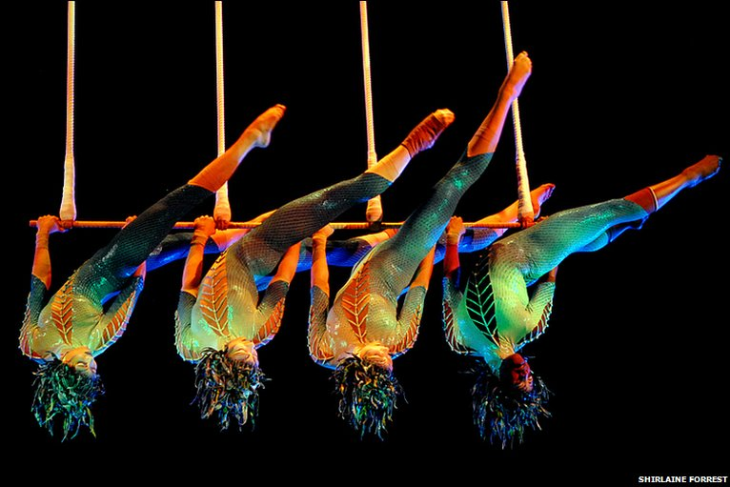
Cirque du Soleil

Slide 31
Red Vs. Blue Ocean Strategy
Red Ocean Strategy | Blue Ocean Strategy
Compete in existing market space | Create uncontested market space
Beat the competition | Make the Competition irrelevant
Exploit Existing demands | Create and capture new demand
Make the value cost tradeoff | Break the value-cost trade-off
Align the whole system of a firm’s activities with its strategic choice of differentiation OR low cost | Align the whole system of a firm’s activities in pursuit of differentiation AND low costs

Slide 32
BOS Chapter 3: Reconstruct Market Boundaries
Reconstruct Market Boundaries is the first principle of Blue Ocean Strategy.
There are 6 important paths that play a huge role in the reconstruction of Market Boundaries.

Slide 34
BOS Chapter 3: Reconstruct Market Boundaries
SIX Important Paths
Look Across Alternative Industries
Look Across Strategic Groups Within Industries
Look Across the Chain of Buyers
Look Across Complementary Product and Service Offerings
Look Across Functional or Emotional Appeal to Buyers
Look Across Time

