Slide 1
Reconstruct Market Boundaries
Blue Ocean Strategy
Ch 3
Group 6

Slide 2
Red Ocean Constraints
Define their industry similarly and focus on being the best within it
Look at their industries through the lens of generally accepted strategic groups and try to stand out in strategic groups they play in
Focus on the same buyer group
Define the scope of the products and services offered by their industry similarly
Accept the industry’s functional or emotional or orientation
Focus on the same point in time in formulating strategy

Slide 3
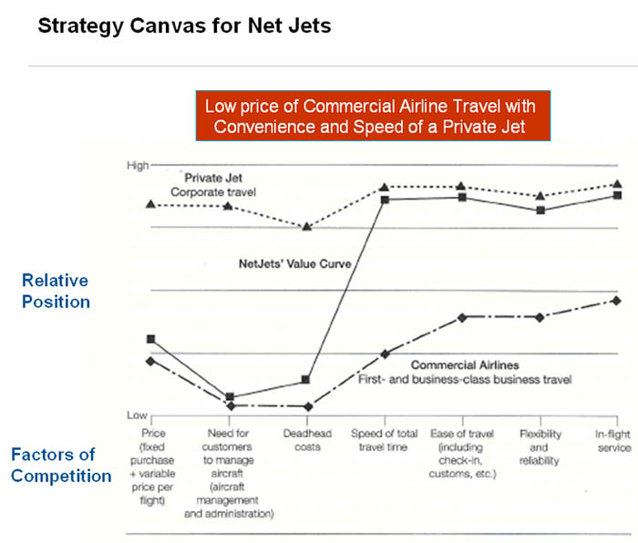
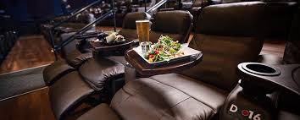
Path 1: Look Across Alternative Industries
Alternatives vs. Substitutes
Space in between provides opportunity for value innovation

Slide 4
Path 2: Look Across Strategic Groups Within Industries
Generally 2 dimensions
Price and Performance
Champion
http://www.championhomes.com/commercial
GM
Chevy, Volt, Bolt

Slide 5
Path 3: Look across the chain of buyers
In most industries, competitors agree who the target buyers are
Chain of buyers
Purchasers
Users
Influencers
Focus on a single buyer group

Slide 6
Novo Nordisk
Insulin producer
1980s purification technology improved insulin
Shifting focus from doctors to the user
Creation of the Novo-Pen, Novolet, and Innovo
30 years later mains the global leader in diabetes care

Slide 7
Path 4: Look across complementary product and service offerings
What is the context in which your product or service is used?
What happens before, during, and after?
Can you identify the pain points?
How can you eliminate these pain points through a complementary product or service offering?

Slide 8
NABI- bus manufacturers
Major Industry Customers: municipally owned transportation companies
Accepted Rules: offering the lowest purchase price
Problem:
Designs outdated, delivery times late, quality low
Discovery:
Complementary activity of maintenance and life-cycle costs
Solution: Fiberglass
Faster, cheaper, easier repairs, lighter weight, environmentally friendlier,
=>life cycle costs lower

Slide 9
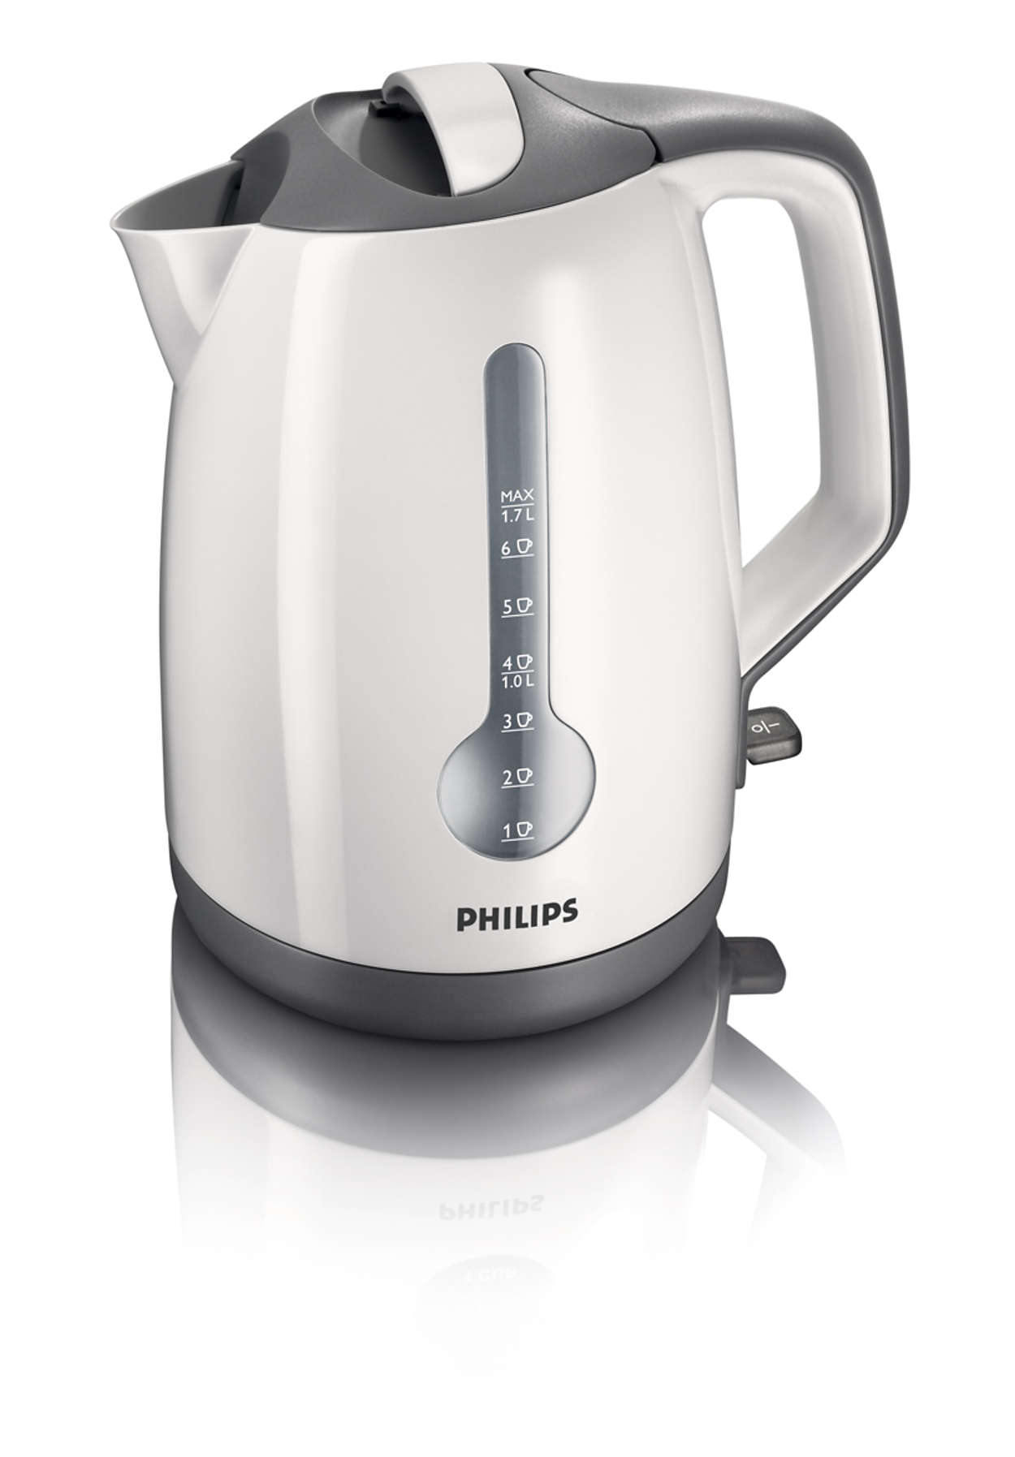
British Tea Kettle Industry
Important to British culture yet flat sales and shrinking profit margins
Philips Electronics Solution
Thought of complementary products to teakettle
Discovered the biggest issue was not the kettle
Saw the opportunity to recreate the kettle
Led to replacement of old kettles

Slide 10
Path 5: Look Across Functional or Emotional Appeal
Functionality focuses on efficiency, practicality
Emotional appeal makes the customer feel good

Slide 11
Quick Beauty and Cemex
QB focused on emotional appeal instead of functionality
Cemex found a way to make buying cement a celebration within a culture

Slide 12
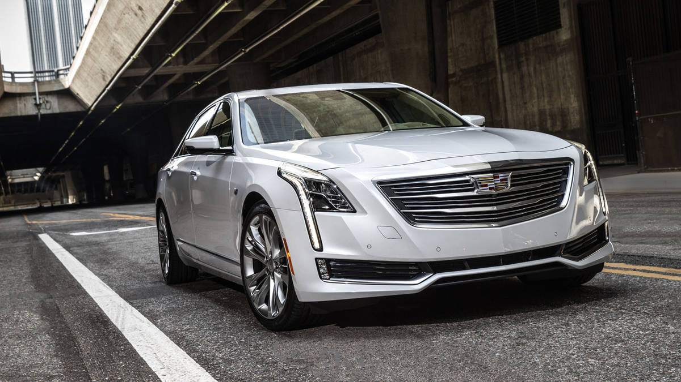
GM: Finding Balance
In the car industry, it is important to find a balance between functionality and emotional appeal
Cars must be both attractive and practical

Slide 13
Path 6: Look Across Time
New trends are always emerging
Focus is not about predicting the future, but recognizing these trends

Slide 14
iTunes and Netflix
iTunes recognized the trend in streaming music and capitalized on it
Netflix did the same thing with streaming video

Slide 15
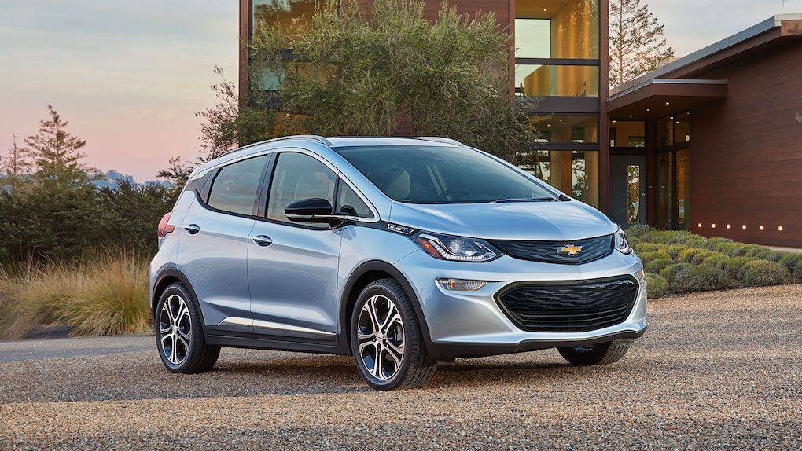
The EV Trend and the Chevy Bolt

Slide 16
Conclusion
Blue oceans can be created many different ways
It is important to always innovate

