Slide 1
Building an Organization Capable of Good Strategy Execution
Chapter 10 CES
Team 7
Adam Stroem, Giselle Luna, Jack Kelley,
Henry Hilla, William Brunner, William Wendt

Slide 3
Introduction
Strategy --> actions and good results (strategy execution)
Crafting a strategy
Analysis-driven
Executing a strategy
Operations-driven
Action-oriented
Make-things-happen task

Slide 4
Overview of Chapter 10
A Framework for Executing Strategy
Three Key Actions
Staffing the Organization
Developing and Building Critical Resources and Capabilities
Matching Organizational Structure to the Strategy

Slide 5
A Framework for Executing Strategy
Must be customized to fit particular situation
Minor improvements vs. radical change
No "one size fits all"
Specific actions required always represent management's judgement

Slide 6
Principal Components of the Strategy Execution Process
Staffing with capable employees and managers
Developing resources and organizational capabilities
Creating a strategy-supportive organizational structure
Allocating sufficient resources to strategy execution effort
Instituting policies and procedures that facilitate strategy execution

Slide 7
Three Key Actions
Staffing the organization
Strategy-supportive resources and capabilities
Acquiring, developing, and strengthening key resources and capabilities
Structuring the organization and work effort
Strategy-supportive organizational structure

Slide 8
Three Key Actions
Staffing the organization
Put together a strong management team
Clear thinkers, great people skills
Recruit/retain talented employees
Why let go of the workers that are helping you succeed?
Google, Mercedes-Benz, Boston consulting group

Slide 9
Three Key Actions
Acquiring, developing, and strengthening key resources and capabilities
Develop set of resources/capabilities for current strategies
Update as external conditions/strategy changes
Train/retrain employees to keep the knowledge level high
Honda, frequent re-forming high intensity teams

Slide 10
Three Key Actions
Structuring the organization and work effort
Establish lines of authority and reporting relationships
Decide how much decision-making authority to delegate
Be balanced, not everyone can have authority

Slide 11
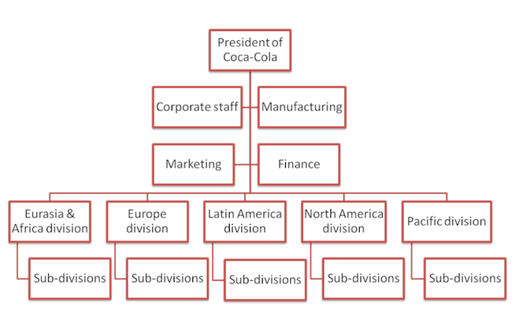
Staffing the organization
Building a strong management team
Recruiting
Training
Retaining

Slide 12
Building a strong management team
Having timely thinking people that are goal oriented
Have a clear understanding of the industry
Being able to understand change

Slide 13
Recruiting, Training, Retaining
Recruiting
Done at the local branch manager level, partnership with the military
Training
Coca-Cola University, Management trainee program
Retaining
Unlimited Opportunities, Employee benefits

Slide 14
Principal Components of the Strategy Execution Process (continued)
Adopting best practices and processes to drive continuous improvement
Installing information and operating systems that enable personnel to carry out strategic roles
Offering incentives directly to achievement of targets
Instilling corporate culture that promotes good strategy execution
Exercising internal leadership needed to propel strategy implementation

Slide 15
Developing & Building Critical Resources and Capabilities

Slide 16
3 Approaches
Developing Capabilities Internally
Acquire Capabilities through Mergers & Acquisitions
Accessing Capabilities through Collaborative Partnerships

Slide 17
Develop Internally
Management sets an objective
Firm must have the ability to do something
Trial & error, recruiting certain skills and expertise
Incremental and experimental progress
Continually invest in resources and systematic efforts
Training: Learning by Doing

Slide 18
Mergers & Acquisitions
Acquire through Mergers & Acquisitions
Capabilities- motivated acquisitions are essential when...
Company does not have the ability to create internally
Environment is advancing at such a rapid pace, time is of the essence

Slide 19
Collaborative Partnerships
Access through collaborative partnerships by...
Outsource the Function
Collaborate with a firm that has complimentary resources and capabilities and a shared objective
Engage in collaborative partnerships for the purpose of learning how the partner does things, internalize the method, thereby acquiring the capabilities

Slide 20
Matching Organizational Structure to the Strategy
Deciding which Value Chain Activities to Perform Internally and Which to Outsource
Improves chances for outclassing rivals
Advantages of outsourcing
Partnerships can contribute to better execution of Strategy

Slide 21
Aligning the Firm's Organizational Structure with Its Strategy
Main Building Blocks of Organizational Structure
How to Decide what Strategy-Critical Activities are Most Critical
Matching Structure to Requirements
Simple, Functional, Multidivisional, and Matrix Structures

Slide 22
Determining How Much Authority to Delegate
Centralized Decision Making
vs.
Decentralized Decision Making
Top executives retain authority for most strategic and operating decisions.
Decision-making authority is pushed down to the lowest organizational level.

Slide 23
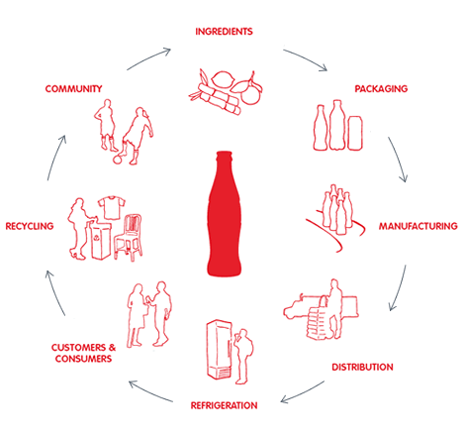
External Partners and Strategic Allies
Bridge-Building that Leads to Productive Working Relationships
Appointing "Relationship Managers"
The Importance of a Network Structure

Slide 24
Conclusion
Strategy execution
Identify what to do differently and then how
Team effort
Building an organization
Three key actions
Building core competencies and competitive capabilities
Three different approaches
Structuring the organization

Slide 25
Thank you!

