Slide 1
The 5 Generic Competitive Strategies
Team 2 Section 003
Jared Coronado, Reed Harman, Jason Guevara, and Alicia Amodeo

Slide 2
Game Plan For Competing Successfully

Slide 3
Please Customers
Strengthen Market Position
Counter the Maneuvers of Rivals
Respond to Shifting Market Conditions
Achieve Competitive Advantage
Game Plan For Competing Successfully

Slide 4
2 Factors Distinguish 5 Competitive Strategies
Broad Market
Vs.
Narrow
Market
Lower costs
Vs.
Differentiation

Slide 5
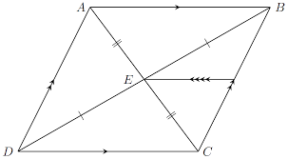
Broad Differentiation Strategy
Low-cost Provider Strategy
Best-cost Provider Strategy
Focused Low-cost Strategy
Focused Differentiation Strategy

Slide 6
Distinguished Features of the 5 Competitive Strategies
Strategic intent
Basis of competitive strategy
Product line
Production emphasis
Marketing emphasis
Keys to maintaining the strategy
Resources and capabilities required

Slide 7
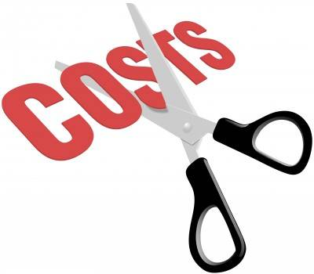
Low Cost Provider Strategies
Low-Cost Leadership has 2 options
One is to lower-cost edge to underprice competitors.
Two is to maintain present price

Slide 8
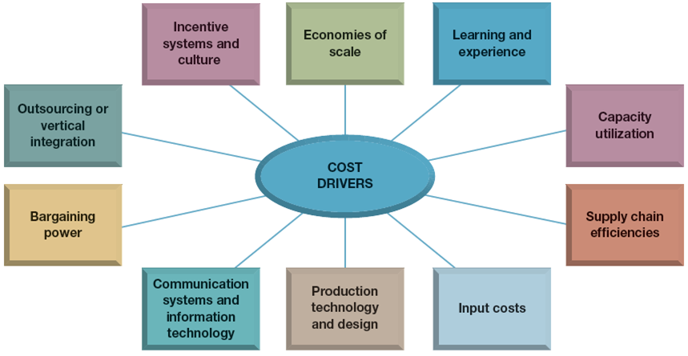
Two Major Avenues for Achieving Cost Advantage
Perform Value Chain activities more cost effectively
Revamp the Firm’s overall value chain to bypass cost producing activities
Cost Efficient Management of Value Chain
Cost Drivers

Slide 9
Revamping the Value Chain system to lower costs
Selling Direct to consumers & bypassing the activities & costs of distributors & dealers.
Create own direct sales force
Conduct sales operations at the company’s website
Streamlining Operations by eliminating low-value added or unnecessary work steps and activities.
Reducing materials handling and shipping costs
We design and manufacture the highest quality product on the rental market, with an exceptional fit and a seamless experience. Our suits would retail for $1200, but we offer them starting at $95.

Slide 10
Keys and Pitfalls of a Low-Cost Provider Strategy
Keys:
Champions of frugality, they seldom hesitate to spend aggressively….
Ensuring that they remain competitively superior.
Pitfalls:
Overly aggressive price cutting
Relying on an approach to reduce costs that can be easily copied by rivals
Becoming too fixated on cost reduction

Slide 11
When a Low-Cost Provider Strategy Works Best
Price Competition among rival sellers is vigorous
Products of rival sellers are identical and readily available from many eager sellers.
Difficult to achieve product differentiation in ways that have value to buyers
Most buyers use the product in the same ways
Buyers incur low costs in switching their purchases from one seller to another

Slide 12
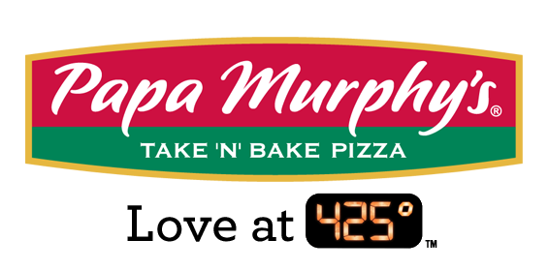
Focused Low-Cost Strategy
Based on low cost aims, securing a competitive advantage by serving buyers in a target market niche
Lower cost and Lower Price
Lowering Cost significantly by limiting its customer base to well-defined market segment.
Innovative ways to bypass nonessential activities
Only Real difference is the size of the buyer group.

Slide 13
Broad Differentiation strategies
Offer unique product attributes.
Appeal to a wide range of buyers
Make the product appealing and worth buying
Offer superior services.

Slide 14
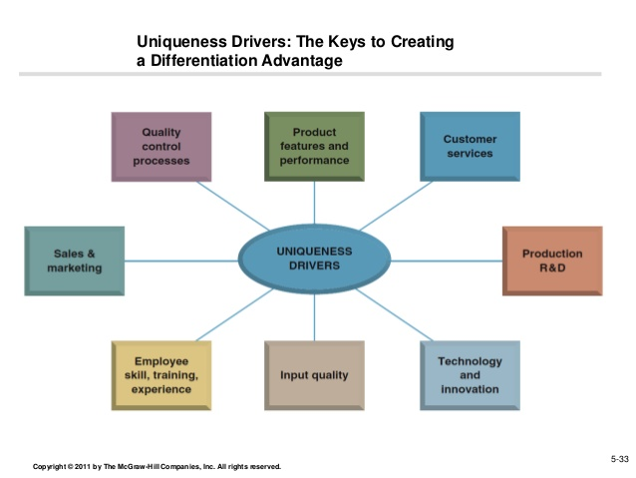
Creating Differentiating Attributes in the value chain
Managing the Value chain to create differentiating attributes.
Value Drives (unique drivers)
Increase differentiation by revamping the value chain.
Using differentiation to gain a competitive advantage and increase profitability.

Slide 15
Revamping the Value chain to increase Differentiation
There are opportunities that lie within a company’s value chain that can help differentiate themselves.
Coordinating with channel allies to enhance customer value
Coordinating with suppliers to better address customer needs.
Texas grown that comes from the heart of texas.
Texas made for quality satisfaction.

Slide 16
When a differentiation strategy works best and pitfalls to avoid when pursuing differentiation
Differentiation strategies tend to work best in markets where:
Buyers needs and uses of the product are diverse
There are many ways to differentiate the product or service that have value to buyers
Few rival firms are following a similar differentiation
Adapting to technological changes.
3 Pitfalls
The strategy is easily copied.
Buyers recognize little value or uniqueness
Overspending on efforts to differentiate

Slide 17
A Focused Differentiation Strategy
A focused differentiation strategy needs a buyer segment that is looking for
Special product attributes
Seller capabilities
2. The firm must stand apart from rivals competing in the same target market niche

Slide 18
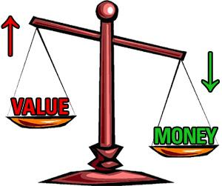
Best-Cost Provider Strategy
Middle ground between a low-cost strategy and a differentiation strategy
Value for their money
Resources and capabilities
The target market is a value-conscious buyer

Slide 19
When a Best-Cost Provider Strategy Works
Position itself in the middle of the market
Works well in 2 ways
When differentiation is the norm
During a recessionary time

Slide 20
The Risk of a Best-Cost Provider Strategy
It’s not solely a low-cost strategy and not solely a differentiation strategy

Slide 21
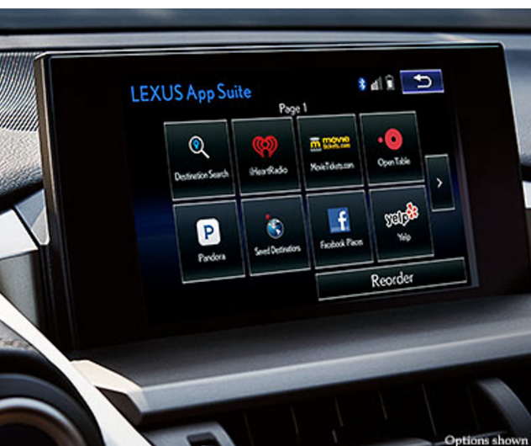
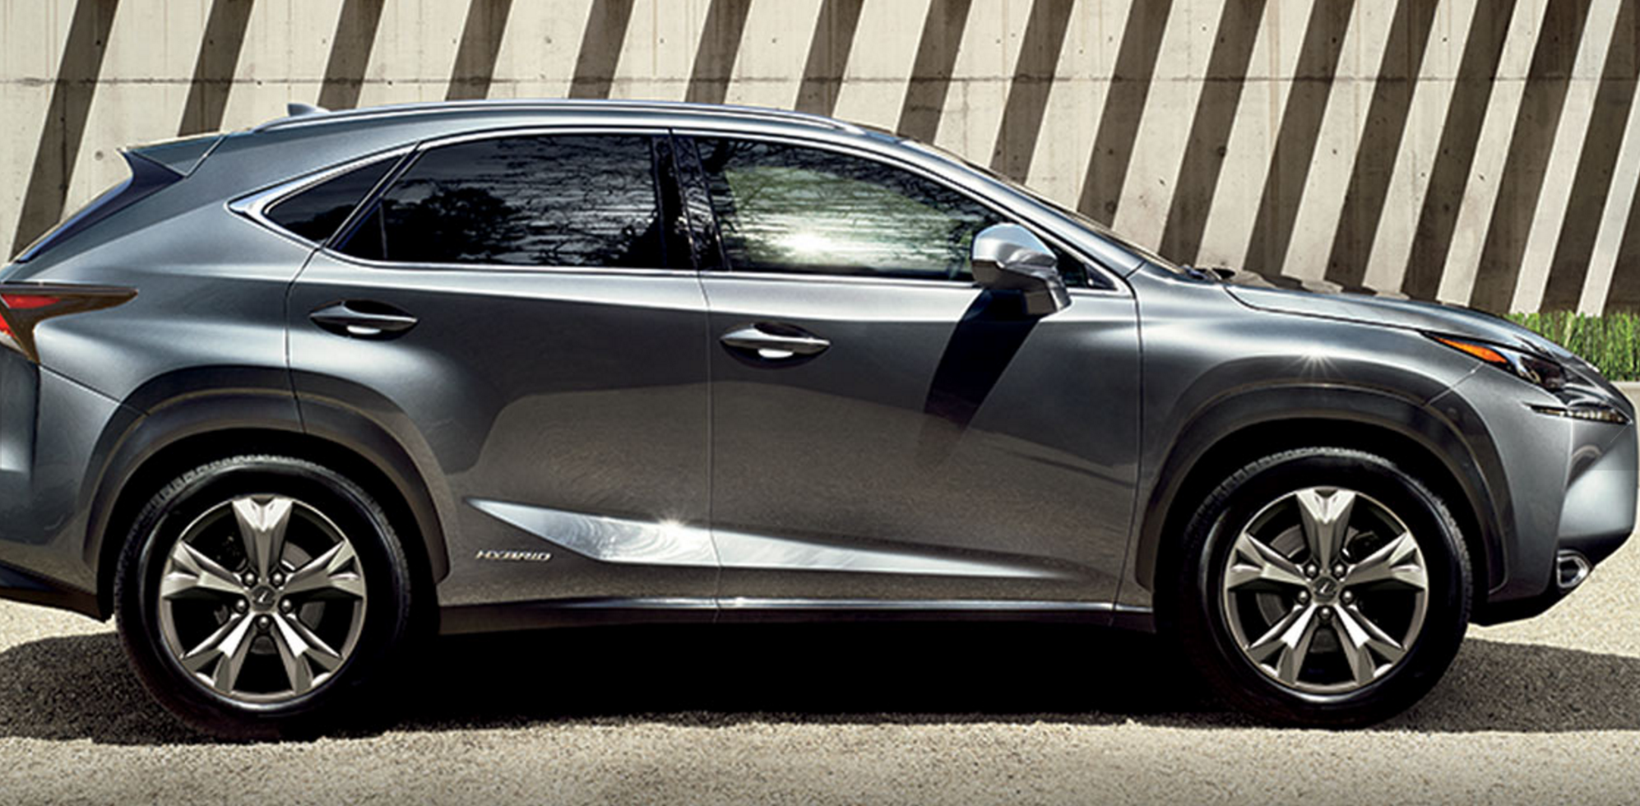
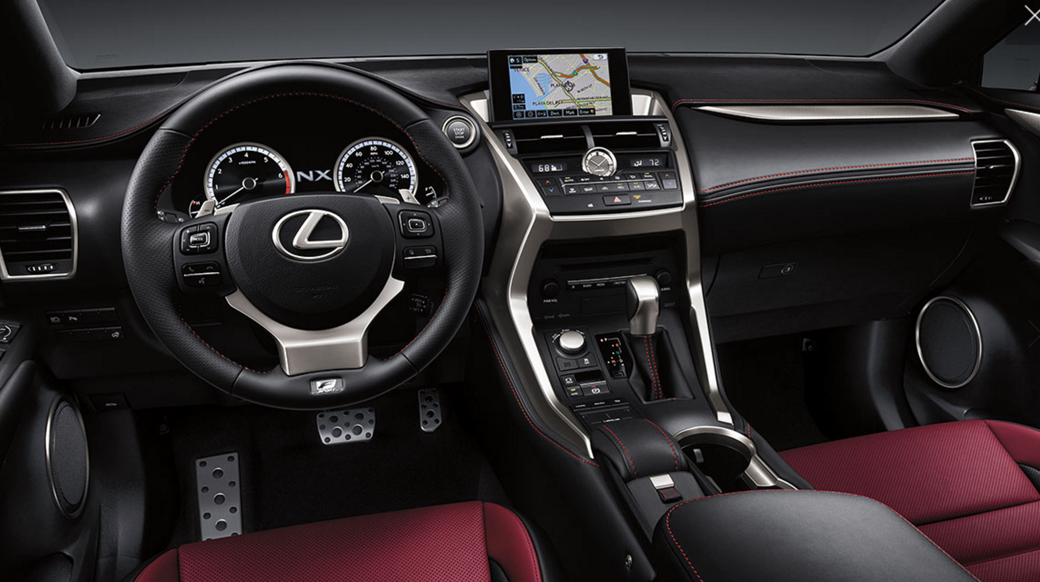
Toyota’s Best-Cost Provider Strategy for its Lexus line
Toyota is normally a low-cost provider
The steps Toyota took in crafting and implementing a best-cost strategy
Best selling luxury car brand worldwide from 1999-2010

