Slide 1
Blue Ocean Strategy:
Nike Ch-1
By Alex Jouganatos, Matthew Pastrano, Shawnee Moreland, and Mami Yamamoto

Slide 2
How We Define Blue Oceans
Uncontested Market Space
Characterized by new demand
Strong profitable growth
“The only way to beat the competition is to stop trying to beat the competition”

Slide 3
New Market Space
To understand how companies achieve success due to their innovativeness, we must first imagine the market place as two separate oceans: Red and Blue.
Blue Oceans we introduced on the previous slide, but they are untapped industries in the market today.
Red Oceans on the other hand are the industries already in existence.
For Nike, they are the first company to provide consumers with athletic hijabs for Muslim, women athletes and self lacing sneakers that adapt to the wearers feet.

Slide 4
Continuing Creation of Blue Oceans
Past Blue Oceans: 40 years ago industries such as e-commerce, cell phones, laptops, routers, switches, networking devices, gas-fired electricity plants, biotechnology, discount retail, express package delivery, minivans, snowboards, and coffee bars did not exist in a meaningful way.
Looking towards the future think of how many unknown industries will exist in 20 years
There is a continuous cycle of industries being born and industries dying. Operations improve, markets expand, industries evolve, and players come and go.

Slide 5
Impact of Creating Blue Oceans
Out of 108 companies, it was found that 86% of launches were incremental improvements within the red ocean market places.
These launches also accounted for only 62% of revenue and 39% of total profits.
The remaining 14% of launches were aimed at creating Blue Oceans and they generated 38% of total revenue and 61% of total profits.

Slide 6
Nike Mission Statement

Slide 7
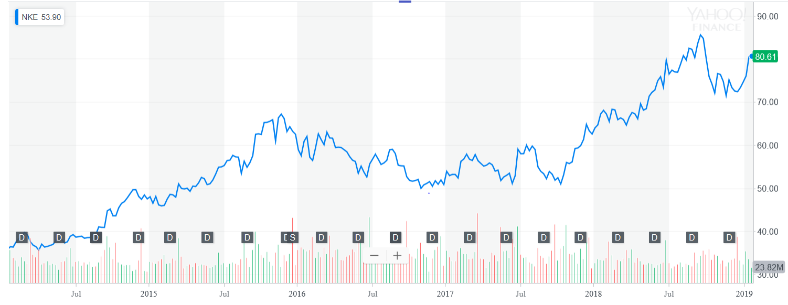
Nike Financials Five Year Trend

Slide 8
Nike Financial Analysis
The previous slide contains Nike’s Sales Revenue and Sales Growth Ratio for the past 5 years
Despite the Sales Revenue increasing from 2014 through 2019 the percentage of Sales Growth is down
This directly affects the Net Income and Net Income growth, despite Nike taking on several new campaigns and Strategies they find themselves down near 55% in Net Income than they were in the past

Slide 9
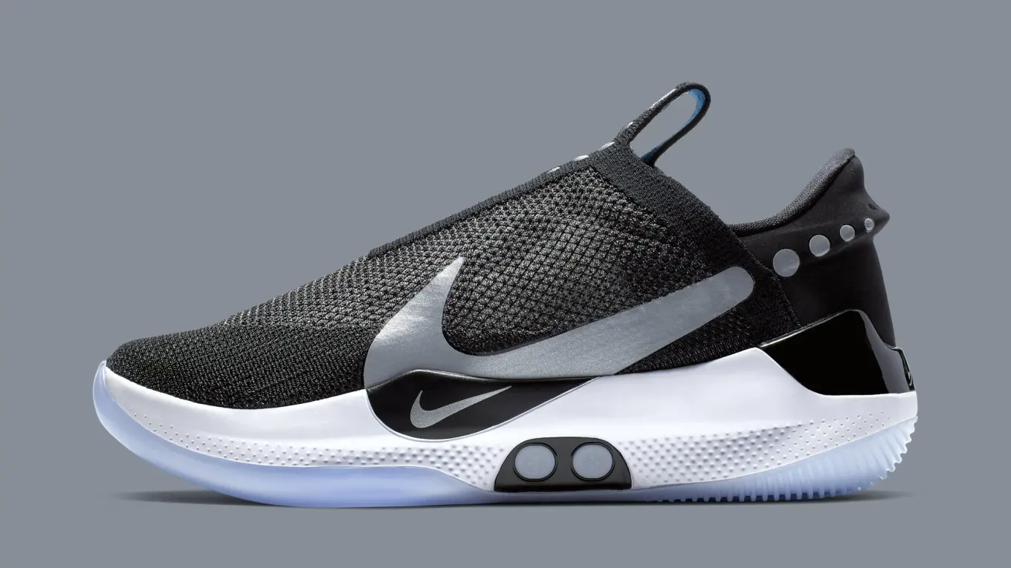
Rising Imperative of Creating Blue Oceans
Accelerated technological advances is one of the driving forces to access Blue Oceans.
Nike has surpassed its two main competitors, Adidas and Under Armour, by being the first to tap into the self lacing sneaker market and being the first to provide performance hijabs to Muslim athletes. Their first mass release of the self lacing technology was the HyperAdapt in 2016 with a high price tag of $720. However, because of the rapid increase with technology, Nike is releasing the Adapt BB in 2019 and cutting the original in price tag by over half for $350.

Slide 10
From Company and Industry to Strategic Move
Strategic move is the unit of analysis for explaining the creation of blue oceans and sustained high performance.
(continuously outerforming or staying ahead of the market)
A strategic move is the set of managerial actions and decisions involved in making a major market-creating business offering.
Compaq was acquired by HP, which might be looked at as unsuccessful, but in doing so made a series of strategic moves that led to creating the server industry, and its comeback in the 1990’s, unlocking a new multi-billion dollar market space in computing.
Notes:
Every company that has broken into a blue ocean market has made a series of strategic moves to get there. Even if some moves turn out to be dead ends, managers learn from these experience, and plan the next move accordingly.

Slide 11
Value Innovation: The Cornerstone of Blue Ocean Strategy
Value innovation occurs only when companies align innovation with utility, price, and cost positions.
Value-cost trade-off: companies can either create greater value to customers at a higher cost or create reasonable value at a lower cost.
The creation of blue ocean is about driving cost down while driving value up for buyers.
Reconstructionist view: market boundaries and industry structure are not given and can be reconstructed by the actions and beliefs of industry players.

Slide 12
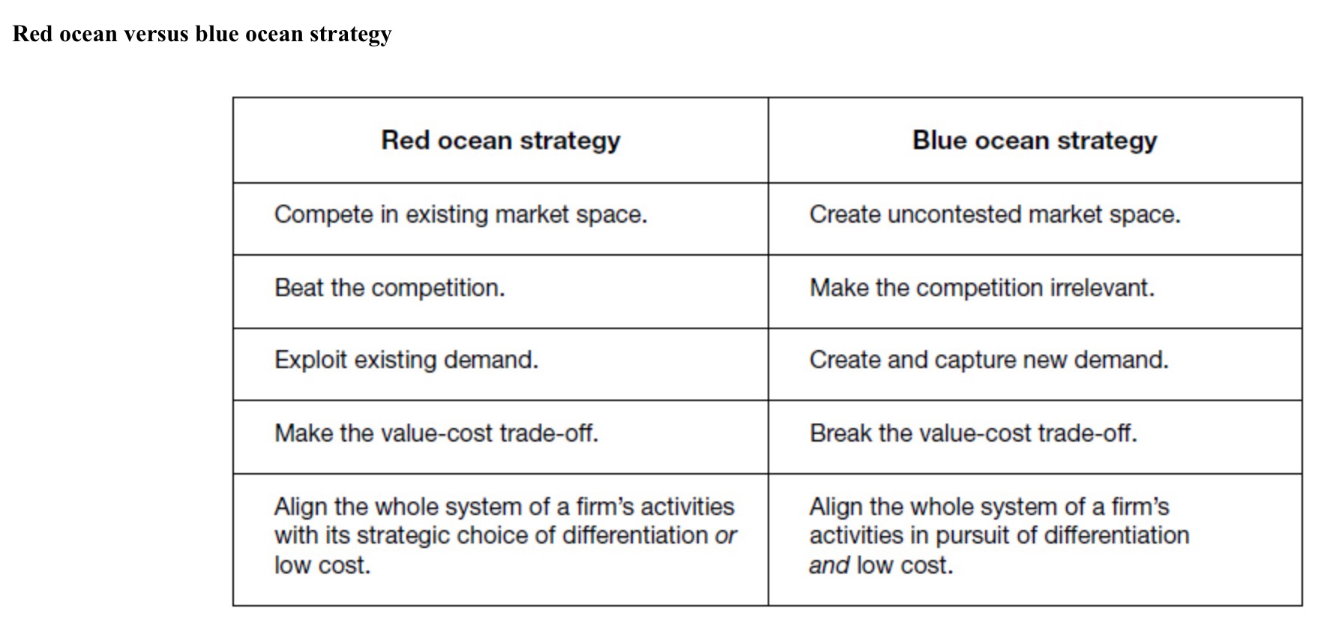

Slide 13
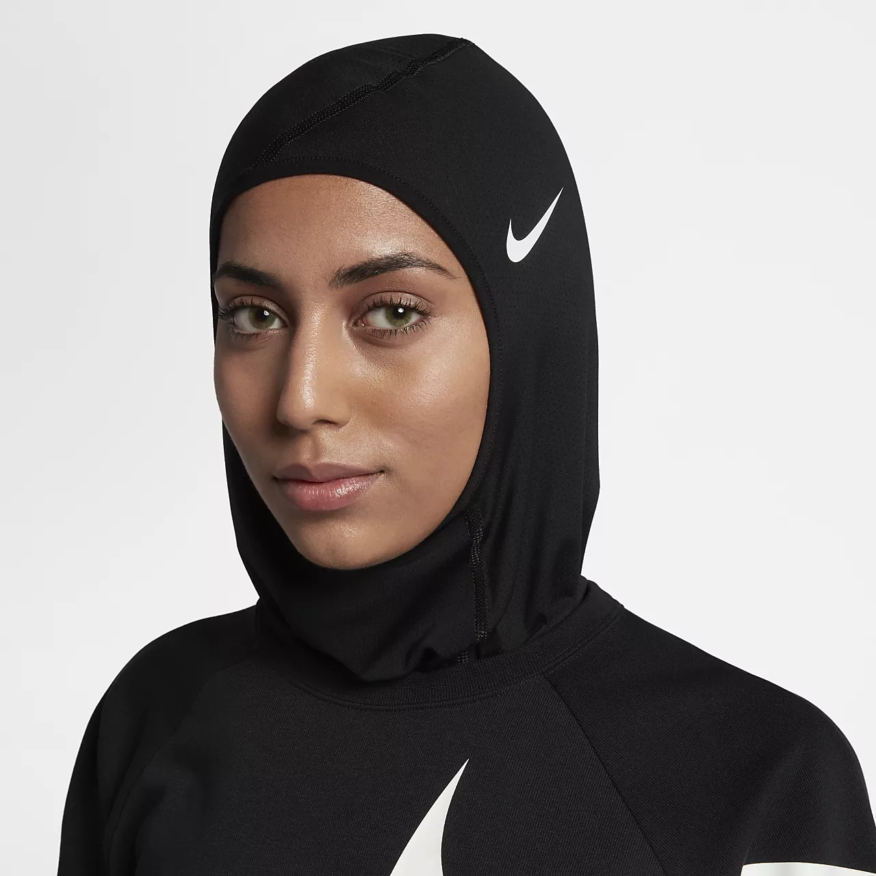
Formulating and Executing Blue Ocean Strategy
The 8 Principles of Blue Ocean Strategy -
Reconstruct market boundaries
Focus on the big picture not the numbers
Despite net income being down, Nike continues to pursue new campaigns and innovative technology.
Reach beyond existing demand
Self lacing sneakers and the performance hijab
Get the strategic sequence right
Overcome key organizational hurdles
Build execution into strategy
Align the value, profit, and people propositions
Renew blue oceans

Slide 14
Key Takeaways
“Nothing is more important than being able to share different perspectives”-Mark Parker, Nike CEO
Red Ocean Market: all industries in existence today, industry boundaries are defined and accepted, and the competitive rules are known.
Blue Ocean Market: Untapped market space, demand creation, and the opportunity for highly profitable growth.
Blue Ocean Markets are important for future growth and innovation.
Nike is ahead of Adidas and Under Armour

