Slide 1
FS: Global Strategies and the Multinational Corporation
By Team 4 (11am): Sofia Paredes, Haylee Berner, Dylan Hawkins, and Linna

Slide 2
Patterns of Internationalization
Trading Industries Aerospace Military hardware Diamond mining Agriculture | Global Industries Cars Oil Semiconductors Consumer Electronics
Sheltered Industries Railroads Laundries / dry cleaning Hairdressing Milk | Multidomestic Industries Packaged Groceries Investment Banking Hotels Consulting
High
International Trade
Low
Low
High
Foreign Direct Investment

Slide 3
Implications for Competition
Internationalization = more competition and lower profitability
1976
84% of the US automobile market was controlled by GM, Ford, and Chrysler
2011
14 companies within US
GM and Ford remained indigenous accounting for 35.7% of auto sales
Influences 3 of the 5 Porter’s forces of competition framework
Competition from potential entrants
Rivalry among existing firms
Increasing the bargaining power of buyers

Slide 4
Analysing Competitive Advantage in an International Context
Growth over the past 20 years is associated with competition reversals
1989 US Steel
2014 ArcelorMittal
Competitive Advantage
Internal strengths in resources and capabilities matches the key success factors in its industry
International Competitive Advantage
Depends on internal strengths in resources and capabilities, its national environment, and the resources within the countries of business

Slide 5
Competitive Advantage in an International Context
Firm Resources and Capabilities
Financial Resources
Physical Resources
Technology
Reputation
Functional Capabilities
General Management Capabilities
THE INDUSTRY ENVIRONMENT
Key Success Factors
COMPETITIVE ADVANTAGE
THE NATIONAL ENVIRONMENT
National resources and capabilities (raw materials, national culture, human resources, transportation, communication and legal infrastructure)
Domestic market conditions
Government policies
Exchange rates
Related and supporting industries

Slide 6
National Influences on Competitiveness: Comparative Advantage
Comparative advantage
A country can use the resources to make products that are available in abundance within that country
US has an abundant supply of:
Technological resources
Trained scientist and engineers, research facilities and universities.
Technology-intensive products
Microprocessors, computer software, pharmaceuticals, medical diagnostic equipment, and management consulting services
Relative efficiencies of producing different products

Slide 7
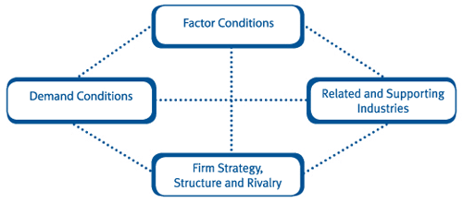
PORTER’S NATIONAL DIAMOND
Examined the dynamics through which particular industries within a country develop the resources and capabilities that confer international competitive advantage.
Identifies four key factors which determine a country’s competitive advantage within a particular sector.

Slide 8
KEY FACTORS EXPLAINED
Factor Conditions: Highly specialised resources with many ‘home grown’ rather than ‘endowed’
Related and Supporting Industries: Clusters of industries
Demand Conditions: In the domestic market, provides primary driver of innovation and quality improvement
Strategy, Structure, and Rivalry: Role of intense domestic competition in driving innovation, efficiency and the upgrading of competitive advantage.

Slide 9
Criticism Perspectives of the Diamond Model
FIRST PERSPECTIVE:
Omitting key factors
Fails to consider the home country’s trading partners
Ignores the role of multinational corps. influencing the competitive success of country
Model needs to be expanded and amended
Small countries struggle to trade in domestic markets, much less global markets
SECOND PERSPECTIVE:
Lacks value
Too general to fully comprehend
Cannot test the predictions

Slide 10
The Internal Location of Production
National Resource Availability
How much will the resource cost? Is it available? Is there enough of the resource?
Firm-specific Competitive Advantage
Is the location optimal for the internal resources and capabilities? Are they mobile?
Tradability
How high are the tariffs? Are there government restrictions? Is the product moveable?
Political Considerations
Is the government imposing restrictions or penalties? Are they offering incentives?

Slide 11
Locating Production: General Motors
National Resource Availability
Firm specific competitive advantage
Tradability
Political Consideration

Slide 12
Location and Value Chain
Where to locate activity X?
The importance of the links between activity X and other activities of the firm
The optimal location of activity X considered independently
How great are the coordination benefits from co-locating activities?
What is the firm’s business strategy?
What internal resources and capabilities does the firm possess in particular locations?
What government incentives/penalties affect the location?
Where is the optimal location of X in terms of the cost and availability of inputs?

Slide 13
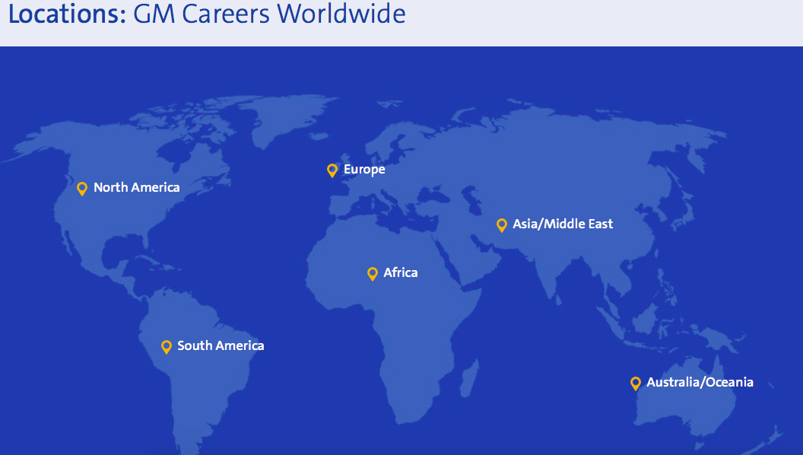
How Should a Firm Enter into a Foreign Market?
Firms must enter in pursuit of profitability
Profitability depends on:
Attractiveness of that market
Competitive advantage within the market

Slide 14
General Motors Foreign Market Strategy
Ford Company Foreign Entry Strategy
GM also has the Daewoo, Holden, Opel, and Vauxhall in other countries.
Develop global platforms
Direct investments
Put vehicles where vehicles are needed the most
China is the main focus
Ford also has the Everest, Ka, Mondeo, and Galaxy in other countries.
Focusing on making two cars suitable for the European and Chinese markets.
Produces low-cost cars, same platform, easy to find parts
Cut costs to increase profit margins

Slide 15
Global Integration Vs. National Differentiation
Benefits of a global strategy:
Cost Benefits of Scale and Replication
“Everywhere everything gets more and more like everything else as the world’s preference structure is homogenized” - Levitt
Once something is created, it has the potential to replicate the original at a fraction of the cost
Disneyland Theme Parks, McDonalds, etc.
Serving Global Customers
Need to service customers
Car manufacturers, advertisements, etc.
Exploiting National Resources: Arbitrage Benefits
Companies internationalize not only for market opportunities, but for resource opportunities
Learning Benefits
Permits new experiences, ideas, and practices to be diffused and integrated
Competing Strategically
Cross-subsidization of competitive initiatives in one market using pricing from other markets

Slide 16
Strategy and organization within the multicultural corporation
Evolution of multinational strategies and structures
Early 20th century
Post WWII
The 1970s-1980s
Present
Changing organization structure
From regional and national to international
Hewlett-Packard
Transnational
Focuses more on responsibilities and decision making rather than structure
Meeting consumer needs in the host country market
New product development
Organize, foster, and exploit innovation
Diversity and autonomy

Slide 17
SUMMARY
A firm’s competitive advantage is not just determined by its own resources and capabilities but also by the conditions of the national environment in which it operates
We discussed and simplified the complexities of internal strategy
We also discussed how companies compete globally and analysed factors that contribute to a firm’s foreign entry strategy

