Slide 1
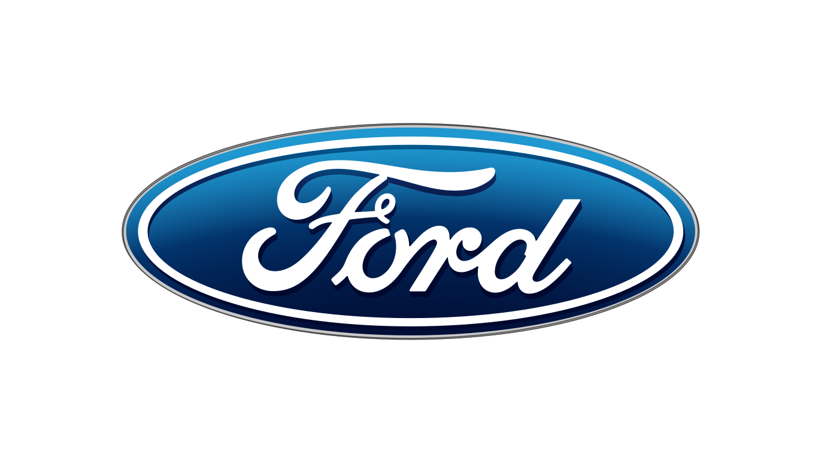
Corporate Strategy
Group 6 – 4380-S01
Blake Hardy
Preston Womack
Mason Fletcher

Slide 2
The Scope of the Firm
“What business are we in?”
Product scope - features and functions
Vertical scope - presence along the industry value chain
Geographical scope - geographical markets it will compete in

Slide 3
Key Concepts for Analysing Firm Scope
Economies of scope: a proportionate saving gained by producing two or more distinct goods, when the cost of doing so is less than that of producing each separately.
Transaction costs: expenses incurred when buying or selling a good or service.
The cost of corporate complexity: Extending the boundaries of a company can reduce some costs, but may also impose others.

Slide 4
Diversification
Refers to the expansion of an existing firm into another product line or field of operation and/ or business.
Related diversification - firm expands into similar field of operation
Unrelated diversification - additional product line is very different from firm’s core business

Slide 5
Benefits and Costs of Diversification
Growth - in the absence of diversification firms are prisoners of their industry
Risk Reduction - don't put all your eggs in one basket
Value Creation: Porter’s ‘Essential Tests’
The attractiveness test - Is the market attractive or can it be made attractive?
The cost-of-entry test - Are future profits negated by the cost of gaining a position in the market?
The better-off test - Does it provide a competitive advantage?
Exploiting Economies of Scope - where different businesses use the same resources and capabilities
Tangible resources - distribution networks, information systems, sales forces and research laboratories
Intangible resources - brands, corporate reputation, and technology
Organizational capabilities - marketing, technological, management and operational capabilities
Transaction Costs of Markets vs. The Costs of Corporate Complexity

Slide 6
Vertical Integration
A company buys and controls other vertically related businesses along its supply chain.
This produces efficiencies in the production process while saving money.
Henry Ford viewed the vertically integrated organization as the ideal business model.
Ex: 1920; Ford bought rubber plantation, coal/ iron ore mines, trains, and ships to help provide raw materials for vehicles. Ford also brought together several different stages of manufacturing such as machine shops, a power plant, and foundry.

Slide 7
Vertical Integration
Backward Vertical Integration - firm acquires ownership and control over the production of its own inputs
Forward Vertical Integration - firm acquires ownership and control of activities previously undertaken by it’s customers
Vertical integration may be full or partial.
The degree of a firm’s vertical integration is indicated by the ratio of its value added to its sales revenue: the more a firm makes rather than buys, the lower are its costs of bought-in goods and services relative to its final sales revenue.

Slide 8
The Benefits and Costs of Vertical integration
Technical Economies From The Physical Integration Process - cost savings that arise from the physical integration process. Linking two stages of production at a single location reduces transportation and energy costs.
Transaction Costs In Vertical Exchanges - cost of bargaining, problem of hold up
Differences In Optimal Scale Among Different Stages Of Production - company does not possess the scale needed for efficiency
The Incentive Problem - changes the incentives between vertically related businesses, less external competition
Flexibility - advantages and disadvantages to different types of flexibility
Compounding Risk - problems at any one stage of production threaten production and profitability at all other stages

Slide 9
Designing Vertical Relationships
Spot Contract - no commitment beyond a single deal
Long Term Contracts - involves a series of transactions over a period time and specifying the terms of sales and the responsibilities of each party
Vendor Partnerships - vertical relationships based on trust and mutual understanding
Franchising - a contractual agreement between the owner of a business system and trademark (the franchiser) and a licensee (franchisee) that permits the franchisee to produce and market the franchisor's product or service in a specific area

Slide 10
Recent Trends In Vertical Integration
Diversity of Hybrid Vertical Relationships
Hybrid vertical relationships have become a main feature over recent years.
This shift has attempted to even out the flexibility with the incentives of the market.
Collaborative vertical relationships
Considered a recent occurrence and are usually associated with microelectronics, biotechnology and other hi‐tech sectors.
Long-term Collaboration
in recent years there has been a massive shift from “arm’s‐length supplier relationships” to long‐term collaboration which results in having fewer suppliers but with closer relationships.

Slide 11
Recent Trends In Vertical Integration cont...
Internet
The online proliferation has radically reduced the transaction costs of markets
Reduction in search costs have allowed online electronic payments to increase
Increased online transactions has resulted in a revival of arm’s-length competitive contracting via business-to-business e-commerce hubs
Virtual Corporation
a firm whose primary function is to coordinate the activities of a network of suppliers and downstream partners. Coordination typically takes place using information and communication technologies.

Slide 12
Managing the Corporate Portfolio
The basic concept of GE/McKinsey matrix portfolio planning model is
Represent graphically the individual businesses of a multi-business company.
The variables typically relate specifically to the attractiveness of the market.
This can influence resource allocation, business strategy, portfolio analyzation/balancing, and target performance.
Boston Consulting Group uses
Industry attractiveness is measured by rate of market growth and competitive advantage
Single indicator as a proxy for each dimension
The 4 quadrants of the BCG matrix predict patterns of profits and cash flow
The quadrant indicate the strategies to be adopted

Slide 13
Managing the Corporate Portfolio cont...
The Heartland Matrix
Based on Campbell’s parenting advantage framework
Value potential depends on both characteristics of the business and parent company
This matrix is more difficult to use than the GE/McKinsey or BCG matrices
Creates value from the configuration and reconfiguration of a portfolio
Involves complex issues that require insight into the basic characteristics of the businesses and management style

Slide 14
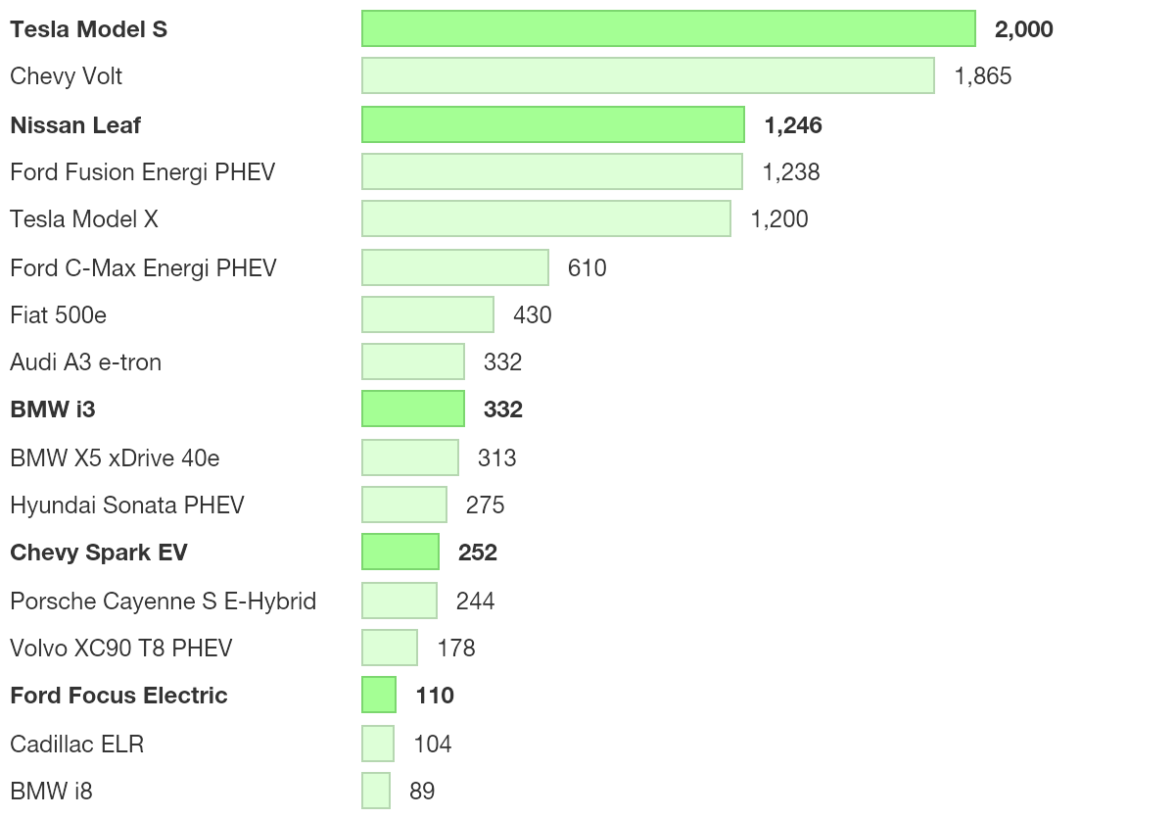
US Electric Car Sales (Apr 2016)

Slide 15
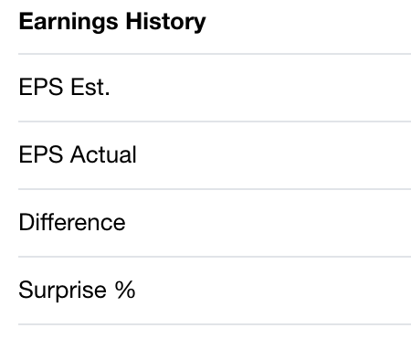
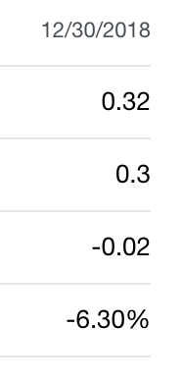
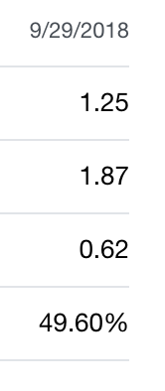
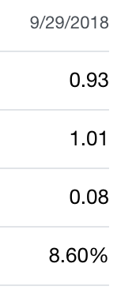
Earnings Per Share
Ford GM FCAU

Slide 16
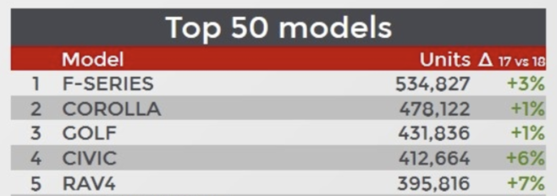
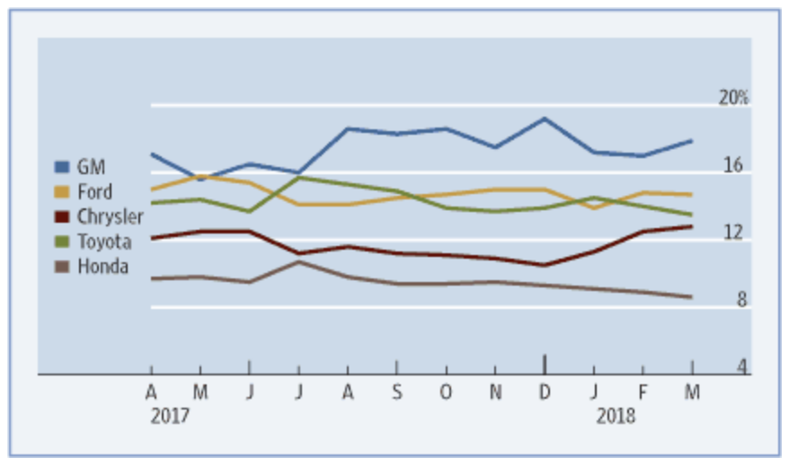
Market Share

Slide 17
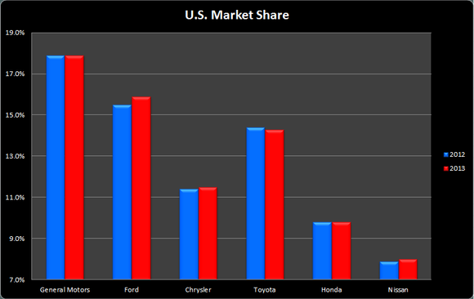

Slide 18
