Slide 1
Industry Analysis:
Electronic Computer Manufacturing
Apple Inc.
Group 2
10:00 AM
Emilye Webb, Maddie Campbell, Christian Todd

Slide 2
Electronic Computer Manufacturing
Began in the 19th century with the first digital computer, the Analytical Engine
It influences the first mechanical computer and this was the beginning of a computer revolution that would change the world
ENIAC was completed in 1946 and was the first general-purpose electronic computer
The government, many businesses, and scientists began using the computer because they thought it was an adequate tool for many areas of business
The industry is continuing to grow and there is nothing that points to the end of this industry
Mainly focuses on personal computers
Also the industry deals with input/output devices such as printers, keyboards, and monitors

Slide 3
Electronic Computer Manufacturing
52 companies within this industry and Apple Inc. is the number one company in the industry based on revenue with a revenue of $265,595,000,000 in 2018 alone
PArt of the reason Apple INc. is dominating the industry is because the constantly come out with new and improved technological advancements for their products
There are 586,232 employees working in this industry and about 132,000 of them work for Apple Inc. as of 2018
The wage of the production and non supervisory roles has only gone up around $4 in the past 10 years and is not at $25.15
Key executives all make over $85o,000 with the CEO making $3 million

Slide 4
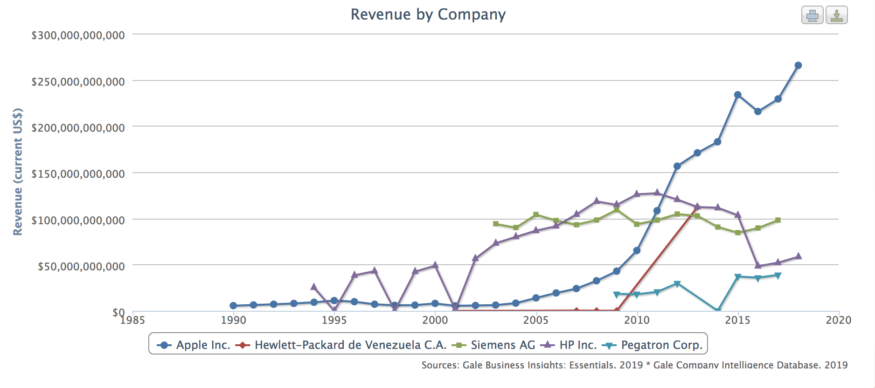

Slide 5
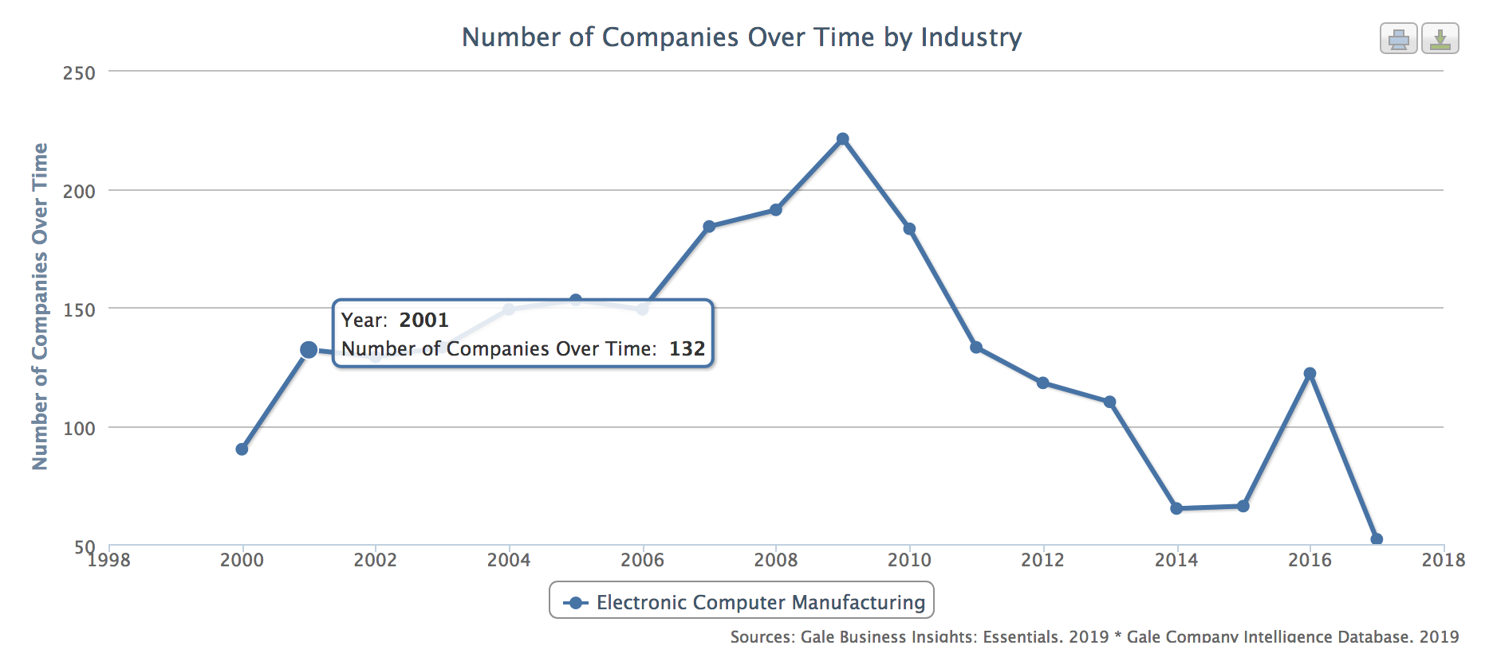

Slide 6
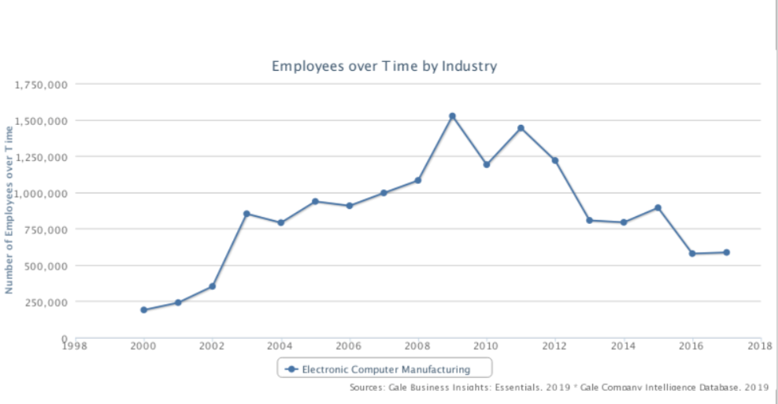

Slide 7
Driving Forces for Change
Within the Electronic Computer Manufacturing Industry, economic growth is constantly being shifted. There are times of rapid, successful growth, as well as times of downfall
When the twenty-first century approached, the economy in the United States was weak, causing the industry to struggle.
September 11th terrorist attack, consumers took a step back due to the lack of confidence.

Slide 8
Driving Forces for Change Continued
A huge competition emerged in 2010 when Apple, Inc. introduced their ipad to the market. Because of the tough competition with the ipad, Dell discontinued the Streak Tablet in 2011.
The economic state has a major effect on the industry, because when consumers are low on income, they are less likely to purchase new products.
Companies are constantly changing and innovating due to the desire to be better and more successful than their competition, and this is what keeps the industry alive.

Slide 9
Overall Industry Attractiveness
It is crucial to look at the profits an industry brings in along with the risks involved.
Industry attractiveness is based on several components, such as competition, strengths, growth, and the overall consumer demand for the products and/or services
In 2018, PC sales across the world had the largest growth they have witnessed since 2012.
Companies within this industry continue to evolve, such as the introduction of Windows 10, having a very positive effect on the industry and the future of the industry

Slide 10
Overall Industry Attractiveness Continued
Due to the constant need of PCs by business, government, etc., the Electronic Computer Industry will always be alive.
The industry is attractive, because they continue to grow and innovate as consumers urge for more technology.

Slide 11
Key Success Factors
Apple, Dell, and Intel have all been successful throughout the years, just some more than others.
IBook (1999-2006)
Macbook Pro (2006-Present)

Slide 12
Strengths of Competitive Forces
Threat of new entrants
Bargaining power of buyers
Bargaining power of suppliers
Threat of substitute products or services
Rivalry amongst existing competitors

