Slide 1
Mid-term paper presentation:
Industry Analysis
10:00am 2/20/19
Team 3
Kaitlyn Thompson, Jess Francis, Anthony Greer, Marcos Acosta

Slide 3
Environment Analysis to Industry Analysis
(Paragraph 1-3)
Business Environment consists of all the external influences that affect its decisions and performance.
P.E.S.T. (political, economical, social, and technological)
Pest analysis has become popular as an environmental scanning framework because it provides a simple yet systematic approach to identifying factors that are likely to shape the competitive conditions within an industry.

Slide 4
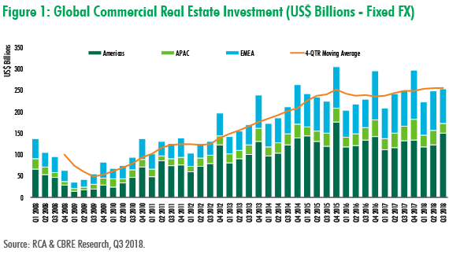
Global CRE Market (Altus Specialized industry)
(paragraph 1-3)

Slide 5
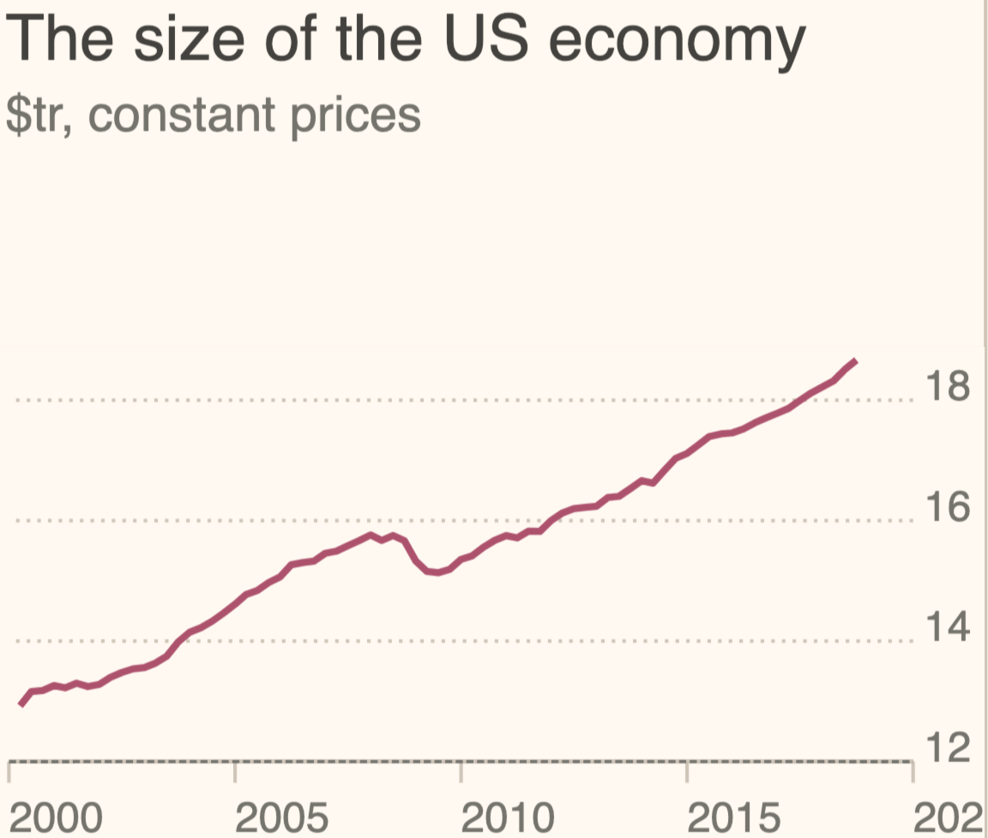
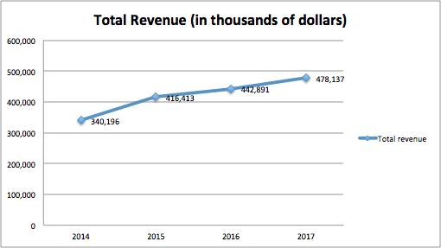
Altus Group
(paragraph 1-3)

Slide 6
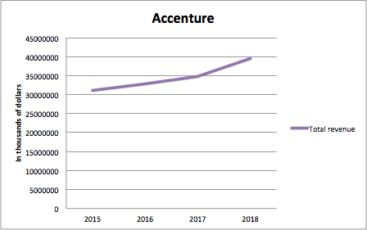
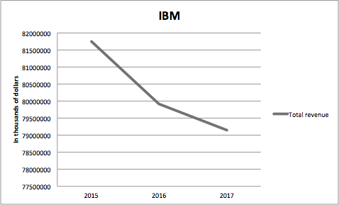
Industry competitors
(paragraph 1-3)

Slide 7
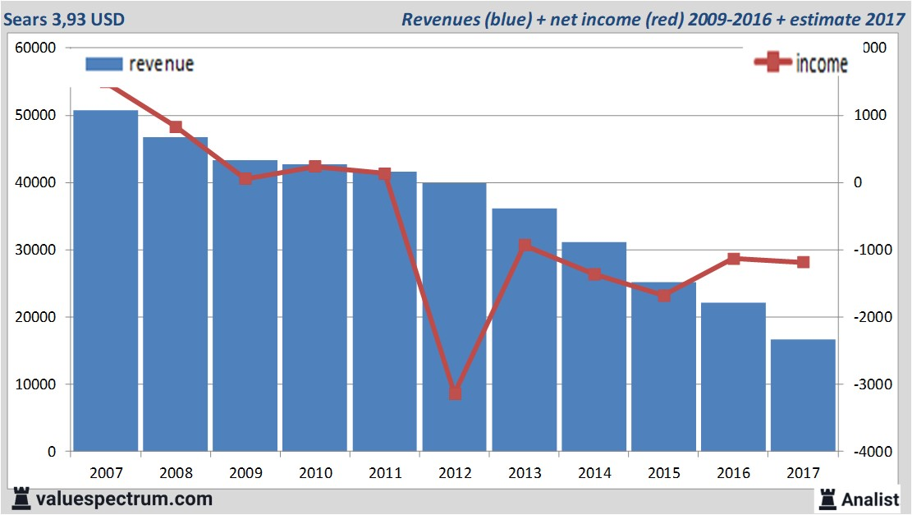
Non-related Industry (Sears Holding)
(paragraph 1-3)

Slide 8
Determinants of Industry Profit: Demand and Competition
(paragraph 4)
What determines the level of profit in an industry?
The value of the product to customers
The intensity of competition
The bargaining power of the producers relative to their suppliers
The surplus of value over cost is distributed between customers and producers by the forces of competition.
The stronger the competition among producers, the more of a surplus is received by customers and less of the surplus is received by producers.
An industry analysis brings all three factors into a single analytic framework.

Slide 9
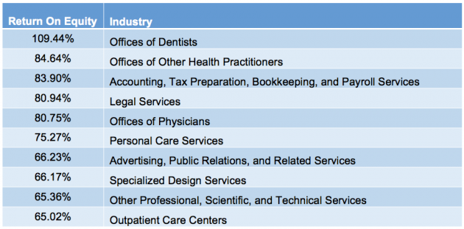
Profitability of US industries
(example from 2015)

Slide 10
Porter’s Five Forces of Competition Framework (paragraph 5)
Horizontal Competition:
Competition from Substitutes: Customers will switch to substitutes in response to price increase.
Competition from Entrants: When a firm earns a return on capital in excess of its cost of capital it acts as a magnet to outside firms.
Barrier to Entry: New entrants cannot enter on equal terms with those established firms.
Competition from Established Rivals: In some industries firms compete aggressively, however in others they compete via advertising, innovation, and other non-price dimensions.
Vertical Competition:
Power of Suppliers: the pressure suppliers can exert on firms by raising prices, lowering quality, or reducing availability of their products.
Power of Buyers: The strength of buying power that firms face from their customers depends on two sets of factors: buyer’s price sensitivity and relative bargaining power.

Slide 11
Bargaining Power of Buyers vs. Suppliers
(Paragraph 8)
The firms in an industry compete in two types of markets:
Market of inputs
Market of outputs
Bargaining power of Buyers :
Buyer’s Price Sensitivity
Relative Bargaining Power
Bargaining power of Suppliers:
Similar to Buyer Bargaining Power

Slide 12
Bargaining Power of Buyers
(Paragraph 9)
Price Sensitivity - the extent to which buyers are sensitive to the prices they are being charged.
Importance of item in question relative to total cost of product or service -Accenture outsources data solutions for consulting
Intense Competition amongst buyers brings eagerness for a decrease in price -With many participants in the CRE market, Altus competitors cannot afford to outsource
Critical Quality to a product or service makes buyers less sensitive to price -Having real-time pricing for CR all over the world gives Altus more value
Minimal Differentiation between a suppliers product/service allows the buyer to switch based on price. -Buyers can use Altus Group for multiple purposes whereas its competitors only specialize in a few areas.

Slide 13
Bargaining Power of Buyers
(Paragraph 9)
Relative Bargaining Power - refusal to deal with opposite party.
Small Concentration of buyers relative to suppliers could be detrimental to suppliers
Buyers Information of suppliers pricing could allow arguable bargaining -Complex information involved in CRE/software
Integrating Vertically as an alternative to paying high prices -Altus decided to acquire Argus to avoid outsourcing

Slide 14
Bargaining Power of Suppliers
(Paragraph 10)
Immensely comparable to buyer bargaining power except on supply side. -Imagine buyer scenario but from supplier perspective
Mostly similar except for commodity, small component, and semi-finished goods suppliers. -Lack bargaining power due to mostly large firms buying their inputs -Often boost bargaining power by joining co-op

Slide 15
Forecasting Industry Profitability
(paragraph 4)
The prediction of profitability can be analyzed in three ways
Examine how the industry’s current and recent levels of competition and profitability are a consequence of its present structure
Identify the trends that are changing the industry structure
Is the industry consolidating
Are new players seeking to enter
Are the industry’s products becoming more differentiated or more commoditized
Will additions to industry capacity outstrip growth of demand
Identify how these structural changes will affect the five forces of competition and resulting profitability of the industry.

Slide 16
Using Industry Analysis to Develop Strategy
(paragraph 12-15)
Industry structure influences competition, which in turn defines industry profitability.
Developing Strategy:
Industry characteristics
Level of profitability
Competitive pressures
It is important to configure ones firm to influence the development of industry structure to achieve advantages.
Architectural Advantages:
Creating a bottleneck
Relieving bottles necks in other parts of value chain
Redefining roles and responsibilities in the industry

Slide 17
Using Industry Analysis to Develop Strategy
(paragraph 12-15)
Strategy Development
Industry Characteristics:
Defining an Industry-connection between the attributes of an industry and how they correlate with levels of profitability
Internal & External
Levels of Profitability-identifying industry trends
Technological Advances
Competitive Pressures-range of success amongst competitors
Emphasis on resources and capabilities

Slide 18
Segmentation Analysis
(paragraph 16)
Segmentation is vital to penetrating the market and attracting the attention of potential customers needs and wants.
Five Stages of Segmentation Analysis
Identify possible segmentation variable
Which customers to serve and what to offer them
Construct segmentation matrix
Easily identifiable segment markets
Analyse segment attractiveness
Identify key success factors in each segment
Analyse the basis of competition within segments
Select segment scope

Slide 19
Identifying Key Success Factors
(paragraph 16)
First, a firm must meet two criteria.
It must supply what customers want to buy.
It must survive competition.
Questions to ask:
What do our customers want?
What does the firm need to do to survive competition?
The ability to answer these two questions and therefore meet the two criteria will indicate how much success a firm will experience.

