Slide 1
Competitive Analysis: Ford
Team 4:
Brooks Garner, Alex Mills, Grayson Watson

Slide 2
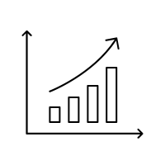
Current Company Strategy
Is it successful?
Financial
Marketing
Management Goals
Employee Satisfaction

Slide 3
Financial Success
$160 B Revenue in 2018
$24.069 B Gross Profit
$156 B Revenue in 2017
$25.455 B Gross Profit
$151 B Revenue in 2016
$25.605 B Gross Profit
Revenue is increasing, gross profit is declining
Similar and worse percentages are being seen across the industry
Still in a state of restructuring and rebuilding

Slide 4
Marketing Success
Product, Place, Promotion, Pricing
Ford has been decreasing their overall product mix and increasing their line of electric vehicles
Utilize dealerships, and auctions to sell cars
Direct to consumer advertising, personal sales, fleet sales
Market-leading pricing, premium pricing on certain products

Slide 5
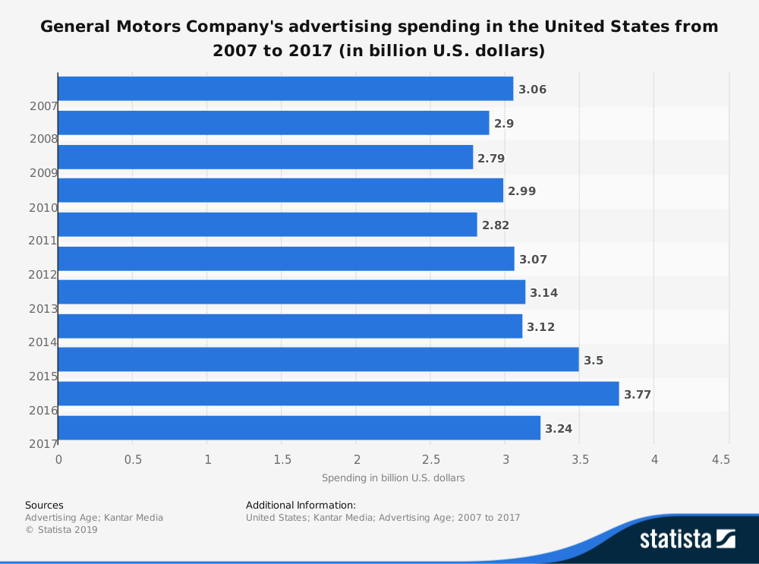
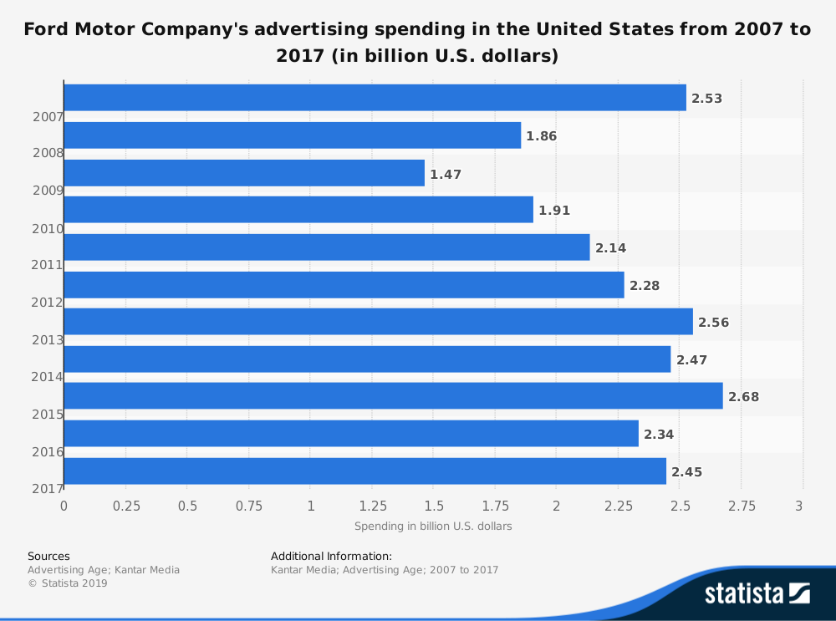
Marketing Statistics

Slide 6
Management Goals 2017
Ford will prepare for disruption by becoming fit.
We will be in the vehicle business - moving both people and goods
Our vehicles will be smart and connected.
These smart vehicles will thrive in a new transportation operating system.
Ford will capitalize on new business opportunities within this transportation operating system.

Slide 7
Employee Satisfaction
Life@Ford
Responding to employee concerns
Voluntary Quit Rate among salary workers increasing
Employee Satisfaction 72% in 2017; decreasing

Slide 8
SWOT
Strengths: Opportunities: 1. Brand Recognition/Loyalty 1. Ride-hailing 2. F-150 Line 2. Product Development 3. Global Supply Chain 3. Autonomous Driving Weaknesses: Threats: 1. Higher costs vs. competitors 1. Intense Competition 2. Weak positions in emerging markets 2. Changing landscape of industry

Slide 9
Relative Competitive Strength
Cost Leadership Strategy
Assembly line
Maximize production
Minimize costs
Differentiation Strategy
New Technology
New Product Development

Slide 10
Technology
BLIS- Blind Spot Information System
Lane-Keeping System
Pre-Collision Assist with Automatic Braking
Engine shut off and restart while parked or sitting, reducing emissions

Slide 11
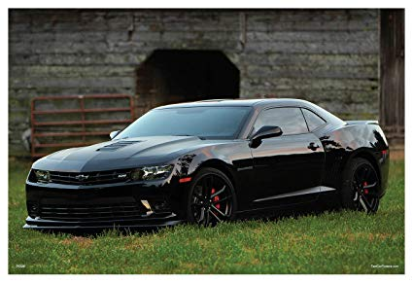
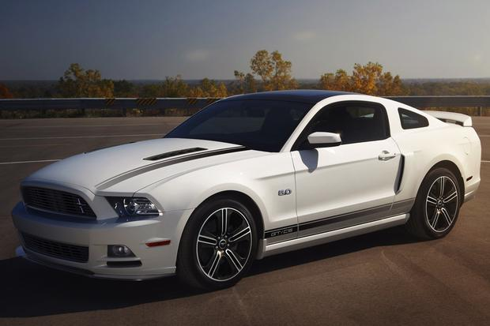
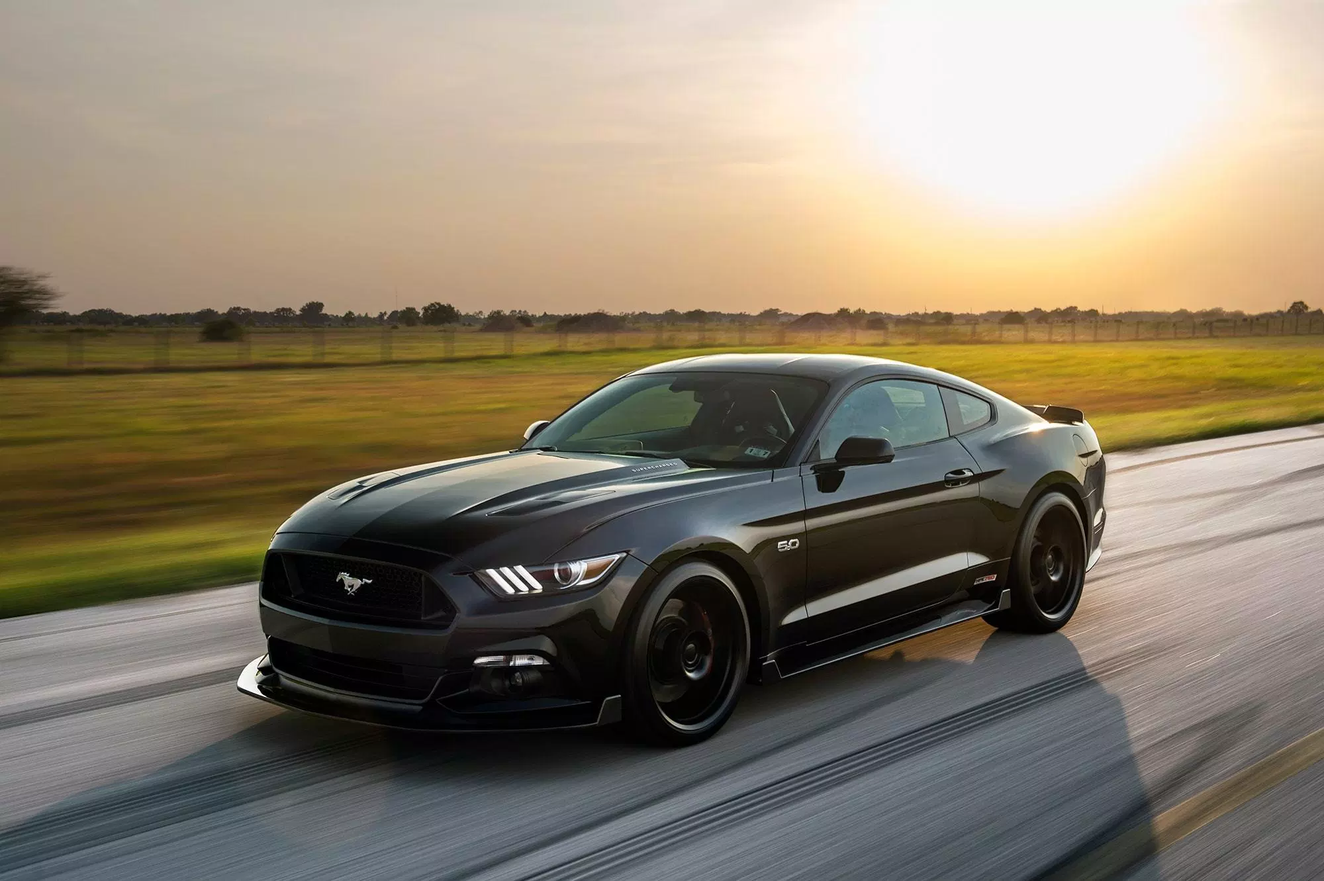
Safety
2014- Chevrolet Camaro’s (GM) had 5 star safety ratings.
But Ford Mustang’s had 3 star safety ratings.
2015- Chevrolet Camaro’s (GM) had 5 star safety ratings.
This time, Ford’s Mustang has 5 star safety ratings as well.

Slide 12
Safety Continued
Ford realized that safety was one of the biggest driving factors for people purchasing vehicles.
In the past, Ford’s safety ratings have been subpar compared to competition.
But after 2014, Ford decided that their 2015 line of cars were going to be a little different, but a lot safer.
Ford increasing their safety ratings helped improve their sales and their competitive advantage.

Slide 13
Ford’s Resources and Assets provide Distinctive Competency
Costs- maximize production, minimize costs
Fuel Emissions- Hybrids, improved engines, automatic engine shut off, etc.
Technology- BLIS, Lane Keeping System, etc.

Slide 14
Rare and Non-imitable Assets
Ford’s ability to produce ground breaking technology is a rare asset because it is very hard for other companies to duplicate.
Ford’s ability to produce this kind of technology for as cheap as they do, is non-imitable because it gives them the best competitive advantage.
This is because they will be able to sell their cars for a cheaper price than their competitors because it costs a lot less to produce their technology.

Slide 15
Relative Cost Position
Generic Strategy
Cost Leadership (maximize production and minimize costs)
Ex. assembly line
Other Strategies
Differentiation
Technology
Safety

Slide 16
Relative Cost Position continued
Ability to produce their cars at a cheaper price allows them to sell them at a cheaper price.
Ford closing the gap on the safety ratings was huge.
2014, Camaro’s outsold Mustangs by a little more than 3500 units.
But….

Slide 17
Relative Cost Position continued
In 2015, after Ford increased their safety ratings….

Slide 18
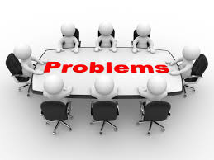
Strategic Issues and Problems
The main hindrances on a company’s success path
Elephants in the room keeping your organization from reaching its goals and being the best company within an industry
Focusing on internal problems within Ford Motor Company
No immediate solution requires a deep forethought and a plan

Slide 19
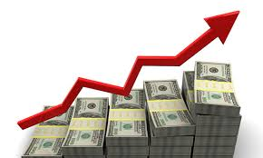
Employees and Management
THE GOOD
Strong Wages
Great Benefits
Advancement Opportunities
THE PROBLEMS
Competitive and Stressful Environment
Long Hours
Not Receiving Time Off
High Turnover Rate

Slide 20
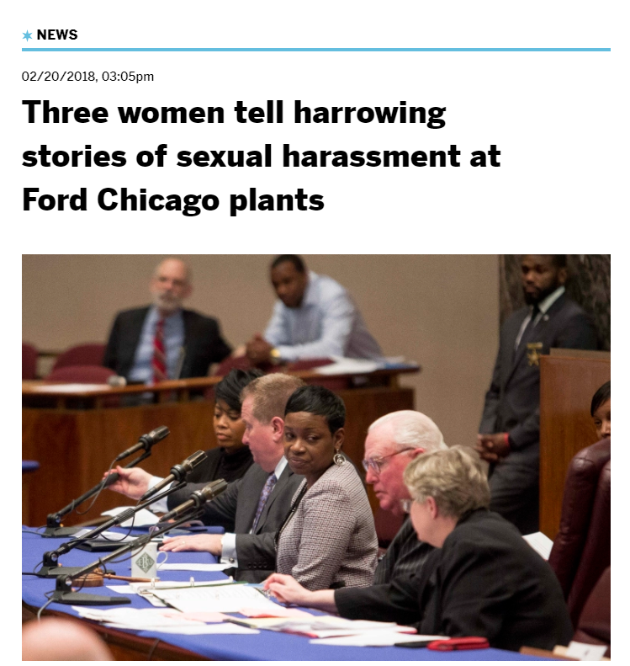
Culture
THE GOOD
High Performance Workforce
Family Atmosphere
Supportive of ideas and innovation
THE PROBLEM
Sexual Harassment Cases have done significant damage to the company and brand image

Slide 21
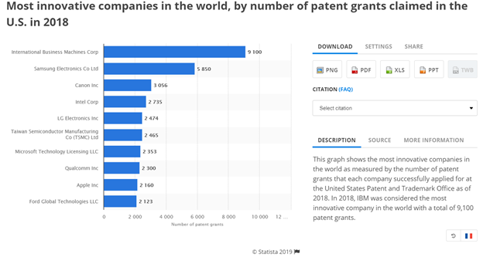

Slide 22
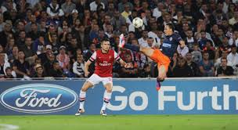
Cash and Resources
THE GOOD
One of the most iconic brand due to investment in sponsors
Massive amounts of marketing and advertisements
Very powerful in USA
THE PROBLEMS
Last year lost money in every other region in the world
Results were worse than a year prior
Less cash and resources than competitors

Slide 23
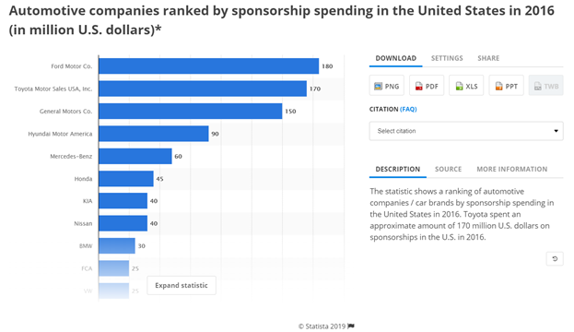

Slide 24
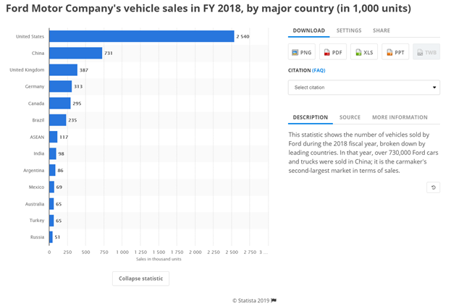

Slide 25
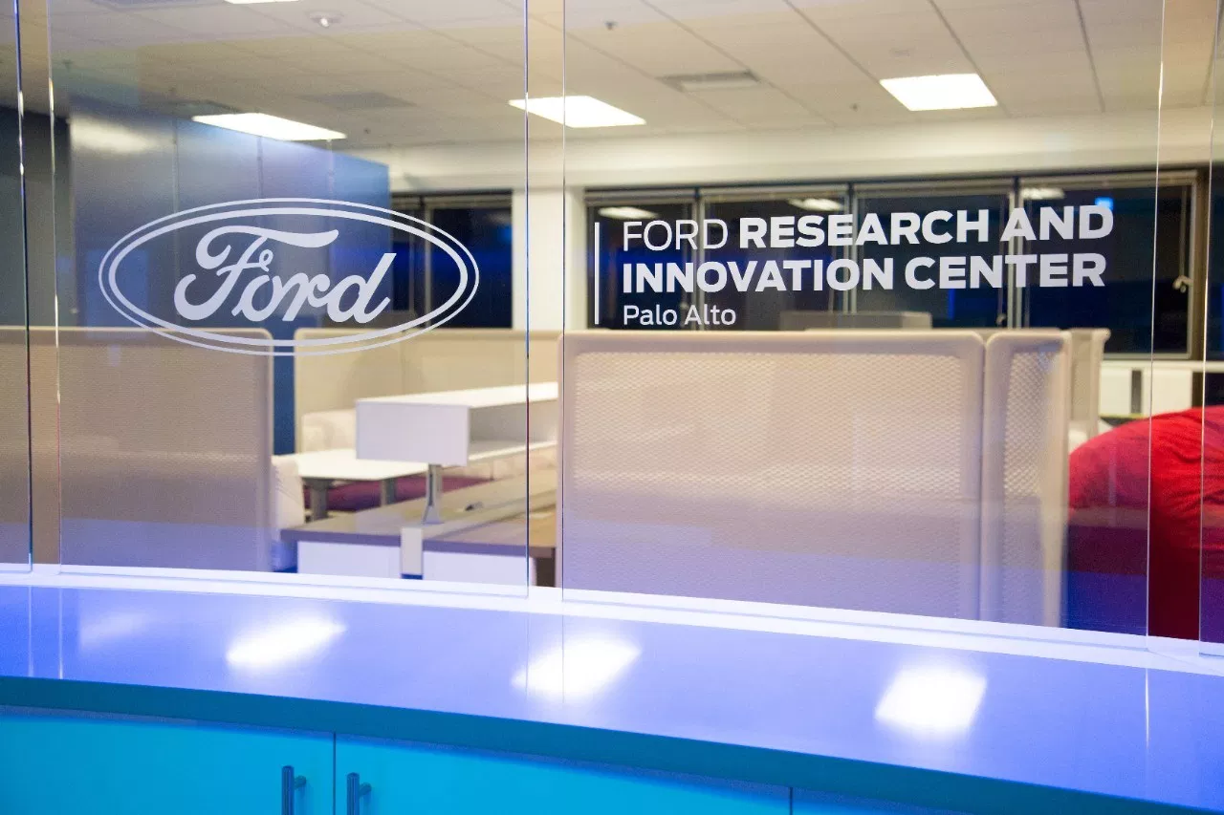
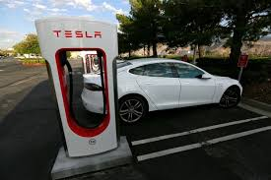
Research and Development
THE GOOD
Takes pride in innovation
Invests massively into R&D in comparison to competitors
State of the art facilities
THE PROBLEMS
Not paying off as of yet
Spent billions in self driving car with not much to show
Massively behind in electric car industry

Slide 26
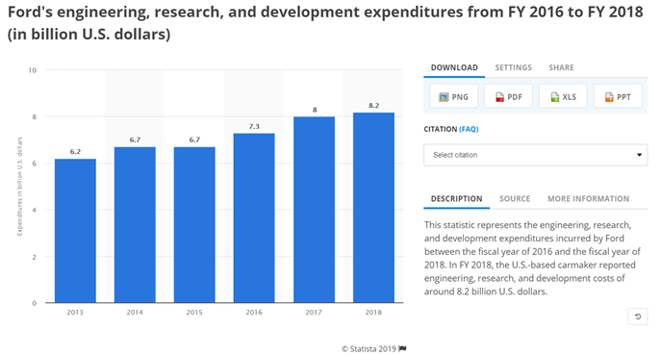

Slide 27
Thank You!

