Slide 1
Industry Analysis
Global Automotive Industry
Brooks Garner, Alex Mills, Grayson Watson
MGT 4380 10:00am
Team 4

Slide 2
Chief Business and Economic Characteristics
Automotive industry
Major industrial and economic force in the world.
Makes 60 million cars and trucks per year.
Employs millions of employees.

Slide 3
Forecasted Economic Impacts of proposed automotive assembly plant.
* in thousands

Slide 4
Transportation and the Automotive Industry
Transportation
Personal vehicles
Company vehicles
Ex.
Getting to work
Deliveries

Slide 5
Automotive Industry History and Current Status
Existed over 100 years.
Originally started in Germany and France.
Moved to the U.S. because of Mass Production and Mass Consumption
Currently the Industry is doing poorly.
Average Margins down from 20% in the 1920’s to 5% in today’s market.
Because it accounts 1.6% of the Europe Stock Market and only 0.6% of the U.S. Stock Market.

Slide 6
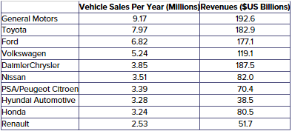
Top Automotive Assembly Companies Globally

Slide 7
Driving Forces for Change
Accelerating the Pace for Disrupting Innovation
Uber and Lyft taking more control.
Less people buying cars.
Possibly safer.
Possibly cheaper
More convenient?

Slide 8
Driving Forces for Change Cont.
Social Media/ Electronic generation
More people on their phones.
Lime, Bird, GoBikes, etc.
Want to be able to order, pay, and complete all from one place.

Slide 9
Driving Forces for Change
Revolutionizing Modern Driving
Driverless cars. Ex. Tesla, Google, and Apple
66% of UK predicts that in 15 years, there will be more driverless cars on the road than normal cars.
Issues
Accidents?
Obeying the highway laws?
Uncomfortable feeling for consumers?

Slide 10
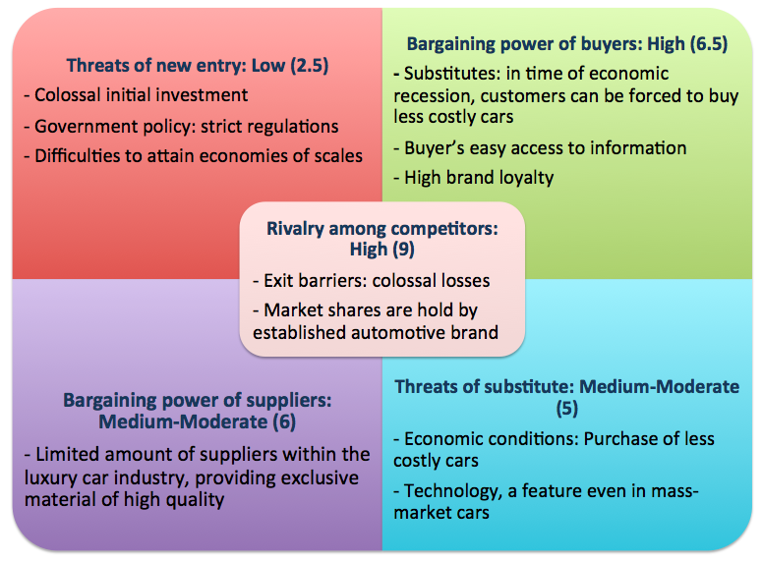
Strength of Competitive Forces

Slide 11
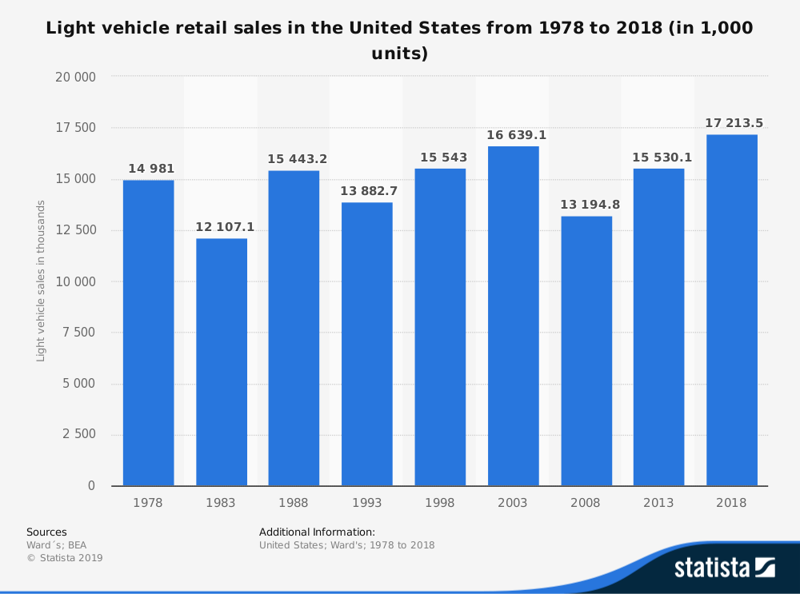
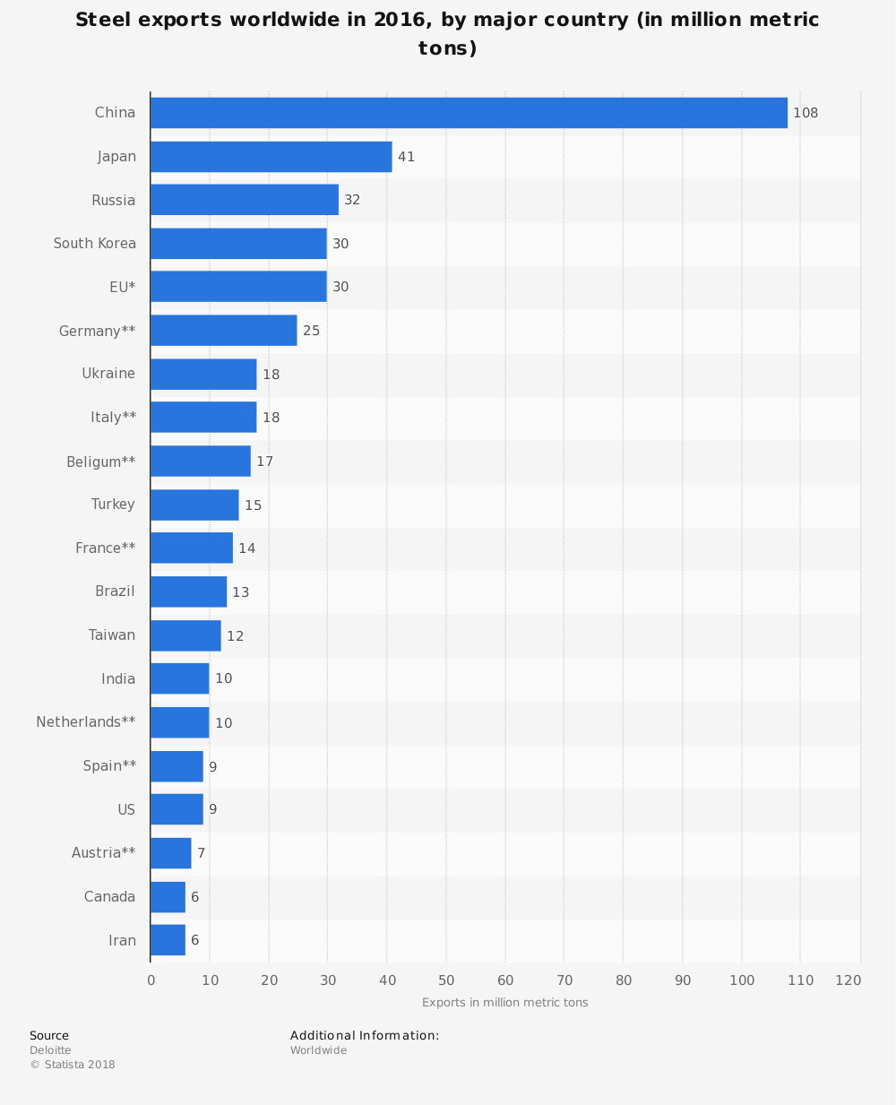
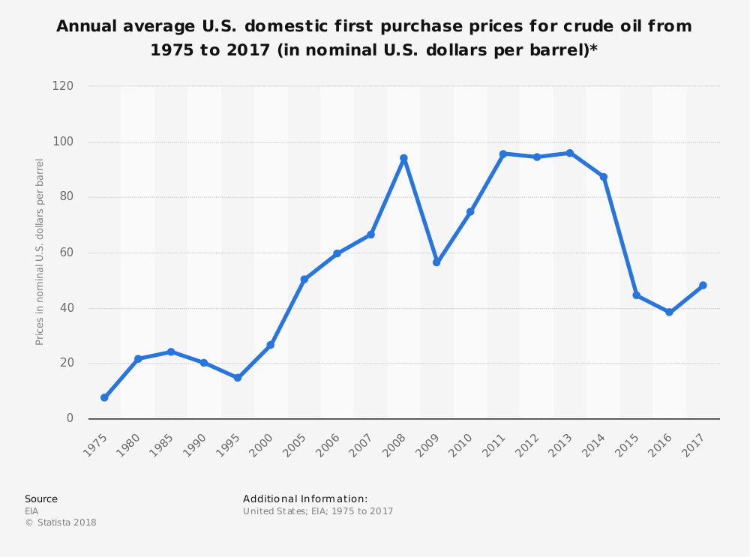

Slide 12
Competitive Positions of Companies within Industry
One of if not the most important factor for any business is how will they compete within the industry
There is not business if the company does not position itself correctly with a competitive advantage
When evaluating the automotive industry, it has one of the reddest oceans which would lead one to ponder, how do you compete?
A fight for supremacy between the giant automobile manufacturers is in full swing

Slide 13
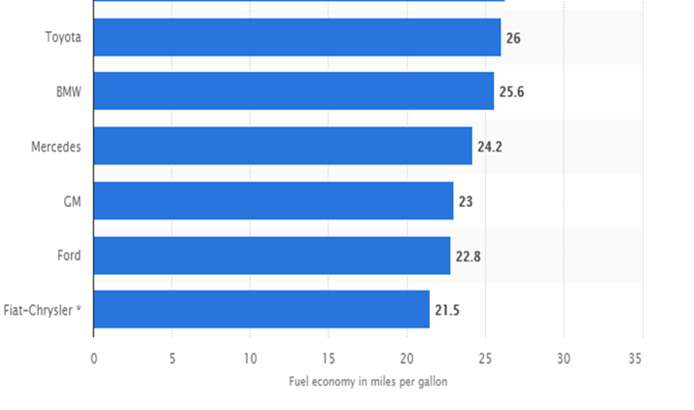
Toyota

Slide 14
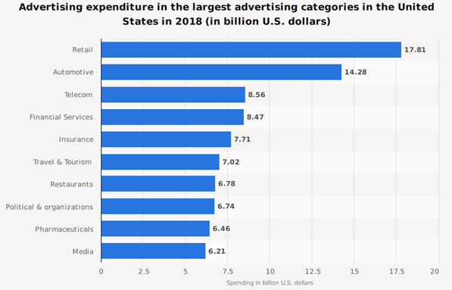
General Motors

Slide 15
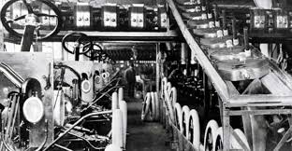
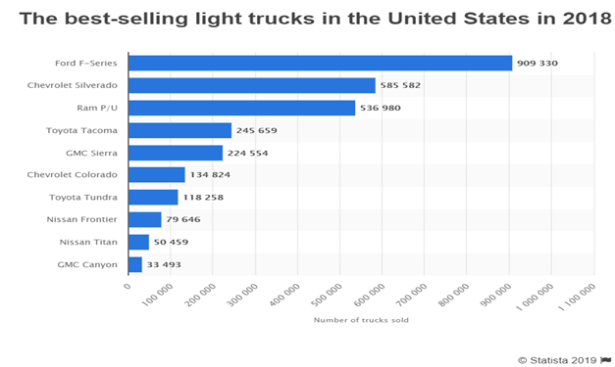
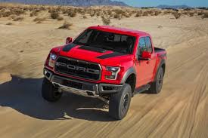
Ford

Slide 16
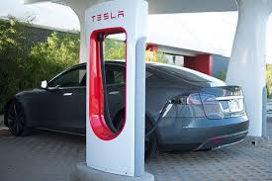
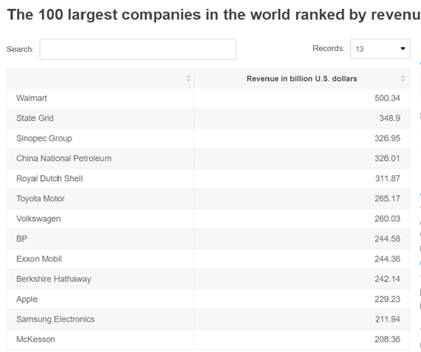
Potential Competitive Moves

Slide 17
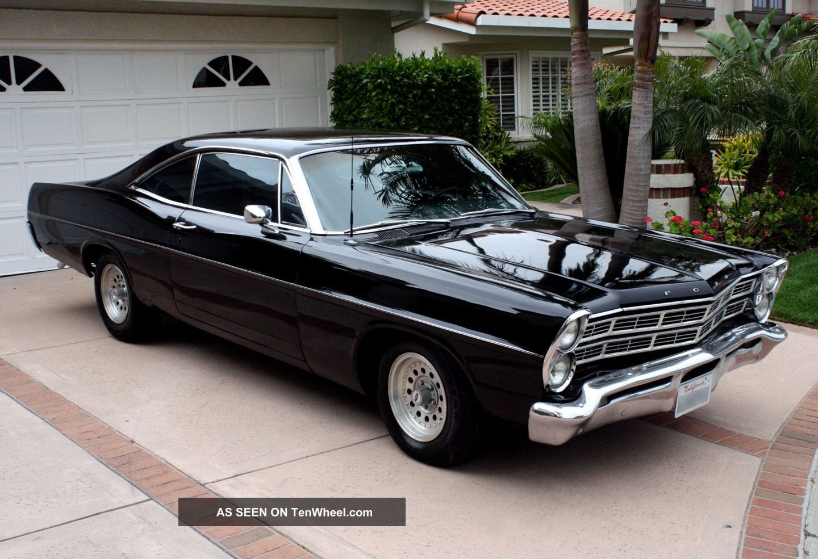
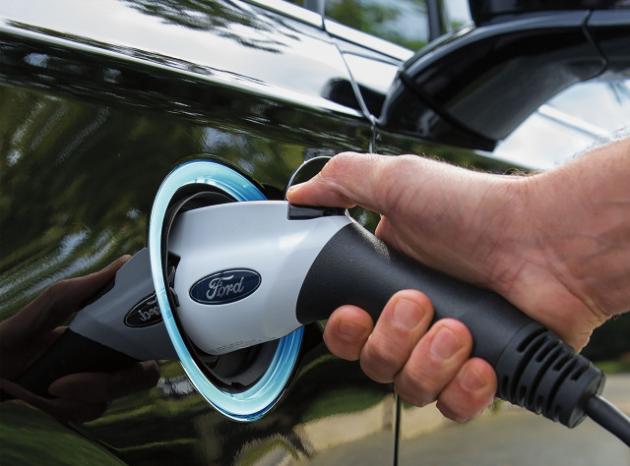
Key Success Factors
Flexibility
Capital Utilization
Brand Recognition
Consumer Loyalty
Innovation

Slide 18
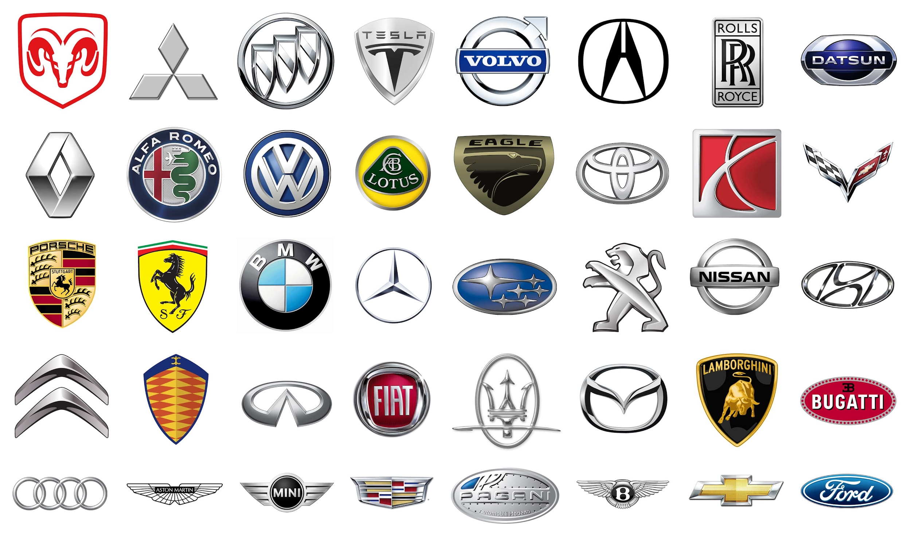
The Automotive Industry
Nearly impossible to enter
Technology revolution
Cost leadership
Innovation
Profitability down

