Slide 1
Foundations of Strategy:
Resources and Capabilities
By Group 4 (11AM): Haylee Berner, Sofia Paredes, Dylan Hawkins, Linna Wu

Slide 2
The Role of Resources and Capabilities in Strategy Formation
There is a strong relationship between strategy and the resources and capabilities of a firm.
Internal Environment: All the factors within an organization that affect its strategic decision making and performance
Switching from external to internal environment:
Internal environment of a firm has become a more stable and secure way to form a strategy
Competitive advantage is now the primary source of superior profitability.

Slide 3
Resource-Based View
COMPETITIVE ADVANTAGE
STRATEGY
INDUSTRY KEY SUCCESS FACTORS
ORGANIZATIONAL CAPABILITIES
RESOURCES
Tangible
Financial (cash, securities, borrowing capacity)
Physical (plant equipment, land, mineral reserves)
Intangible
Technology (patents, copyrights, trade secrets)
Reputation (brands, relationships)
Culture
Human
Skills/know-how
Capacity for communication and collaboration
Motivation
Foundations of Strategy Figure 3.2

Slide 4
Identifying Resources
Tangible Resources:
Easiest to identify and evaluate
Financial resources and physical assets are identified in the firm’s financial statements
Used to understand a firm’s potential to create competitive advantage and additional value
Improving efficiency
Using existing assets more profitably
Intangible Resources:
Brand names and trade mark are a form of reputational assets
Value lies in the confidence it instills in customers
Arguably more valuable than tangible resources

Slide 5
Human Resources
General Motor HR Department:
Changed from a tactical to a strategic role
Accelerate Cultural Change
Increase Engagement
Consolidate Various Programs into one
Providing a consistent recognition experience globally
Kathleen S. Barclay’s 3Ts: Technology, Talent and Transformation
GM is hiring about 200 people a year out of elite schools such as the University of California at Berkeley, Stanford University, and Massachusetts Institute of Technology.
The company also has attracted more women

Slide 6
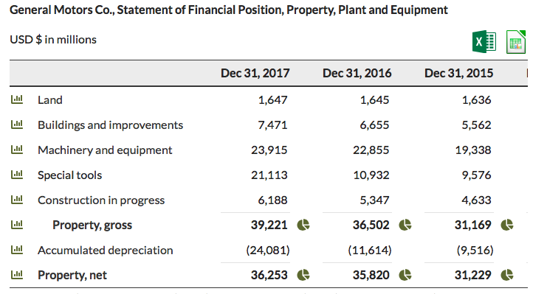
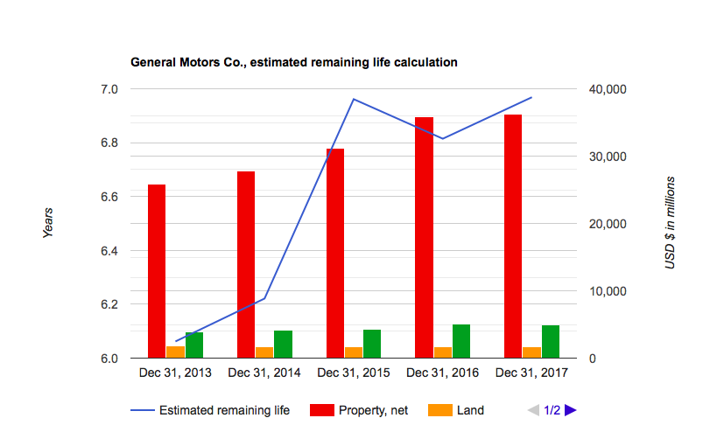
General Motors Company: Tangible Resources
General Motors Co.’s property, gross increased from 2015 to 2016 and from 2016 to 2017.
General Motors Co.’s property, net increased from 2015 to 2016 and from 2016 to 2017.
General Motors Co.’s average age of depreciable property, plant and equipment deteriorated from 2015 to 2016 and from 2016 to 2017.
General Motors Co.’s estimated remaining life of depreciable property, plant and equipment declined from 2015 to 2016 but then increased from 2016 to 2017 exceeding 2015 level.

Slide 7
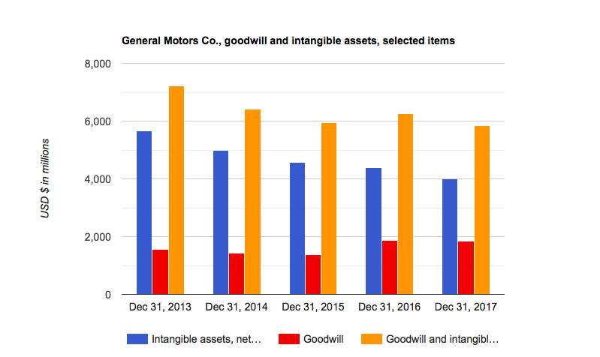
General Motor Company: Intangible Resources
General Motors Co.’s intangible assets, net carrying amount declined from 2015 to 2016 and from 2016 to 2017.
General Motors Co.’s goodwill increased from 2015 to 2016 but then slightly declined from 2016 to 2017.
General Motors Co.’s goodwill and intangible assets, net increased from 2015 to 2016 but then declined significantly from 2016 to 2017.

Slide 8
Identifying Organizational Capabilities
Organizational Capacity: A firm’s capacity to deploy resources for desired end results
Distinctive Competence: those things that an organization does particularly well relative to its competitors.
What a firm does to make them superior relative to competitors
Important success factors a firm competes on
Core Competencies: Those capabilities fundamental to a firm’s strategy and performance.

Slide 9
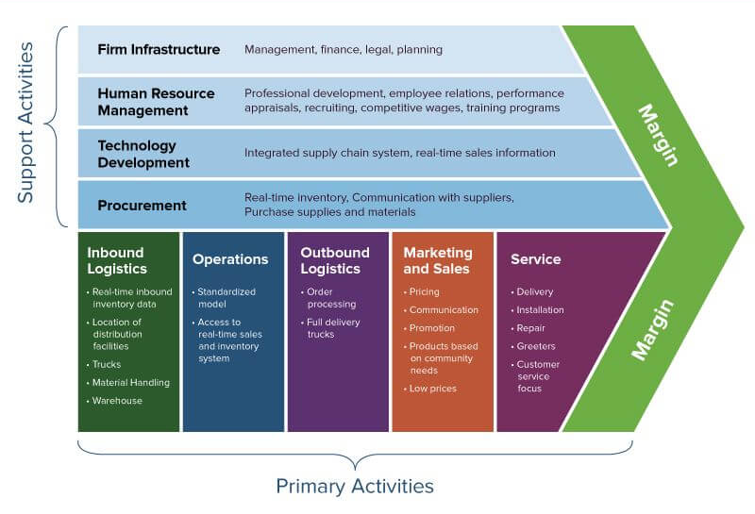
Classifying Capabilities
Functional Analysis: Identifies organizational capabilities in relation to each of the principal functional area of the firm.
Value Chain Analysis: Separates the activities of the firm into a sequential chain and explores the linkage between activities
Gains insight to competitive position
Michael Porter’s Value Chain Analysis

Slide 10
Appraising the strategic importance of resources and capabilities

Slide 11
Appraising Resources and Capabilities
Establishing Competitive Advantages: 2 conditions must be present
Scarcity: if a resource or capability is widely available within the industry, it may be in order to compete but it will not be a sufficient basis for competitive advantage.
Relevance: A resource or capability must be relevant to the Key Success Factors in the market.
Sustaining Competitive Advantage: Once established, competitive advantage tends to diminish over time; 3 characteristics of resources and capabilities determine the sustaining competitive advantage.
Durability: The more durable a resource, the greater its ability to support a competitive advantage over the long term.
Transferability: If resources and capabilities are transferable- they can bought and sold--any competitive advantage that is based upon them will be eroded.
Replicability: if a firm cannot buy a resource or capability, it must build it.

Slide 12
General Motor: Appraising Resources
The company’s tangible resources include the firm’s financial resources as it enjoys a large deposit of capital. The company has a well reporting structure forming good organizational resources. In addition to that, GM has technological resources as has a patent of manufacturing the most environmental friendly vehicles.
Some intangible resources to General Motor include innovation resources as its ability to come up with electric vehicles, reputational resources as it has a good reputation in terms of different vehicle portfolio.
General Motors have a great capabilities has enabled it developed a competitive advantage over others by coming up with different vehicles portfolio which attract a lot of customers in terms of creativity and uniqueness.
This has enabled General Motors to develop its core competence as its planning to be the first automotive company to launch a self-driven vehicle by the year of 2020.

Slide 13
Appropriating the Returns to Competitive Advantage
1.Property Rights
2.Relative Bargaining power
3.Embeddedness
Who gains the returns generated by superior resources and capability? The owner of that resource or capability. The less clear are property rights in resources and capabilities, the greater the importance of relative bargaining power in determining the division of returns between the firms and its members.

Slide 14
Competitive Advantage: General Motors Company
GM is one of the largest vehicle manufacturers and marketers in the world, with operations on six continents.
September 16, 1908 - General Motors Company is founded under William Durant. The new company brings together several car companies, including Buick.
July 10, 2009 - General Motors emerges from bankruptcy after 39 days. Now known as General Motors Company instead of General Motors Corporation.
2014: Cost the company $4.1 billion in repair costs, victim compensation and other expenses.
2015: GM holds around 17-18% of a market that's closing in that 18-million sales pace
April 3, 2018 - GM announces it will no longer report monthly sales, ending a common practice in the auto industry.
GMC has the ability to stay in business even if the market completely craters

Slide 15
Developing Strategy Implications
STEP 1: Identify the key resources and capabilities
Tangible, Intageable, and Human Resources
Corporate, Operations, Product design capabilities etc.
STEP 2: Appraising resources and capabilities
What are our principal resources and capabilities and how do we create value?
Comparing Competitors (strengths/weaknesses)
STEP 3: Develop strategy implications
Exploiting key strengths
Managing key weaknesses
Utilizing inconsequential strengths

Slide 16
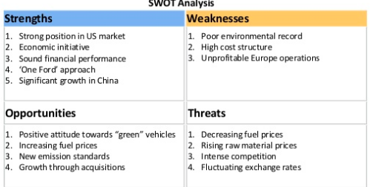
General Motor Company VS. Ford Company
Ford Motor company is a global company with two core businesses: Automotive and Financial services. The automotive business consists of the design, development, manufacturing, sale, and service of cars. Ford has been focusing on cutting costs to increase margins more than its competitors.

Slide 17
Chapter Overview
Resources & Capabilities and Their Role in a Firm’s Strategy
Identifying and Appraising the Resources and Capabilities of the Firm (General Motors Company)
Sustainable Competitive Advantage
Formulating Strategies with the Results of Resource and Capability Analysis

Slide 18
Works Cited
https://www.stock-analysis-on.net/NYSE/Company/General-Motors-Co/Profile
https://www.stock-analysis-on.net/NYSE/Company/General-Motors-Co/Analysis/Property-Plant-and-Equipment
https://www.stock-analysis-on.net/NYSE/Company/General-Motors-Co/Analysis/Goodwill-and-Intangible-Assets
https://www.shrm.org/hr-today/news/hr-magazine/pages/0302leonard.aspx
http://lhra.io/blog/4-strategic-drivers-general-motors-adoption-recognition-technology-case-study/
https://www.cnn.com/2014/04/08/us/general-motors-fast-facts/index.html

