Slide 1
General Motors
Competitive Situation Analysis
Team 4: Sofia Paredes, Haylee Berner, Dylan Hawkins, (Linna)Zihui Wu

Slide 2
Current Performance
General Motors is the world’s largest automobile maker today.
General Motors manufactures and sells four models: Buick, Cadillac, Chevrolet, and GMC
In 2017, GM’s assets and liabilities and equity both equaled $212,482.
In 2018, GM’s assets and liabilities and equity both equaled $227,339.
GM is shutting down 5 facilities and cutting 15% of its staff in the U.S.
GM currently has 11 manufacturing plants in North America.

Slide 3
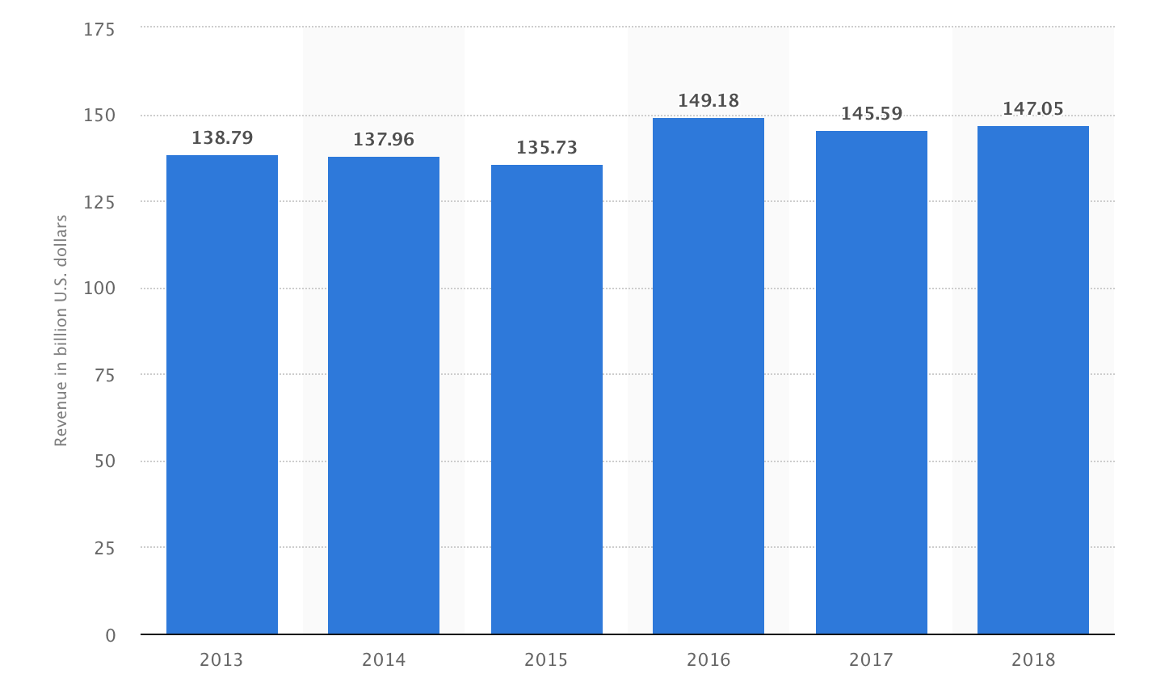
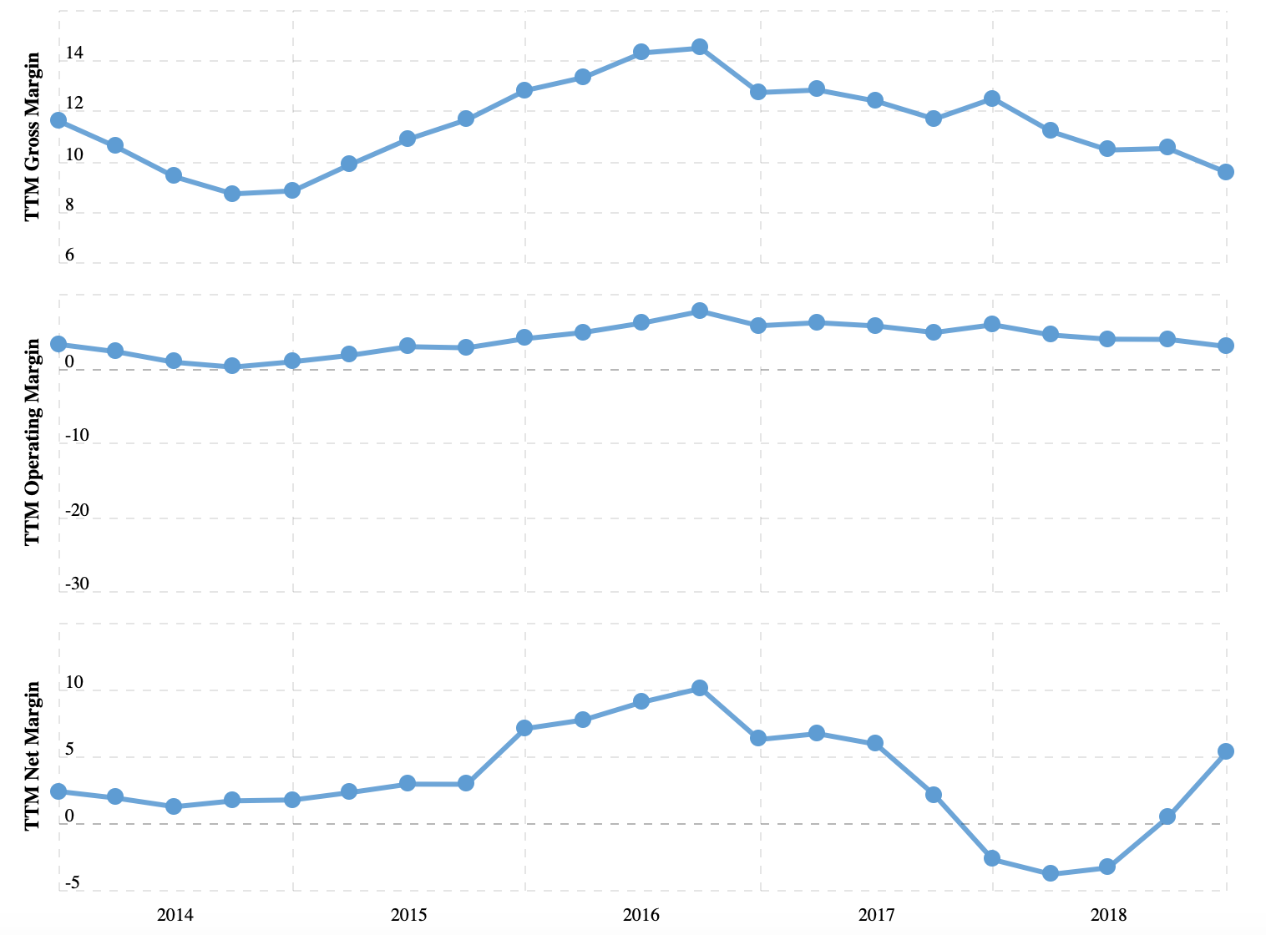
Performance Indicators

Slide 4
SWOT - STRENGTHS
General Motors | Ford | Toyota
Global presence New vision and strategy Strong brand portfolio Strong presence in China Knowledge of home market Well performing brands | Brand image and equity manufacturing capabilities and supply chain Large product portfolio Focus on innovation Position in US and China markets Financial position Marketing capabilities | Research and development (R&D) Brand Value Global supply chain Rapid innovation capabilities

Slide 5
SWOT - WEAKNESSES
General Motors | Ford | Toyota
Brand dilution Bureaucratic culture Car recalls Limited Diversification | Product Fails Emerging Markets Product Recalls Weak Position in Emerging Markets | Recalls and vehicle failures Weak global presence

Slide 6
SWOT - OPPORTUNITIES
General Motors | Ford | Toyota
Positive attitude towards “green” vehicles Increasing fuel prices Changing customer needs Growth through acquisitions Growing global automotive industry | Expansion Hybrid, electric and fuel cell AI and autonomous driving Digital marketing opportunities Supply chain digitization Electrical vehicles | Growing Global Automotive Industry Green Vehicle Technology

Slide 7
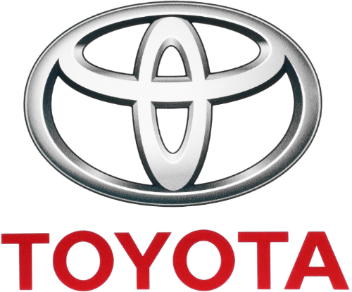
SWOT - THREATS
General Motors | Ford | Toyota
Increased competition The rising U.S. dollar exchange rate Increasing government regulations may raise the costs U.S. automotive market is poised to slow down or even decline | Environmental Regulations Global Economy Intense competition Regulatory threats Rising costs of raw materials and labor | New Emissions Standards Rise in Material Costs Increasing Intense Competition Natural Disasters

Slide 8
Resources & Capabilities
Resources and capabilities are the principal basis of strategy.
Tangible Resources
Intangible Resources
General Motor Human Resource Department:
Changed from a tactical to a strategic role
Accelerate Cultural Change
Increase Engagement
Consolidate Various Programs into one
Providing a consistent recognition experience globally
Kathleen S. Barclay’s 3Ts: Technology, Talent and Transformation
GM is hiring about 200 people a year out of elite schools such as the University of California at Berkeley, Stanford University, and Massachusetts Institute of Technology.
The company also has attracted more women

Slide 9
Company Capability Profile:
An organizational capability profile describes the skills, knowledge and resources that enable your company to provide quality products or services to customers.
Managerial Factors
Competitive Factors
Financial Factors
Technological Factors

Slide 10
Competitive Strength Assessment
Quality/Product Performance
JD Power Awards - Quality
Ford - 5 awards
GM - 1 award
Toyota - did not make top 20
JD Power Awards - Performance
GM - Chevy Traverse & Chevy Equinox in top 10
Ford - F - 150 in top ten behind GM
Toyota - did not make top 10

Slide 11
Competitive Strength Assessment
Reputation/Image
1980 - 46% of the Market Share
2018 - 17.02% of the Market Share
Different brands create different images
GM - keeps their brands in a row
Toyota - Lexus in wealthier areas, Toyota in lower to middle class areas
Raw Materials
Steel, aluminum, resins, copper, lead, & platinum metals
Non-substitutable

Slide 12
Competitive Strength Assessment
Technological Skills
Hybrid / e-vehicles
Car/Ride sharing
Autonomous Vehicles
Alternative Fuels
Hydrogen Fuel Cell Technology
Connectivity
OnStar
Intellectual Property
Patents, Trademarks, Servicemarks

Slide 13
Competitive Strength Assessment
Manufacturing Capabilities
GM
Over 100 locations
33 countries
GM Financial 26/39 in US
Ford
More than 65 countries
Only 76 plants
Toyota
170 countries

Slide 14
Competitive Strength Assessment
Marketing/Distribution
GM
Reach as many people as possible
Zero emission, zero crashes, zero congestion
Simple, in and out
Different vehicles for different regions
Toyota
Markets Lexus to higher class buyers
Keeps distribution simple and fast

Slide 15
Competitive Strength Assessment
Financial Strength
GM
2017-2018 - Debt increased from 75.12B to 94.22B
Debt ratio EY 2018 18.39%
Ford
2017-2018 - Debt increased from 132,854M to 142,790M
Debt ratio EY 2018 13.84%
Toyota
Debt to revenue ratio 2.59%

Slide 16
Cost Position
Switching from passenger cars to crossovers and trucks.
Shut down three plants and two powertrain plants only producing passenger cars.
GM wants to shorten the gap between capacity and demand of vehicles.
Four plants across the U.S. are only working at an average of 50% capacity.
Lansing, Michigan plant producing at 33% capacity
Bowling Green, Kentucky plant producing at 27% capacity
Ford and Fiat Chrysler only producing smaller cars at one location each and at a smaller capacity
Toyota Corolla only being assembled at a plant in Alabama.

Slide 17
Organizational Life Cycle
Overseas operations began in the early 1920’s and 30’s.
By 1941, GM produced 44% of the vehicles in the U.S.
GM modernized in the late 70’s and early 80’s due to Japanese automobiles.
In the early 90’, GM shut down plants and fire tens of thousands employees.
GM sold its other business ventures to focus just on automobiles.
In June of 2009, GM filed for Chapter 11 bankruptcy.
In 2014, GM ignition switches caused around 120 deaths.
In 2015-2016, GM had record sale numbers.

Slide 18
Strategic Issues & Problems
Challenges GM is facing: -
Car sales in the U.S. had a boom thanks to all individuals and businesses who deferred buying new vehicles during the Great Recession.
Another problem is demand for small and mid-size cars in the U.S. has plunged, and consumers haven’t been flocking to buy GM’s hybrid Chevy Volt.
Re-allocating resources in the face of fundamental market shifts. When and how are the best ways to do it?

Slide 19
Toyota, a Japanese car company is concerned about the environment and backed hybrid development. Public opinion suggests that Toyota is a green company. Neither GM nor any of its brands are taken as proving green alternatives like fuel economy, safety or environmentalism.
Toyota, Honda, Nissan, BMW, Mazda, Porsche have a distinctive brand image. The problem for GM is not having a distinctive brand image (brand identity).
Toyota(green and quality), Honda(green, quality,and great engines), Nissan(design), BMW(performance), Porsche(iconic sports cars)

Slide 20
Why people are not buying GMs
Too expensive for repairing the engine and have transmission problems.
I have personally owned three GM vehicles, and every single one has run into a very expensive engine and transmission problems. My two Chevrolet minivans had intake manifold problems. Then, one of the minivans had engine gasket failure ($2,900 repair). Latest in the saga is that my 8-year old Saturn Aura had transmission failure due to failed wave plate ($3,700 repair). There is a technical service bulletin (TSB 14404) out there for this well known manufacturing defect. But GM gave a runaround, did not fix it, and did not want to reimburse for repairs.
Ignition switch fiasco from 2014 threatens the brand images that GM cars have potential safety problems.
Most people are preferring the fuel efficient and small/medium sizes car. They would like to buy the car that more environmental friendliness. Customers have some many options for substitution (Toyota is more fuel efficient and high quality ). GM vehicles have a great market share in Asian countries, people are likely to buy more small size and high performance vehicles.

Slide 21
Recommendations
Conduct interviews
People who own
People who have previously owned
People who have never owed
Figure out what needs to be changed
Will be different for every region

Slide 22
Conclusion
Competitive analysis helps organizations integrate factors of industry analysis.
General Motors’ executives have answered important questions related to manufacturing, warranties, inventory optimization, customer intelligence, labor efficiency, supply chain logistics, competitive environment, and many more areas.
They can now respond to changing economic conditions immediately, make decisions based on real-time data inflow, and utilize predictive analytics to make calculated decisions about the future of the organization.
All this ultimately contributes towards decreasing risk and increasing profitability.
GM has been empowered to maximize their efficiency and make data-driven decisions related to production, demand, supply, labor, and more with confidence to ultimately lead them towards a more blue ocean strategy.

