Slide 1
Amazon Company Analysis
By: Patricia Martinez, Bryan Arias, and Shavena Smith

Slide 2
Introduction
Amazon having been established in 1994 as a bookstore, gradually has risen to the top ranks as the most used online e-commerce business in the U.S.
By providing products and services at ease, Amazon sustains a competitive advantage and superiority among its major competitors by specializing in providing what other companies cannot
Mission Statement: “We strive to offer our customers the lowest possible prices, the best available selection, and the utmost convenience”

Slide 3
Financial Strength
Customer Obsession
Amazon works from the perspective of the customer to come up with ideas that will legitimately generate value
Ex: Prime
5 major industries: retail, logistics, consumer technology, cloud computing, and most recently, media & entertainment
Last year, invested $13.7B in Whole Foods- pushing into brick-and-mortar retail

Slide 4
As the United States’ biggest online retailer, the company accounts for about 4% of all retail and about 44% of all e-commerce spending in the US.
Wall Street banks like Morgan Stanley expect Amazon to continue growing at a rate that no company its size has ever done before, estimating 16% average compound growth in sales through 2025
market capitalization exceeding $1T

Slide 5
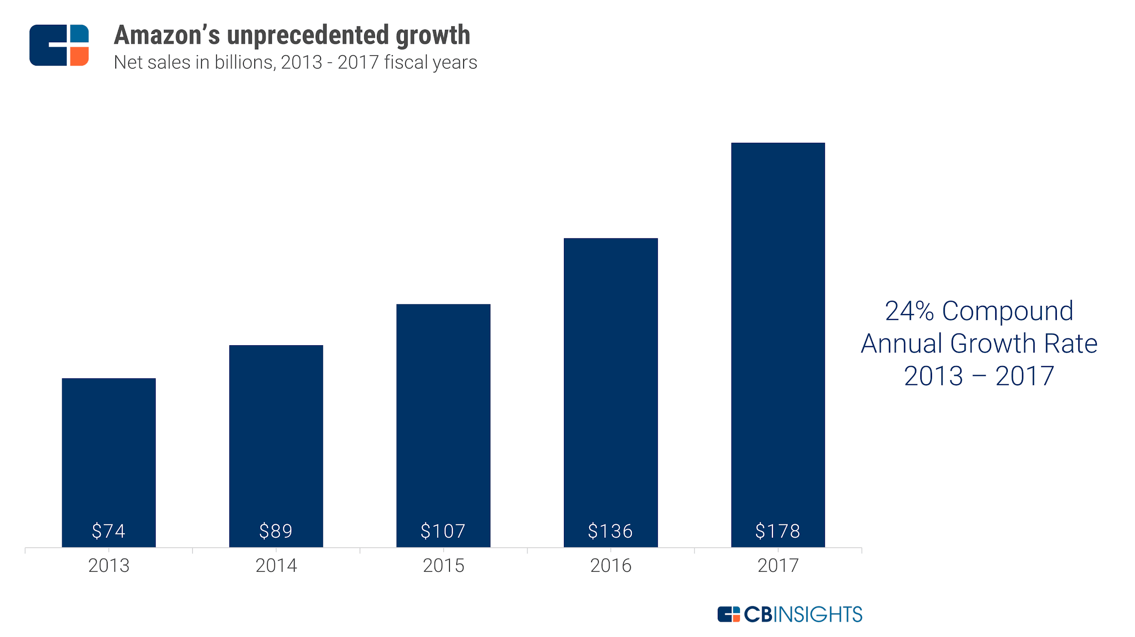

Slide 6
Liquidity Ratios
 |  | Dec 31, 2018 | Dec 31, 2017 | Dec 31, 2016 | Dec 31, 2015 | Dec 31, 2014
 | Current ratio | 1.10 | 1.04 | 1.04 | 1.08 | 1.12
 | Quick ratio | 0.80 | 0.70 | 0.74 | 0.71 | 0.74
 | Cash ratio | 0.60 | 0.54 | 0.59 | 0.58 | 0.62
Ratio | AMAZON
Current ratio | Amazon.com Inc.’s current ratio deteriorated from 2016 to 2017 but then improved from 2017 to 2018 exceeding 2016 level.
Quick ratio | Amazon.com Inc.’s quick ratio deteriorated from 2016 to 2017 but then improved from 2017 to 2018 exceeding 2016 level.
Cash ratio | Amazon.com Inc.’s cash ratio deteriorated from 2016 to 2017 but then improved from 2017 to 2018 exceeding 2016 level.

Slide 7
Competitive Growth
Comparing Amazon’s (AMZN) stock with Walmart’s (WMT) and Alibaba’s (BABA) stock growth over a 5-year period (April 16, 2014 to April 16, 2019) it is interpretable that Amazon’s stock price has grown from $303.83 U.S. dollars to a whopping $1,863.04 (with respect to change)
610% growth in value over a 60-month time span.

Slide 8
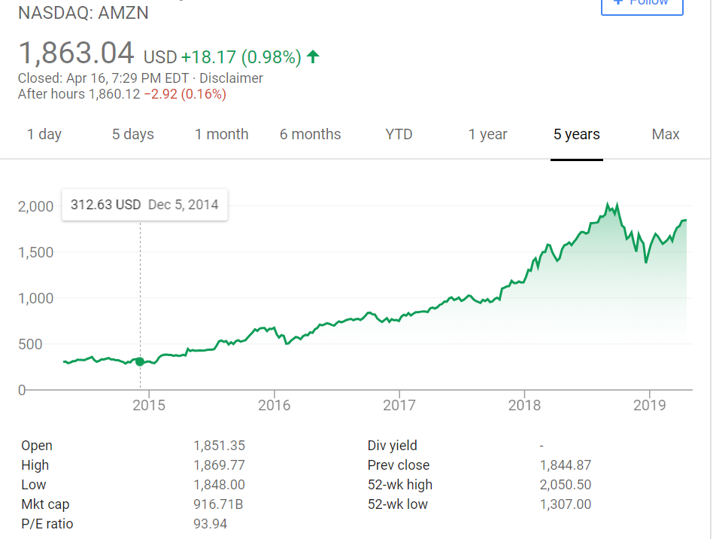
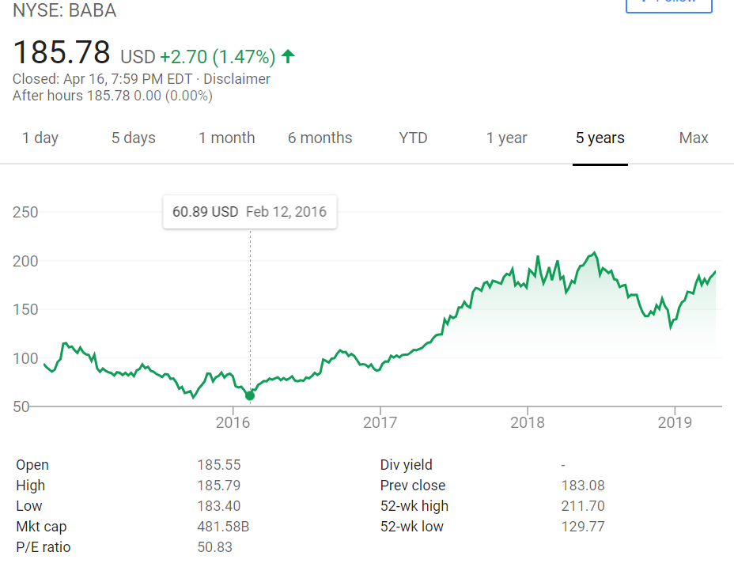

Slide 9
Customer Loyalty
Amazon, being customer centric, makes sure to keep their customers in mind with every decision that they make
Looking into Amazon’s Customer Loyalty, the company does an outstanding job in retaining Amazon Prime subscriptions, Audible subscriptions (parent company), and keeping their customers content.

Slide 10
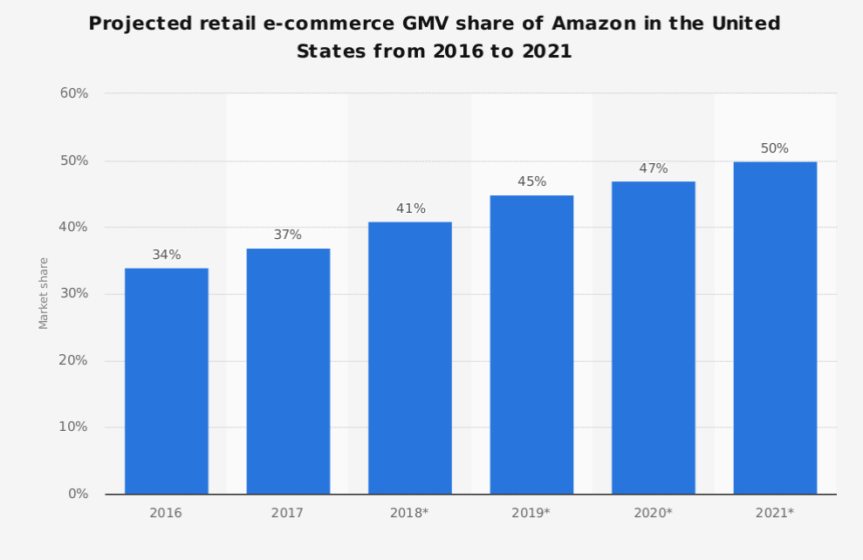
Estimated Market Share Analysis from Statista
In a recent forecast analysis from “Statista” it portrays that Amazon by the year 2021 will have a 50% market share of all e-commerce sales in the United States

Slide 11
Presumed Risks
Amazon’s biggest possible downfall, even in their prime, are their competitors
Walmart has expanded their online store to compete
Walmart’s focus on low prices and an ever-expanding assortment of convenient online initiatives drove customers to its stores and to its websites

Slide 12
Strategic Moves
Amazon must implement new business ideas to stay at the top
1. Purchasing a delivery service
2. Enter the fitness industry
3. Acquire a dollar general
4. Offer rental services
5. Partnering with a furniture store

Slide 13
SWOT Analysis
Strengths: its strong brand, extensive product mix, and its highest revenues in the industry.
Weaknesses: the limited penetration in developing markets, easily imitable business model and limited brick-and-mortar presence
Opportunities: penetrating developed markets, expand their brick-and-mortar business, and boost measures to reduce counterfeit sales
Threats: cybercrime, imitation, and aggressive competition with large retail firms

Slide 14
Competitive Strengths
Looking into Amazon’s competitive strengths, some of the things that make the company such a powerhouse is its adaptability to get into niche markets, their selling of broad range items, and the easability of shopping for the modern shopper,
Sets themselves apart from competitors with the creation and development of new Blue Ocean Strategies
Amazon has recently implemented a proposal for business owners to sell their products on Amazon’s website for a small fixed monthly fee

Slide 15
Current Overlap
Amazon is known to pursue the “small business approach” even though they are a fortune 500 company
Amazon has been known to push out “mom-and-pop” stores because they can give what others small businesses cannot plus more
Amazon has the evident advantage of being an e-commerce store because people do not need to leave their homes to get what they need

Slide 16
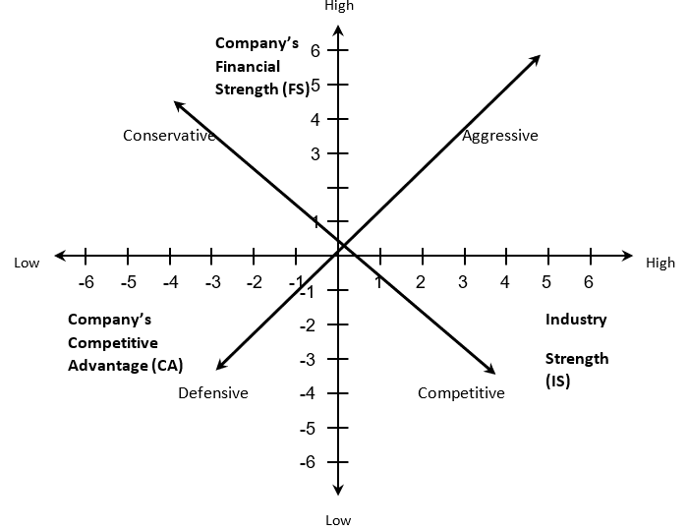
Amazon Space Chart
shows two of Amazon’s most noticeable features, its aggressiveness and its competitiveness

Slide 17
Conclusion
Amazon is a leader in many areas and aspects. With the way online shopping is growing, Amazon is expected to grow in its market share only more, while other large retailers are doing their best not to go bankrupt like Sears, Toys R Us, and more. Being an era of internet, it is essential to keep up with the change in today’s world, because if not constantly changing one can suffer losses or worse get bankrupt and have to foresee liquidation. Amazon sustains a competitive advantage and superiority among its major competitors by specializing in providing what other companies cannot.

